Slide 1
Knowing Just Enough to be Dangerous!

Slide 2
Two exemplars
Intelligent Design
Climate Denial

Slide 3
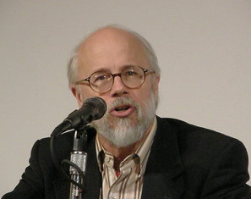
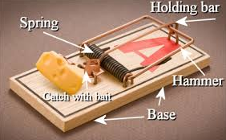
“ID”

Slide 4
Sunspots and Climate Denial

Slide 5
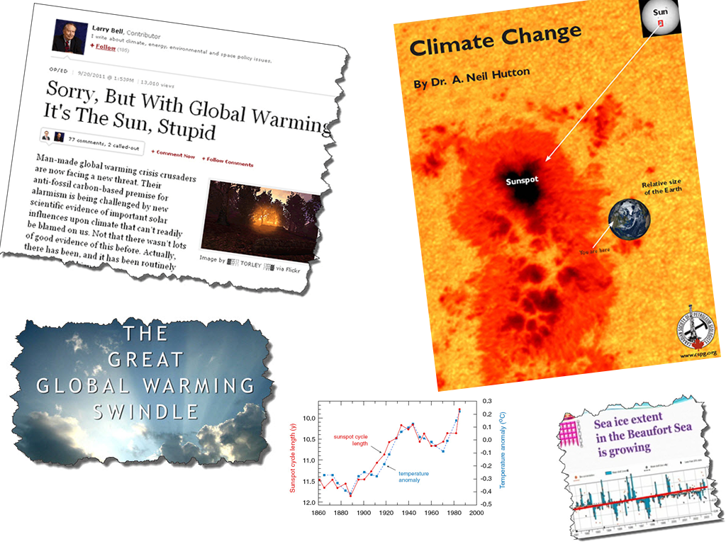

Slide 6
Sunspots,
Solar Cycles and
Climate Confusion!

Slide 7
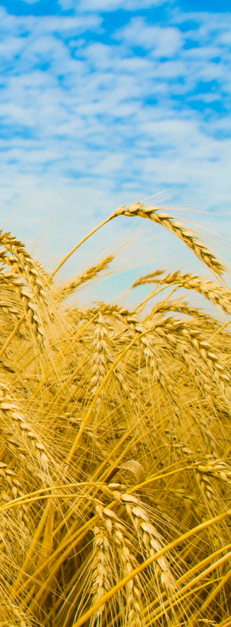
Sunspots and the Price of Grain in England
1801 Sir William Herschel notes an apparent link between past grain prices and sunspot numbers
First suggestion that sunspots (solar activity) maybe be a proxy for climate change

Slide 8
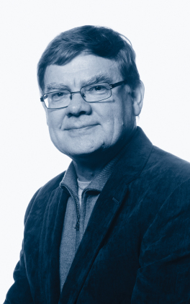
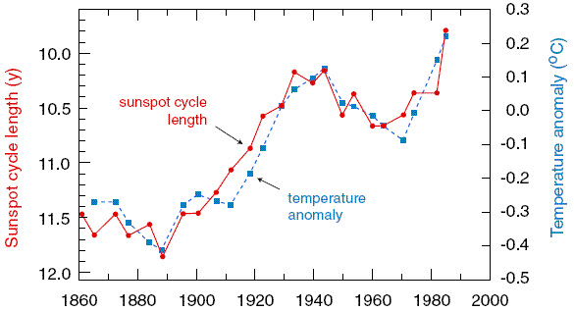
Lassen – Friis-Christensen Science, 254, 698-700, 1991

Slide 9
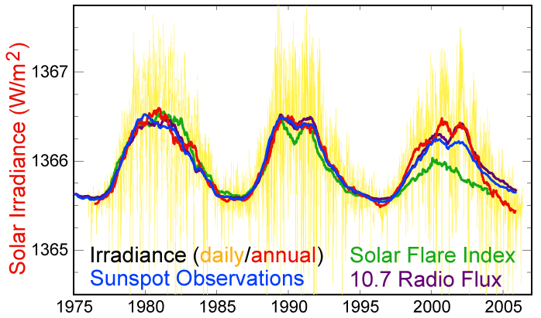
A Quick Calculation…
Temperature change ΔT over past century is 0.8 C
Total Solar Irradiance (TSI) has varied by no more than 0.1% over the past 50 years (at least)

Slide 10
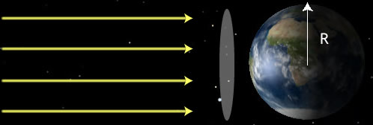
A Quick Calculation…
TSI = 1366 Wm⁻² = Flux (F)
Earth albedo “a” = 0.30
TSI → solar irradiance via:

Slide 11
A Quick Calculation…
Forcing due to CO₂ is on the order of 1.68 Wm⁻² or more than 7 times as significant as variation in TSI
All anthropogenic forcings are on the order of 2.29 Wm⁻² or about 10 times as much as variation in TSI

Slide 12
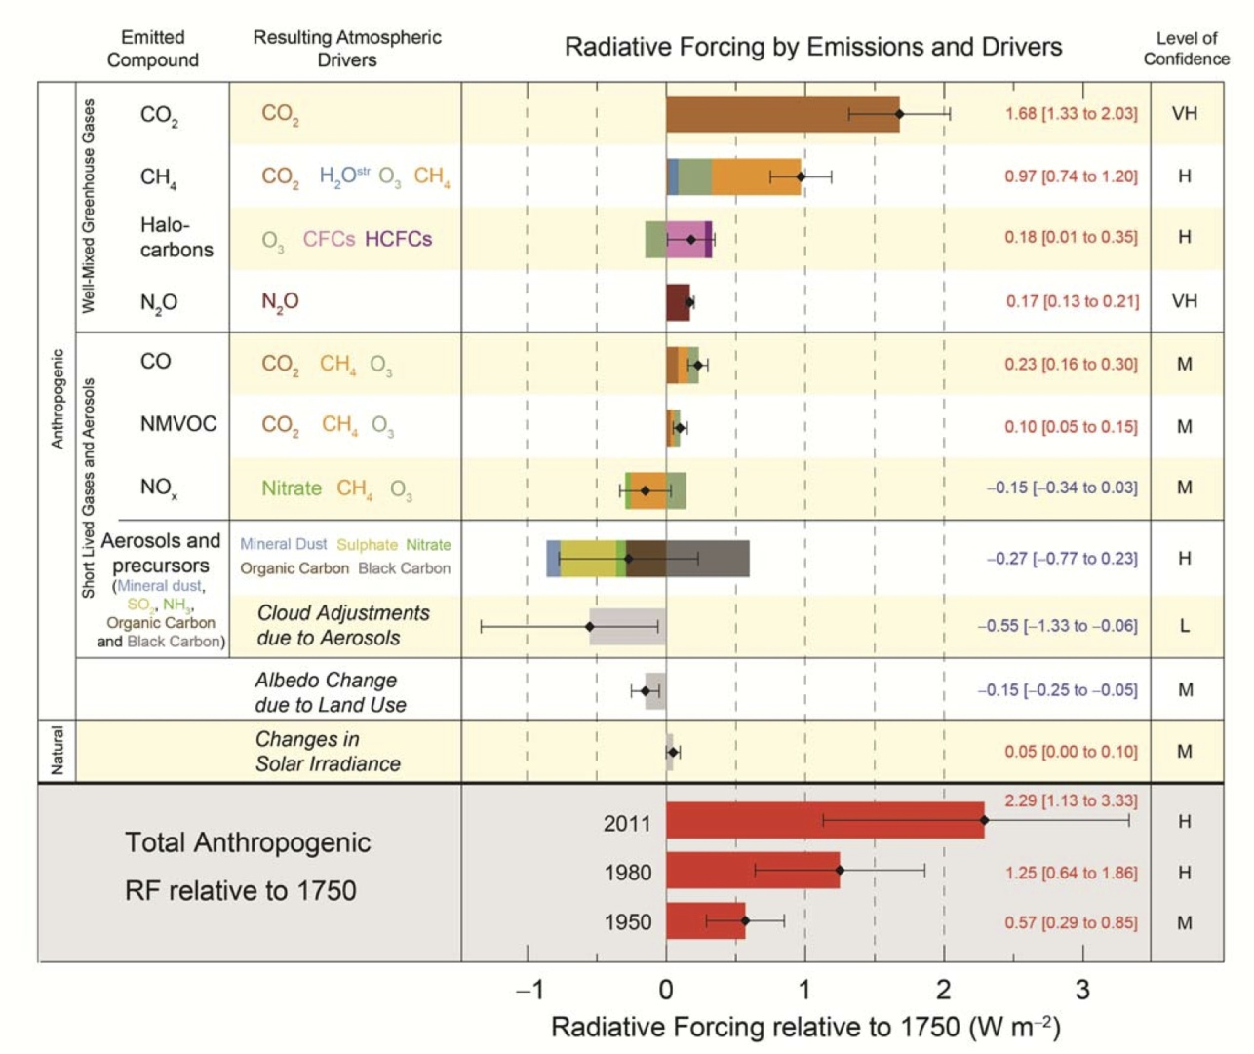
A Quick Calculation…
Latest IPCC report AR5 concludes solar effects have been minimal over the past 50 years

Slide 13
Maybe it’s Cosmic Rays…
Solar activity affects the interplanetary magnetic field and solar wind – this has an influence on cosmic ray flux entering the atmosphere
Ionization from cosmic rays is minimum when solar activity (sunspots etc) is at a maximum
Cloud formation may be suppressed during times of increased solar activity
Svensmark and Friis-Christensen publish this hypothesis in 1997 (‘Variation of Cosmic Ray Flux and Global Cloud Coverage – a Missing Link in Solar–Climate Relationships’, Journal of Atmospheric and Solar-Terrestrial Physics, Vol. 59, pp. 1225–32,1997)
This idea does not survive careful scrutiny!
http://www.thecloudmystery.com/The_Cloud_Mystery/The_Science.html

Slide 14
What do Models tell us?
There are many readily available tools that the public (including teachers and students) can use to test ideas for themselves:
MODTRAN
EdGCM

Slide 15
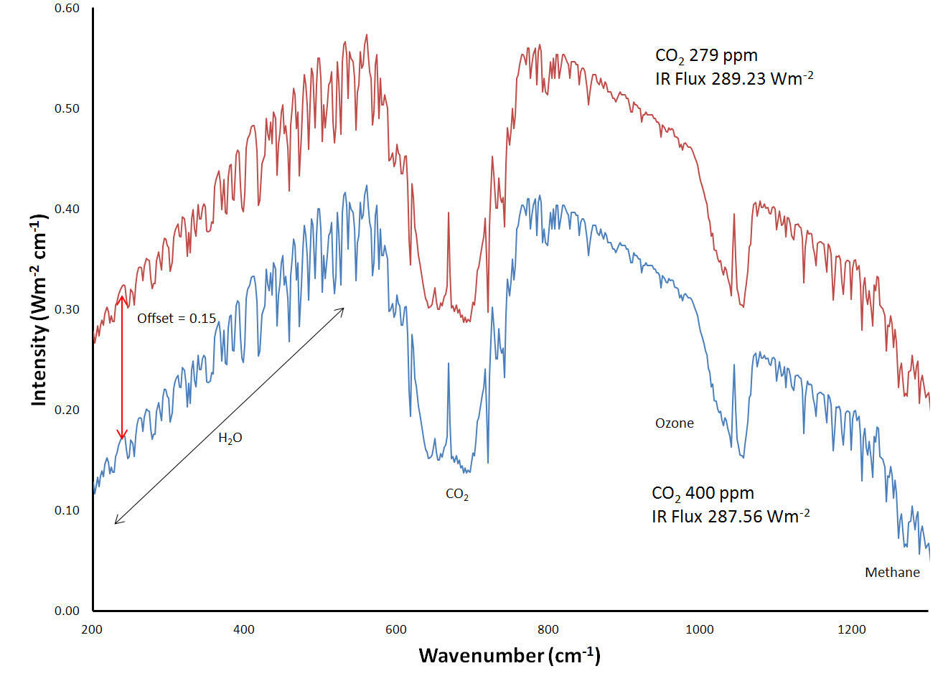
What do Models tell us?
MODTRAN
1.67 Wm⁻²

Slide 16
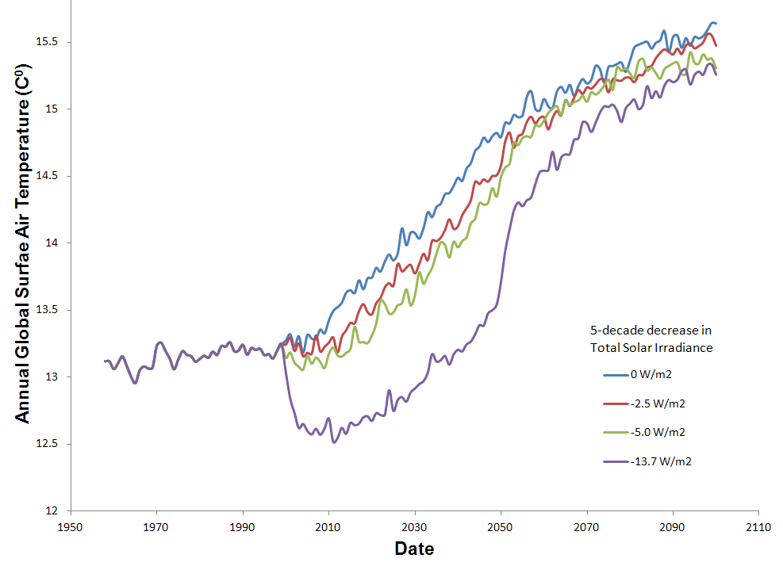
What do Models tell us?
EdGCM

Slide 17
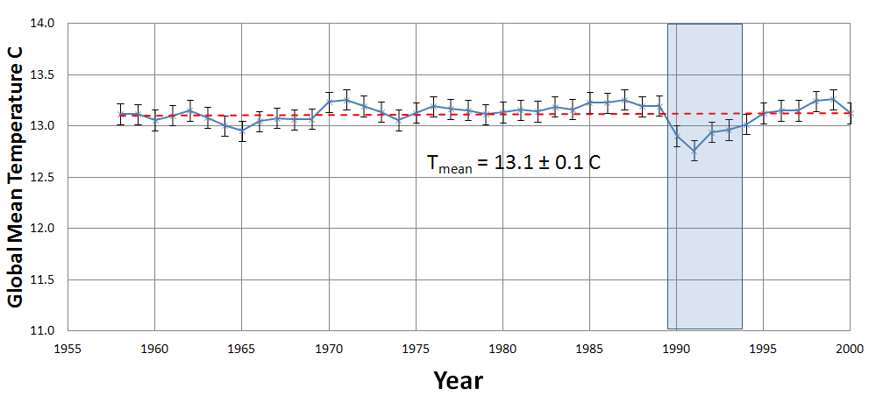
What do Models tell us?
EdGCM – “Pinatubo-like” Event

Slide 18
What about Lassen – Friis-Christensen?

Slide 19
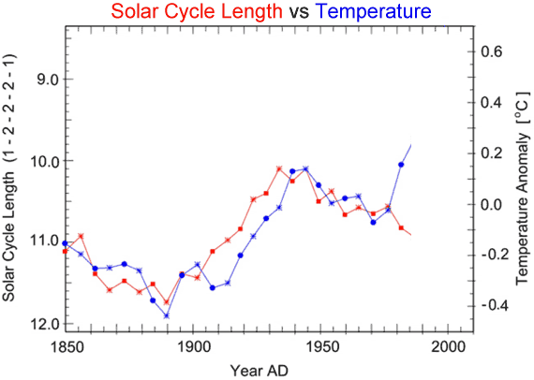
What about Lassen – Friis-Christensen?

Slide 20
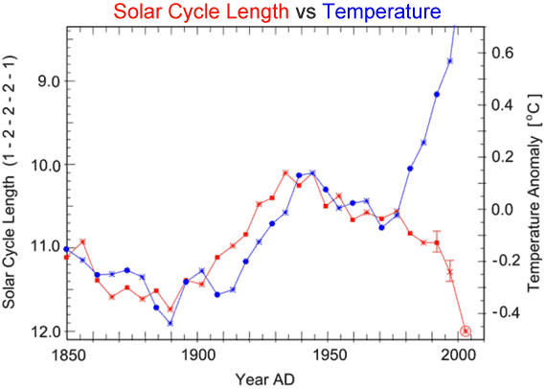
What about Lassen – Friis-Christensen?

Slide 21
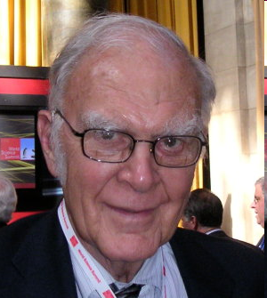
F. Sherwood Roland Nobel Laureate Chemistry Ozone Depletion
“What’s the use of having developed a science well enough to make predictions if, in the end, all we’re willing to do is stand around and wait for them to come true?”

Slide 22
Thank You!

