Slide 1
Myths, Metaphors and the Shaping of Science
Where our notions of science (and how it relates to religion) have come from

Slide 2
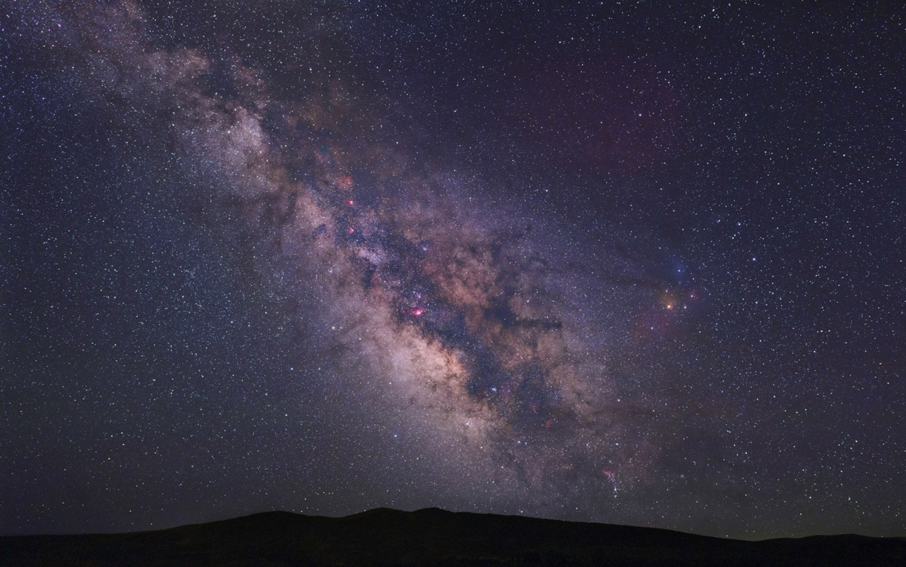
Some thoughts...
Look at the night sky after class and ponder – these are the same stars that your great grandmother may have seen as a young girl – BUT – are you seeing the same “thing”?

Slide 3
Some thoughts...
Has Science transformed the way in which we “see”
creation?
each other?
God?

Slide 4
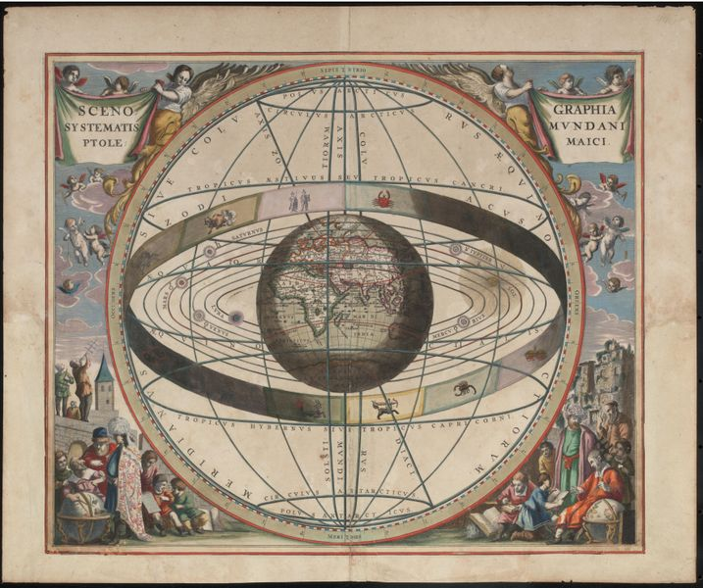
Emerging from the Medieval World

Slide 5
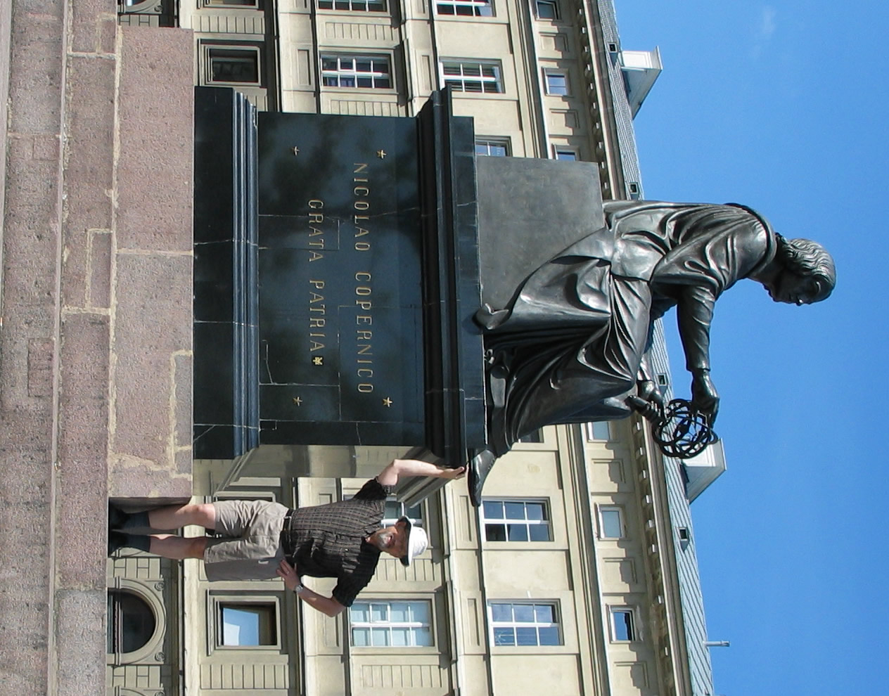

Slide 6
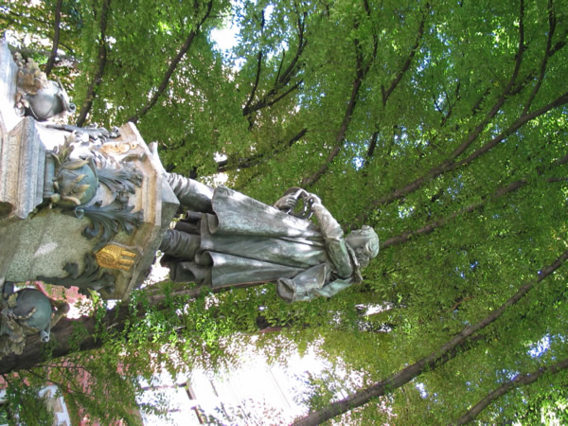
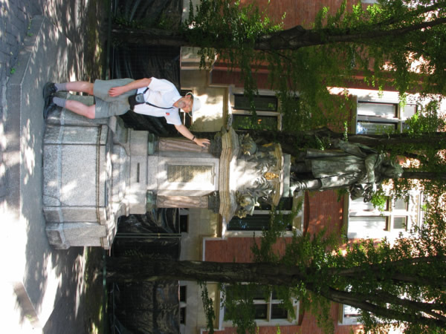

Slide 7
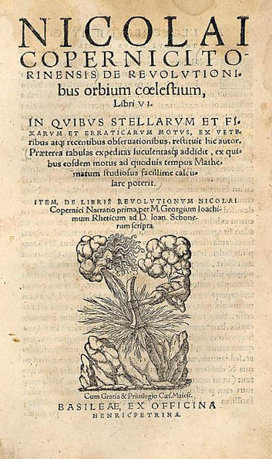
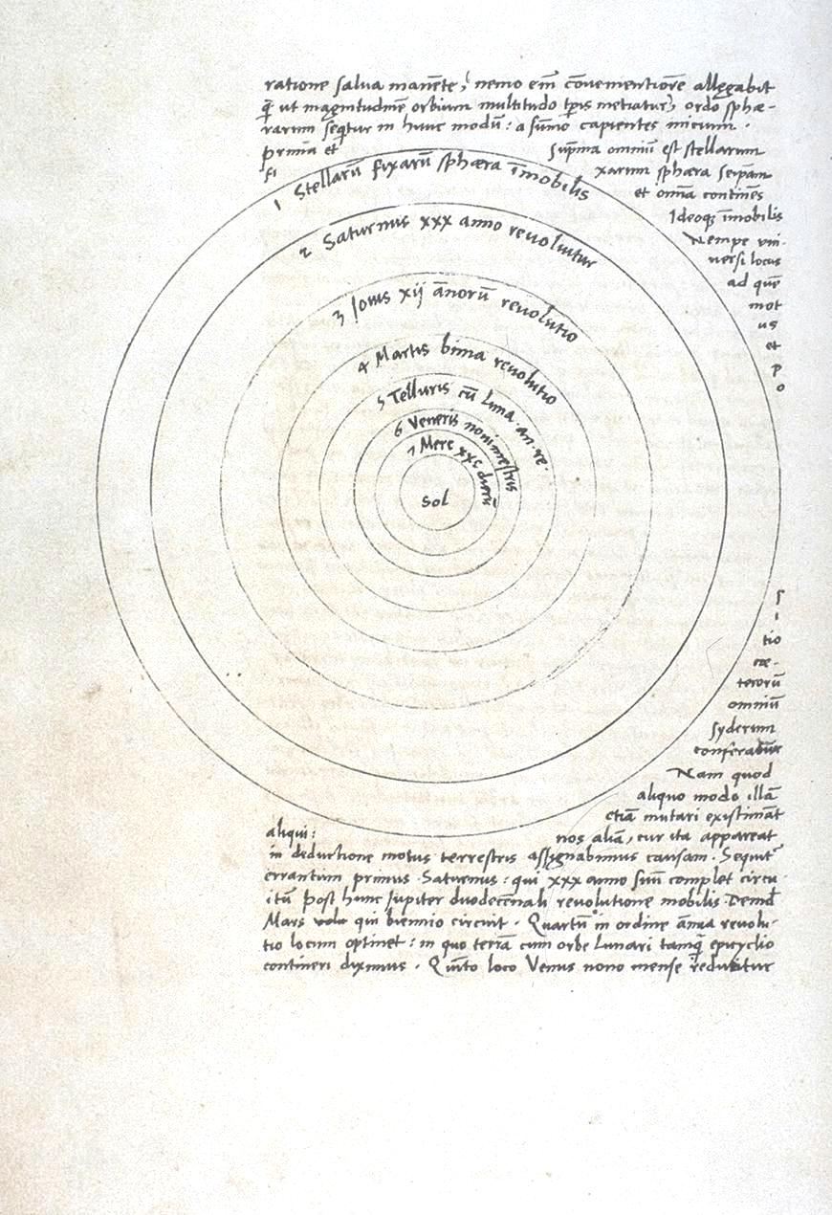
De revolutionibus orbium coelestium (1543)
(The Revolution of the Heavenly Spheres)
Copernicus
What did the Ptolemaic cosmology look like?

Slide 8
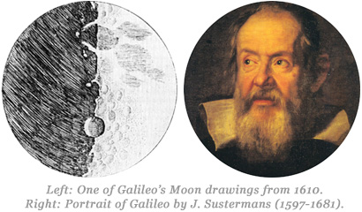
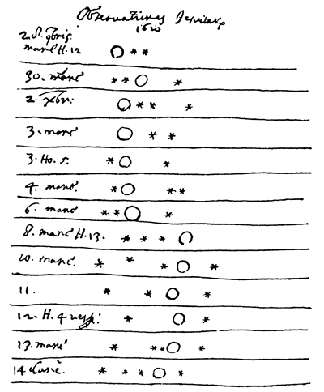
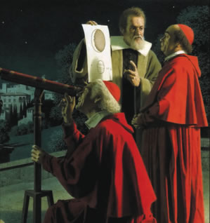
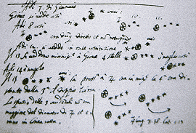
De revolutionibus orbium coelestium (1543)
(The Revolution of the Heavenly Spheres)
Copernicus
Councils of Trent
1545 - 1563
Galileo
Sidereus Nuncius (1610)
(The Starry Messenger)

Slide 9
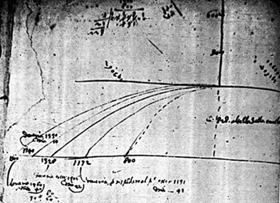
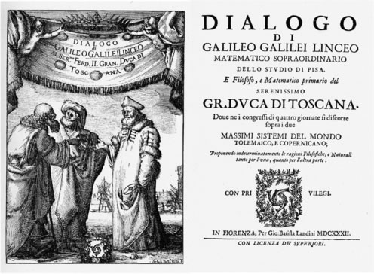
Copernicus
1543
Councils of Trent
1545 - 1563
Galileo
Sidereus Nuncius (1610)
(The Starry Messenger)
Galileo
Dialogo sopra i due massimi sistemi del mondo (1632)
(Dialogue Concerning the Two Chief World Systems)
Newton
b 1643

Slide 10
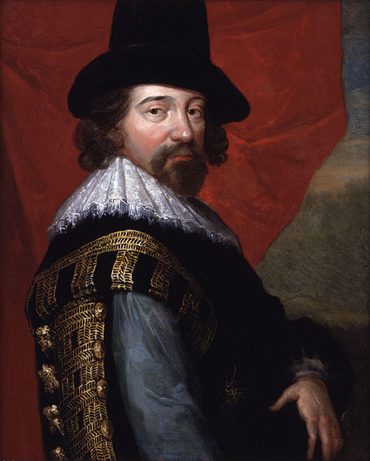
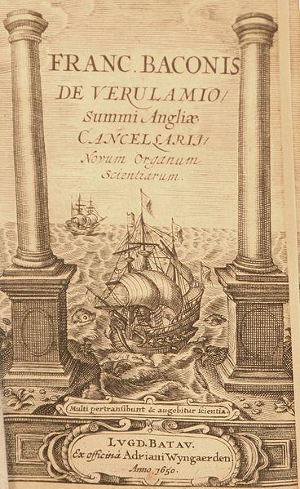
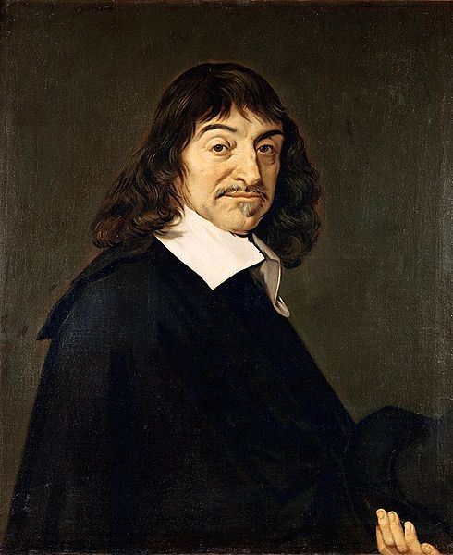
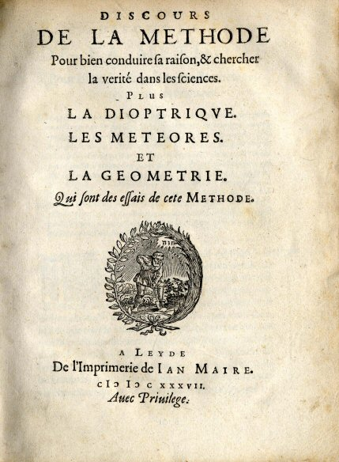
Copernicus
1543d
Councils of Trent
1545 - 1563
Galileo
Sidereus Nuncius (1579-1643)
Bacon
b 1620
Descartes
b 1637
Newton
b 1643
The Royal Society
1660
Académie des sciences
1666

Slide 11
THE NEW ORGANON OR TRUE DIRECTIONS CONCERNING THE INTERPRETATION OF NATURE Francis Bacon
Those who have taken upon them to lay down the law of nature as a thing already searched out and understood, whether they have spoken in simple assurance or professional affectation, have therein done philosophy and the sciences great injury. For as they have been successful in inducing belief, so they have been effective in quenching and stopping inquiry; and have done more harm by spoiling and putting an end to other men's efforts than good by their own. Those on the other hand who have taken a contrary course, and asserted that absolutely nothing can be known — whether it were from hatred of the ancient sophists, or from uncertainty and fluctuation of mind, or even from a kind of fullness of learning, that they fell upon this opinion — have certainly advanced reasons for it that are not to be despised; but yet they have neither started from true principles nor rested in the just conclusion, zeal and affectation having carried them much too far. The more ancient of the Greeks (whose writings are lost) took up with better judgment a position between these two extremes — between the presumption of pronouncing on everything, and the despair of comprehending anything; and though frequently and bitterly complaining of the difficulty of inquiry and the obscurity of things, and like impatient horses champing at the bit, they did not the less follow up their object and engage with nature, thinking (it seems) that this very question — viz., whether or not anything can be known — was to be settled not by arguing, but by trying. And yet they too, trusting entirely to the force of their understanding, applied no rule, but made everything turn upon hard thinking and perpetual working and exercise of the mind.

Slide 12
Now my method, though hard to practice, is easy to explain; and it is this. I propose to establish progressive stages of certainty. The evidence of the sense, helped and guarded by a certain process of correction, I retain. But the mental operation which follows the act of sense I for the most part reject; and instead of it I open and lay out a new and certain path for the mind to proceed in, starting directly from the simple sensuous perception. The necessity of this was felt, no doubt, by those who attributed so much importance to logic, showing thereby that they were in search of helps for the understanding, and had no confidence in the native and spontaneous process of the mind. But this remedy comes too late to do any good, when the mind is already, through the daily intercourse and conversation of life, occupied with unsound doctrines and beset on all sides by vain imaginations. And therefore that art of logic, coming (as I said) too late to the rescue, and no way able to set matters right again, has had the effect of fixing errors rather than disclosing truth. There remains but one course for the recovery of a sound and healthy condition — namely, that the entire work of the understanding be commenced afresh, and the mind itself be from the very outset not left to take its own course, but guided at every step; and the business be done as if by machinery.

Slide 13
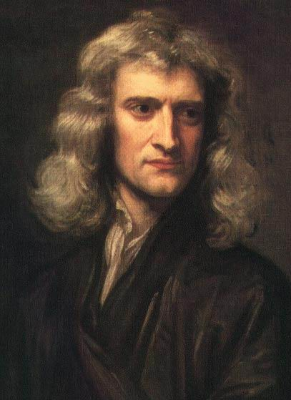
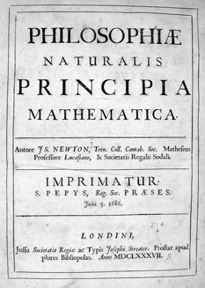
The Royal Society
1660
Académie des sciences
1666
Newton
Philosophiæ Naturalis Principia Mathematica, (1687)
(Mathematical Principles of Natural Philosophy)
Calculus
Law of Universal Gravitation
3 laws of motion
Optics
Forces and interactions

Slide 14
Rules of Reasoning in Philosophy
Rule 1: We are to admit no more causes of natural things than such as are both true and sufficient to explain their appearances.
Rule 2: Therefore to the same natural effects we must, as far as possible, assign the same causes.
Rule 3: The qualities of bodies, which admit neither intensification nor remission of degrees, and which are found to belong to all bodies within the reach of our experiments, are to be esteemed the universal qualities of all bodies whatsoever.
Rule 4: In experimental philosophy we are to look upon propositions inferred by general induction from phenomena as accurately or very nearly true, not withstanding any contrary hypothesis that may be imagined, till such time as other phenomena occur, by which they may either be made more accurate, or liable to exceptions.

Slide 15
Four precepts from the Method…
"The first was never to accept anything for true which I did not clearly know to be such; that is to say, carefully to avoid precipitancy and prejudice, and to comprise nothing more in my judgment than what was presented to my mind so clearly and distinctly as to exclude all ground of doubt.
The second, to divide each of the difficulties under examination into as many parts as possible, and as might be necessary for its adequate solution.
The third, to conduct my thoughts in such order that, by commencing with objects the simplest and easiest to know, I might ascend by little and little, and, as it were, step by step, to the knowledge of the more complex; assigning in thought a certain order even to those objects which in their own nature do not stand in a relation of antecedence and sequence.
And the last, in every case to make enumerations so complete, and reviews so general, that I might be assured that nothing was omitted."

Slide 16
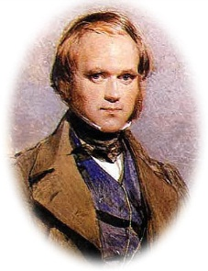
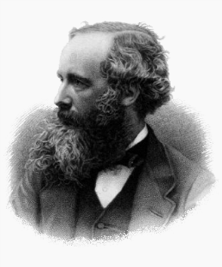
The Newtonian or Classical Worldview
Establishment of an over-arching “paradigm”
Mathematization of the world
Emergence of powerful “machine-metaphor”
Math explosion!
The Bernoullis
1800
1873
1900
1687
Euler
Lagrange
Calculus further articulated
Fourier
Laplace
Differential Equations
1859

Slide 17
So … finally
What characterizes “scientific knowledge”?
What is the nature of a scientific truth claim?
Does science tell us what is “true” or only what is “probable”?
Is scientific knowledge different than other forms of knowledge?
Does science provide a “a-cultural”, objective knowledge?

Slide 18
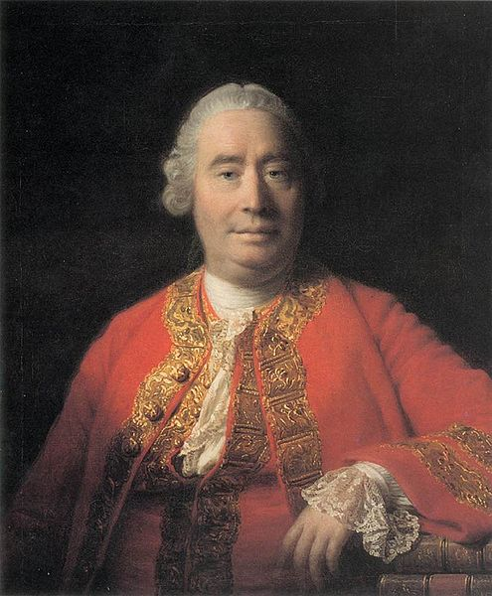
Empiricism and the Problem of Induction
18th century explosion of scientific knowledge was driven by an empirical current (Bacon on steroids?) but this entailed the Problem of Induction
The problem of induction was most clearly articulated by David Hume and a subtle shift from rationalism (science built on reason) to a form of (practical) skepticism (circa 1750)

Slide 19
Ascent of “Scientific Knowledge” and birth of Engineering
Practical
knowledge
of the
guilds
Knowledge of the natural world
Knowledge through
contemplation
X
Engineering as application of scientific knowledge

Slide 20
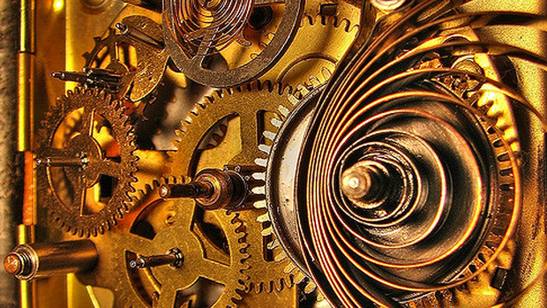
What Does Newton’s World Look Like?
The world METAPHOR changes during the time of Newton
Garden or Kingdom gives way to Clock!

Slide 21
Newton’s successors and a radically changing vision...
theism
deism
atheism

Slide 22
Good Theory - Weak MYTH
Myth: a story that you tell knowing that it is not true (a-historical)
MYTH: a story that you tell that is intended to convey deep truths and convictions. It is neither historical or anti-historical (from Northrop Frye)

Slide 23
Taking stock...Backgrounding Science
it is historically and culturally delimited
it makes - a priori metaphysical and epistemological assertions about the natural world
it is socially situated

Slide 24
Some Metaphysical and Epistemological Assumptions about the Natural World
Simplicity
Mathematical Nature of Reality - Beauty and Elegance
Foundationalism
Materialism
“The Cosmos, all that is or ever was or ever will be”.
Cosmos, 1980

Slide 25
Ways of Relating Science and Religion
Conflict
Independence
Dialogue
Integration

