Slide 1
Using DE’s in Mathematical Models

Slide 2
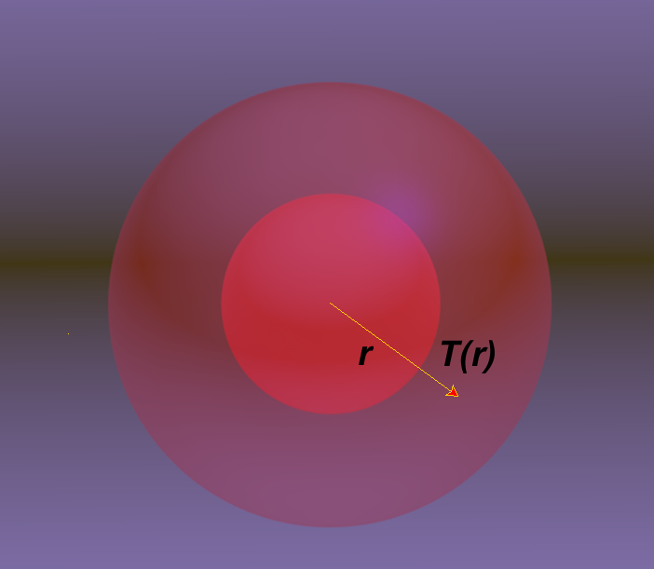
Temperature Gradients
A sphere of radius 1 m has a temperature of 15 C and lies inside a sphere of radius 2 m which has a temperature of 25 C. The temperature as a function of distance satisfies the equation Find an expression for T(r)
(Hint: let S = dT/dr)
T(1) = 15⁰C
T(2) = 25⁰C

Slide 3
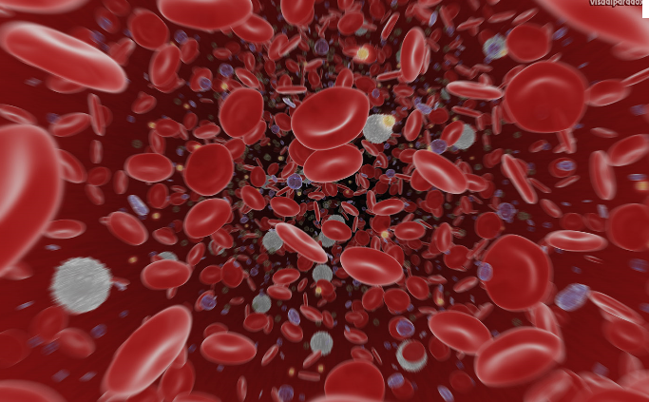
Concentration of Glucose in Blood
Glucose solution is administered intravenously to a patient at a constant rate r.
As glucose is added some is broken down to form other substances
kC(t) = amount of glucose converted
C(t) is the concentration of glucose in the bloodstream
Let C(0) = 0; find C(t).
Assume C(0) < r/k, find

Slide 4
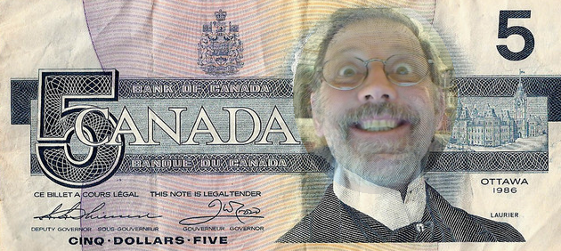
Canada Introduces New Five Dollar Bill!
Canada is soon to introduce a new $5 bill to replace the 50 billion dollars in existing bills. Each day 50 million dollars of this bill come into banks where they will be replaced with the new bill.
Let x(t) be a mathematical function that represents the amount of the new currency in circulation.
Create a mathematical model that describes how the new bill is introduced to the currency supply. Estimate how many days it will take before 90% of the old bills have been replaced.

