Slide 1
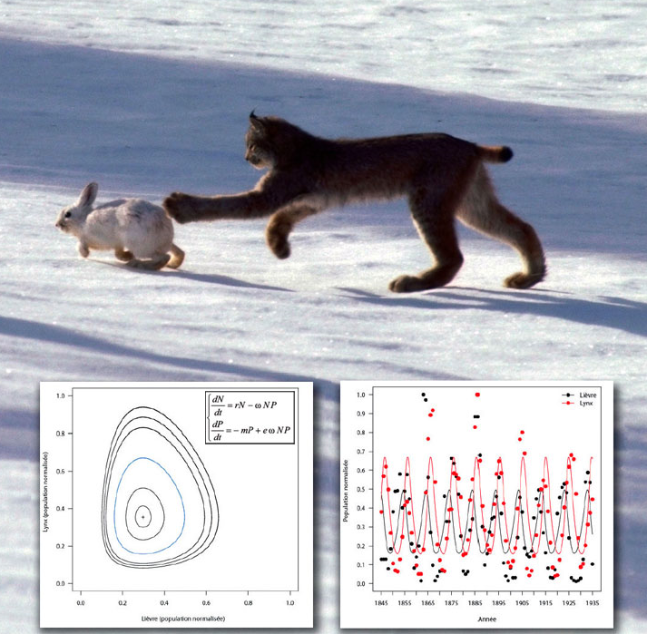
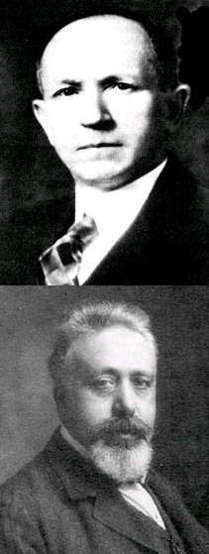
Predator-Prey Systems
Alfred Lotka (top)
Vito Volterra

Slide 2
Interacting Populations
When two or more populations interact some very interesting (and complicated) behaviour ensues
Predator-Prey models illustrate this and (in general) cannot be solved by simple methods – we will use an Euler Method approach
Some Key Term to learn:
Phase plane
Phase trajectories and portraits

Slide 3
Rabbits and Wolves - From words to equations
The rabbit population R(t) is growing with a rate ‘k’ constant but is declining at a rate that is proportional to the rate constant ‘a’ at which the populations interact
The wolf population W(t) is declining (starvation) at a rate ‘r’ but is increasing at a rate that is proportional to the rate constant ‘b’ at which the populations interact

Slide 4
Expressed as a system…
Study section 11.8

Slide 5
The Phase Plane – a useful way to examine the system

Slide 6
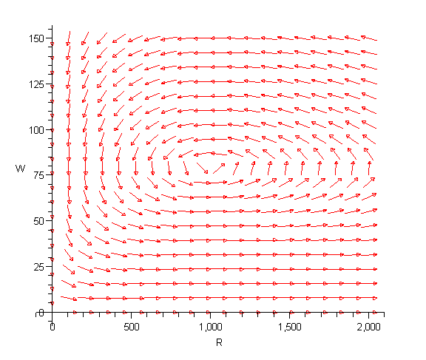
Phase Portrait…
Wolves versus Rabbits
k = 0.08
a = 0.001
r = 0.02
b = 0.0002
What if we had 500 rabbits and
100 wolves?

Slide 7
Is there a “stable” Rabbit/Wolf Population?
What if both populations were constant – is that even possible?
If it is then what do you know about dR and dW?

Slide 8
Challenge….
How could we modify what we have just done to recognize that even without predation the rabbit population would be “self-limiting” or logistic in nature?

Slide 9
Your turn…
Try 11.8 questions #: 3,5,9,13

