Slide 1
Techniques of Integration
Or the fine art of pattern recognition!
Chapter 7

Slide 2
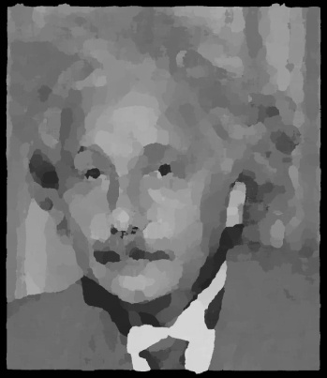
Who’s this?
Pattern recognition is “built into us”. We all possess amazing pattern recognition abilities!

Slide 3
Name this tune…
Learning how to recognize integral patterns is much like learning to recognize familiar faces or tunes!

Slide 4
Why is integration so much harder than differentiation?
Any “fool” can drop a vase! That’s differentiation.
Sometimes it takes an “artist” to put it back together! That’s integration.

Slide 5
Summary of Techniques
Substitution
Integration by Parts
Trigonometric Integrals
Trig Substitution
Partial Fraction
CAS and Tables
Numerical
7.2
7.1
7.4
7.3
7.5

Slide 6
Examples…
Pg 408 - 409: 9,10,13,24,27,40,47
Do the following:
Read section 7.5 – Strategy for Integration
Identify the pattern
Decide on the appropriate subs
Integrate

