Slide 1
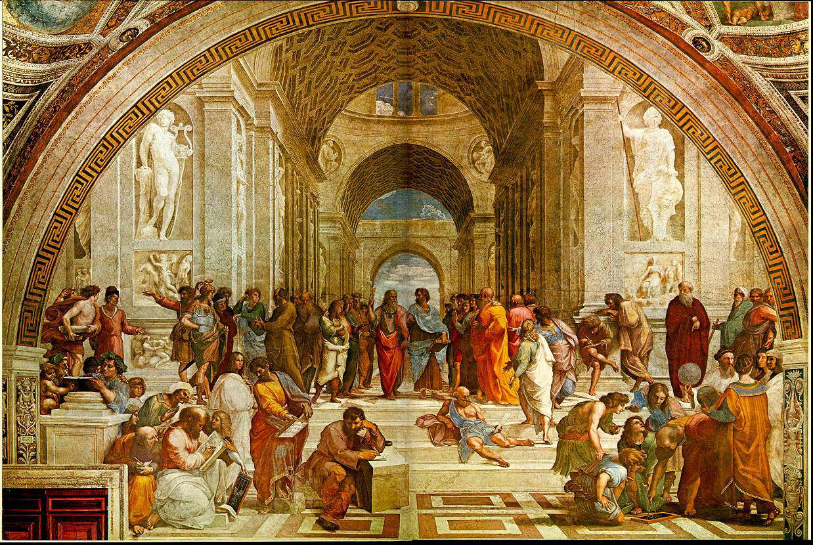
Is Science Rational?
Exploring the thinking of Michael Polanyi, Thomas Kuhn and Nicholas Maxwell

Slide 2
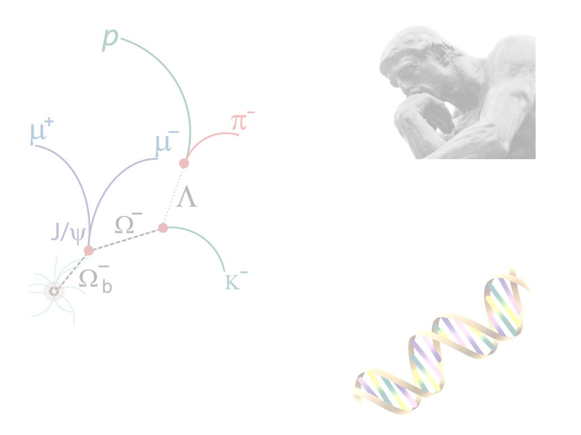
Taking Stock…
For a working scientist – science “works”!
  Does this mean science is “rational”?
  What’s at stake?
  What does it mean to argue that science is “rational”?

Slide 3

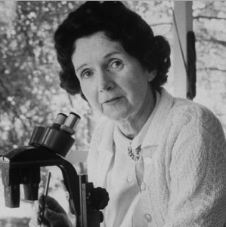




Slide 4
The heart has its reasons which
reason knows nothing of.
Two extremes: to exclude reason,
to admit reason only.
Pascal Pensees

Slide 5
Why were neither Popper or Scheffler “happy” with Hume’s conclusion that there are no logical justifications for scientific knowledge claims – that they are rather “habits of the mind”?
'Hume's philosophy ... represents the bankruptcy of eighteenth-century reasonableness' and, 'It is therefore important to discover whether there is any answer to Hume within a philosophy that is wholly or mainly empirical. If not, there is no intellectual difference between sanity and insanity. The lunatic who believes that he is a poached egg is to be condemned solely on the ground that he is in a minority. . . .‘
Sir Bertrand Russell, A History of Western Philosophy (1946)
Does this call into question the rationality of science?

Slide 6
“When reference is made to secularization, the secularization of science is often forgotten.. That is the case because the greater number of Christians who have enjoyed a scientific education lack a clear idea of the connection between scientific thought and religion. The claim is repeatedly made that by its very nature non-theological science must be altogether free of personal belief, because its objectivity would be imperiled the moment it was bound to any presuppositions originating in faith. This idea has been accepted without weighing its consequences and without asking whether it is justified from either a biblical or a critical, scientific point of view.”
“…science, secularized and isolated, has become a satanic power, an
idol which dominates all of culture.”
Herman Dooyeweerd "La Secularisation de la Science” (1954)
Is the “problem” a supposed humanistic belief in the (possibility or ideal of) autonomy of human intellect from:
Presuppositions
Religion
The human body itself! (Popper’s “Epistemology without a knowing subject”?

Slide 7
Dueling with Dualisms!
Mind-Body
Fact - Value
Subject-Object
Theory - Praxis

Slide 8
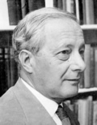
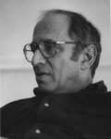
Re-conceptualizing the idea of Objectivity
Michael Polanyi’s Post Critical Philosophy and Tacit Knowledge
  Personal Knowledge (1958)
  The Tacit Dimension (1967)
Thomas Kuhn
  The Structure of Scientific Revolutions (1962)

Slide 9
The personal “dimension” to knowledge…
My search has led me to a novel idea of human knowledge from which a harmonious view of thought and existence, rooted in the universe, seems to emerge.
I shall reconsider human knowledge by starting from the fact that we can know more than we can tell.
Tacit Knowing pg 4
Our body is the ultimate instrument of all our external knowledge, whether intellectual or practical.
Tacit Knowing pg 15
It appears, then, that to know that a statement is true is to know more than we can tell and that hence, when a discovery solves a problem, it is itself
fraught with further intimations of an indeterminate range, and that furthermore, when we accept the discovery as true, we commit ourselves to a belief in all these as yet undisclosed, perhaps as yet unthinkable, consequences.
Tacit Knowing pg 23

Slide 10
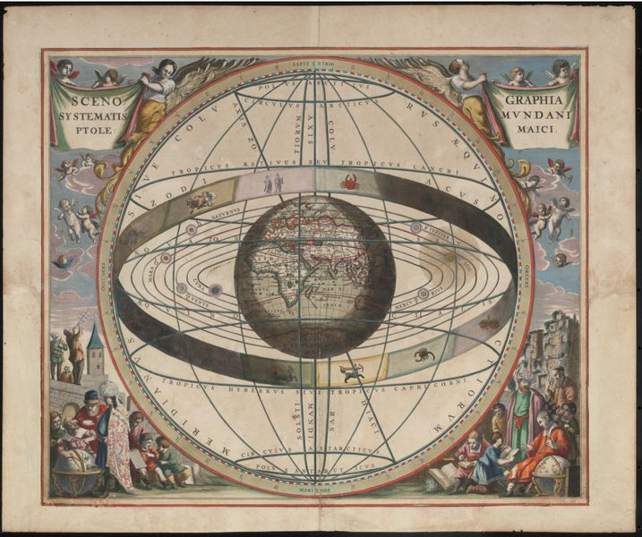
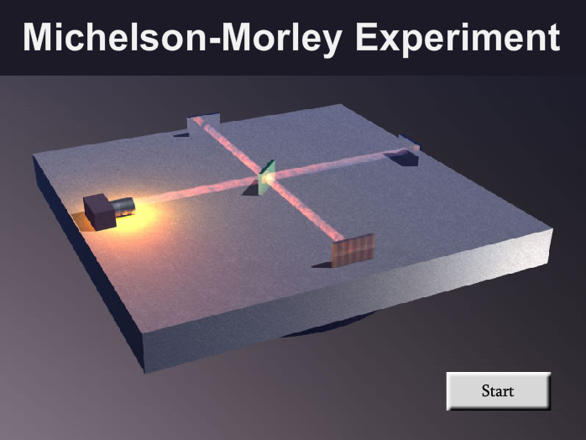
What is “Objectivity”?
Back to Copernicus
Relativity and the Michelson-Morley Experiment

Slide 11
Polanyi’s Conception of Objectivity
Behaving objectively entails attending to the “rational appeal” within a theory
Theoretic knowledge is more objective than the knowledge offered by the senses
We transcend our subjectivity by “striving passionately to fulfil our personal obligations to universal standards”.

Slide 12
We cannot truly account for our acceptance of such theories (of modern physics) without endorsing our acknowledgement of a beauty that exhilarates and a profundity that entrances us. Yet the prevailing conception of science, based on the disjunction of subjectivity and objectivity, seeks—and must seek at all costs—to eliminate from science such passionate, personal, human appraisals of theories, or at least to minimize their function to that of a negligible by-play. For modern man has set up as the ideal of knowledge
the conception of natural science as a set of statements which is 'objective'
in the sense that its substance is entirely determined by observation, even
while its presentation may be shaped by convention. This conception,
stemming from a craving rooted in the very depths of our culture, would
be shattered if the intuition of rationality in nature had to be acknowledged
as a justifiable and indeed essential part of scientific theory. That
is why scientific theory is represented as a mere economical description
of facts; or as embodying a conventional policy for drawing empirical
inferences; or as a working hypothesis, suited to man's practical convenience—interpretations that deliberately overlook the rational core
of science.
Michael Polanyi, Personal Knowledge pg 15-16

Slide 13
Rather than “doing away” with the body Polanyi places our humanity at the centre of the scientific process. Science becomes “reliable” by:
  Our “indwelling” in our discipline
  Our participation in a “community of explorers”
  Our passionate commitment or “universal intent” to asset claims that we believe true for all
  Our tacit knowledge guiding us to the solution (or recognition) of a problem

Slide 14
Polanyi develops a very human way of knowing that avoids the subjectivity/objectivity dualism:
But this does not make our understanding subjective. Comprehension is neither an arbitrary act or a passive experience, but a responsible act claiming universal validity. Such knowledge is indeed objective in the sense of establishing contact with a hidden reality, contact that is defined as the condition for anticipating an indeterminate range of as yet unknown (and perhaps yet inconceivable) true implications. It seems reasonable to describe this fusion of the personal and the objective as personal knowledge.
Michael Polanyi, PK, vii-viii
Popper hated this!
..save the sciences ... from an obscurantist faith in the expert’s special skill, and in his personal knowledge and authority; a faith that so well fits our ‘post-rationalist’ and ‘post-critical’ age, proudly dedicated to the destruction of the tradition of rational philosophy, and of rational thought itself.
Sir Karl Popper, The Logic of Scientific Discovery

Slide 15
Kuhn and Paradigms…
In The Structure of Scientific Revolutions Thomas Kuhn argues that science evolves – not in a logically linear fashion but through dramatic shifts in how scientists see the world
He coins the term “paradigm” and “paradigm shift”
Newtonian Physics
Quantum Physics

Slide 16
So … Is Science Rational?
Popper, Polanyi and Kuhn would all say yes
– but for very different reasons!

Slide 17
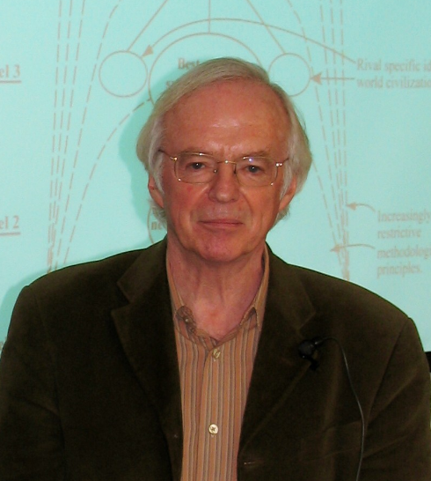

Nicholas Maxwell
Questions the “animating spirit” behind western rational inquiry (science)
Author of…
  What’s Wrong With Science (1976)
  From Knowledge to Wisdom (1984)
  Is Science Neurotic? (2004)
We need a revolution in the aims and methods of academic inquiry, so that the basic aim becomes to promote wisdom by rational means, instead of just to acquire knowledge.
Nicholas Maxwell

Slide 18
The philosophy of knowledge can be summarized as follows. The proper, aim for rational inquiry is to acquire knowledge about the world, objective knowledge of truth. Ultimately, no doubt, knowledge is sought as a means to the end of achieving that which is humanly desirable and of value. At the most fundamental level of all, in other words, the aim of rational inquiry may well be to help promote social progress, human welfare and enlightenment.
In order to achieve these fundamental human, social aims, however, it is essential that rational inquiry devotes itself, in the first instance, to achieving the purely intellectual aim of acquiring objective knowledge of truth. Only by dissociating itself decisively from the goals, values and beliefs of common social life, so that claims to objective knowledge can be subjected to scrupulously rational assessment, can inquiry accumulate genuine knowledge, thus ultimately being of benefit to humanity. Rational inquiry
must, as it were, ignore human need in order to help fulfill such need. Truth, not that which is humanly desirable, must be the central intellectual concern of rational inquiry.
Nicholas Maxwell; From Knowledge to Wisdom, pg 10
How Maxwell characterises the “standard empiricist” view that prevails in science and academic discourse

Slide 19
In Chapter Two of FKTW Maxwell unpacks the standard view of science and scientific knowledge in 19 points
    Inquiry for social good
    Produce objective knowledge
    Kinds of knowledge
    Inquiry is of value when pursued for it own sake
    Methodology of science demands sharp break (dualism?) between object and subject
    All personal ambitions, desires must be “ruthlessly ignored” (Just the facts ma’am – nothing but the facts!)
    Intellectual aims of science must be distinguished from social aims even if these are implicit in the research
    Intellectual problems of science must be distinguished from social problems even if these are implicit in the research

Slide 20
“It is no part of the intellectual aim of intellectual inquiry to enhance our wisdom”. FWTK pg 21
Intellectual progress of science must be distinguished from social progress
Focuses specifically on scientific inquiry which Maxwell identifies as standard empiricism
Standard Empiricism demands a sharp distinction between context of discovery and context of justification (point where Popper and Polanyi deviate starkly)
Hierarchical view of science
Hierarchical view of mathematics
Expert knowledge is “professionalized” knowledge
Scientists are authoritative only “insofar as they restrict themselves to delivering purely factual judgments” FKTW pg 25
“The Mind must be sharply separated off from the Heart” FKTW pg 26
The arts make no direct contribution to intellectual inquiry (C.P. Snow?)
Ideas must be potentially testable (and falsifiable if possible)
Maxwell on realism and debt to Popper

Slide 21
It deserves to be noted that both the philosophy of knowledge
and the philosophy of wisdom are philosophies of inquiry in this
common-sense conception of 'philosophy', in that both are views
about what ought to be, ideally, the basic aims and methods of
inquiry. Thus neither of these 'philosophies' can have any very
respectable place within the intellectual domain of inquiry pursued
in accordance with the philosophy of knowledge. In this way the
philosophy of knowledge preserves itself from criticism. Once the
philosophy of knowledge is adopted and put into practice,
accepted intellectual standards effectively debar critical, rational
discussion of philosophies of inquiry. Claims to knowledge can be
critically discussed: but the adoption of the aim to acquire
knowledge as the basic aim for inquiry becomes more or less
immune from critical reconsideration.
Maxwell; FKTW pg 27
Maxwell on scientific theories

Slide 22
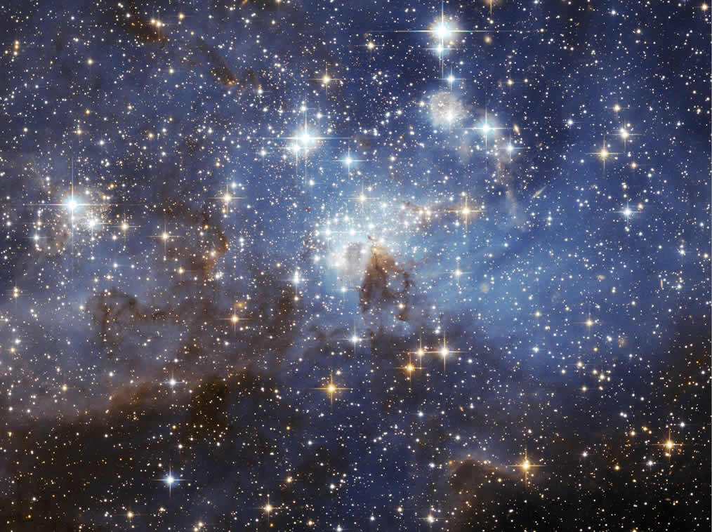

Slide 23
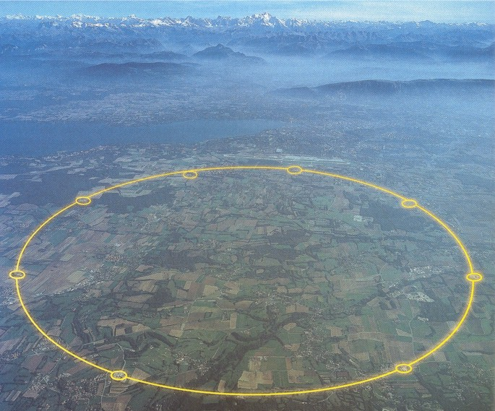

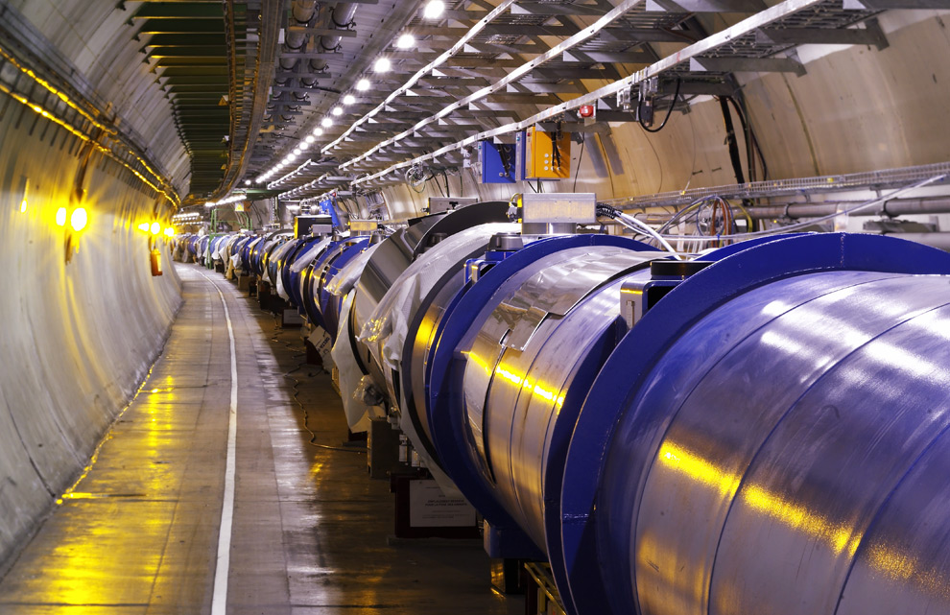

Slide 24
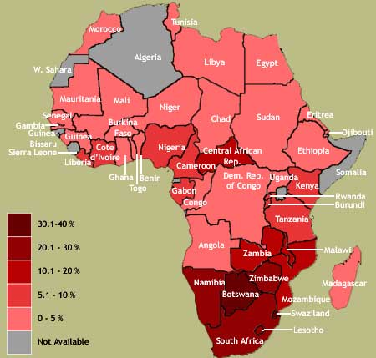

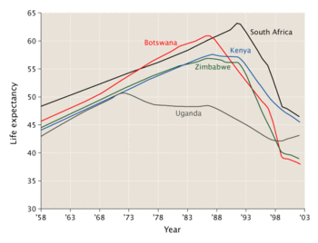
Different ways of presenting the devastating data on HIV-Aids in Africa

Slide 25

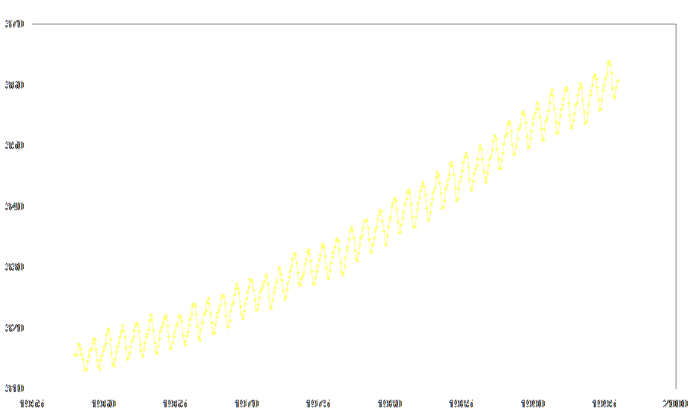
Perhaps one of the most important graphs in history!

