Slide 1
Quantum Mechanics… The Rules of the Game!
Chapter Q6

Slide 2
A not so simple, “simple” question….
What is the smallest box in which you could hold an electron?
Multiple Choice: An electron is:
A) a particle
B) a wave
C) both A & B
D) a quanton
Why does the answer matter?

Slide 3
Learning the terminology
Intrinsic properties:
Mass
Charge
spin
Observables:
Position
Momentum
Angular Momentum
Energy
q-Vector →Wave Function
Probability Distribution
Expectation Values

Slide 4
The Official Rules the Quantum Mechanics Game…
R1: State Vector Rule
R2: Eigenvector Rule
R3: Collapse Rule
R4: Probability Rule
R5: The Sequence Rule
R6: Superposition Rule
R7: Time-Evolution Rule
Explain the above rules and walk us through the accompanying examples in Moore

Slide 5
Child’s Play! – let’s get on with it…

Slide 6
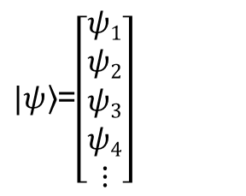
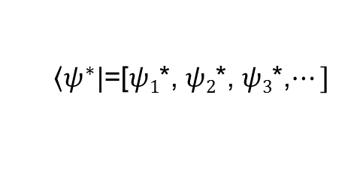
So what’s a q-Vector, what’s a wavefunction?
Careful look at Q7.3,4
q-vector that gives you the “state” that the quanton is in.
Called a “ket”
$|\left.ψ\right\rangle$=$\left[\begin{aligned}ψ1 \\ ψ2 \\ ψ3 \\ ψ4 \\ ⋮\end{aligned}\right]$
$\left\langle ψ^{∗}|\right.$=[$ψ1$*, $ψ2$*, $ψ3$*,$⋯]$
Complex conjugate of the ket vector → called a “bra”
These give us the “machinery” to predict how a quanton changes from one state to another!

Slide 7
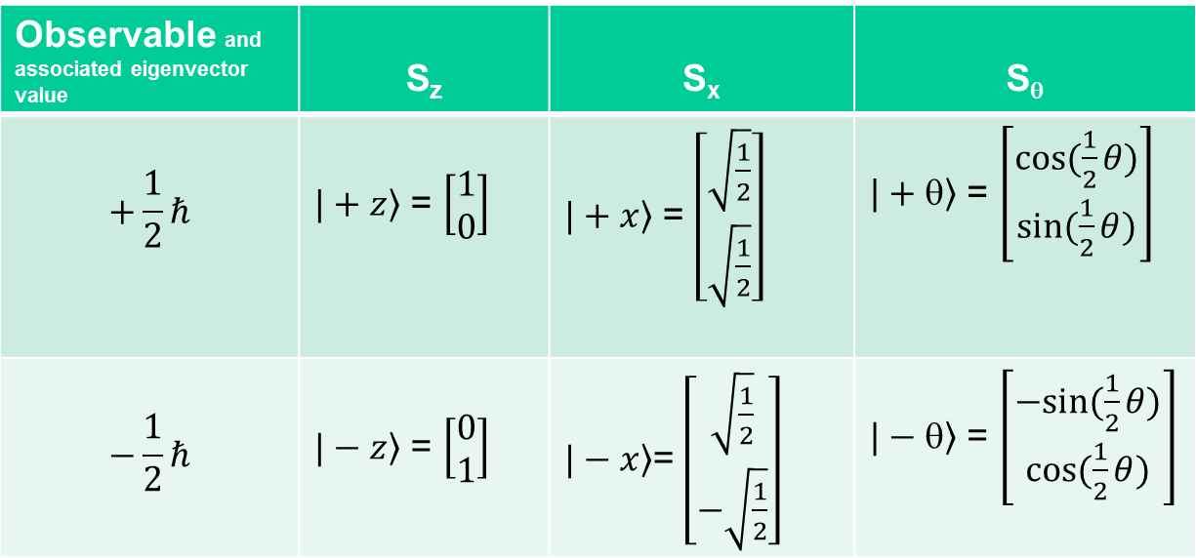
Example – spin states
Observable and associated eigenvector value | S_{z} | S_{x} | S_{θ}
$$+\frac{1}{2}ℏ$$ | $\left.|+z\right\rangle$ = $\left[\begin{aligned}1 \\ 0\end{aligned}\right]$ | $\left.|+x\right\rangle$ = $\left[\begin{aligned}\sqrt{\frac{1}{2}} \\ \sqrt{\frac{1}{2}}\end{aligned}\right]$ | $\left.|+θ\right\rangle$ = $\left[\begin{aligned}cos(\frac{1}{2}θ) \\ sin(\frac{1}{2}θ)\end{aligned}\right]$
$$−\frac{1}{2}ℏ$$ | $\left.|−z\right\rangle$ = $\left[\begin{aligned}0 \\ 1\end{aligned}\right]$ | $\left.|−x\right\rangle$= $\left[\begin{aligned}\sqrt{\frac{1}{2}} \\ −\sqrt{\frac{1}{2}}\end{aligned}\right]$ | $\left.|−θ\right\rangle$ = $\left[\begin{aligned}−sin(\frac{1}{2}θ) \\ cos(\frac{1}{2}θ)\end{aligned}\right]$

Slide 8
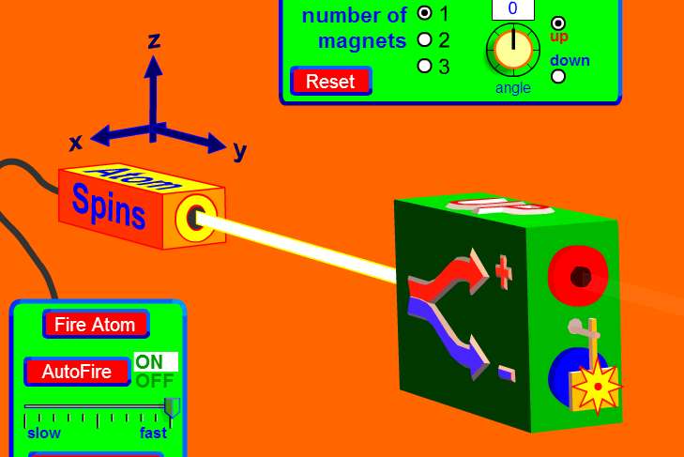
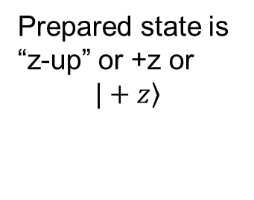
Prepared state is “z-up” or +z or
$$\left.|+z\right\rangle$$
Randomized spin-states

Slide 9
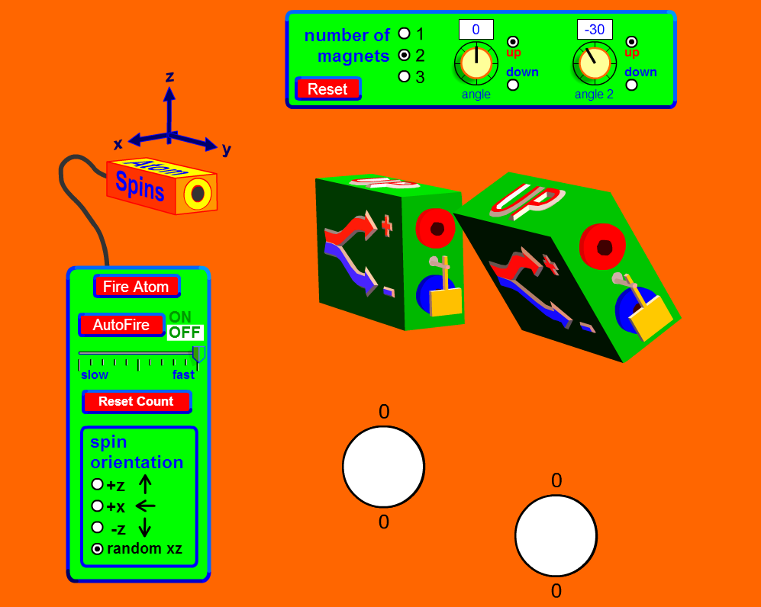
Test this for θ = 30º
$${|⟨+θ│+z⟩| }^{2}$$
This gives us the probability that a quanton
in the +z state will leave in the +θ state

Slide 10
