Slide 1
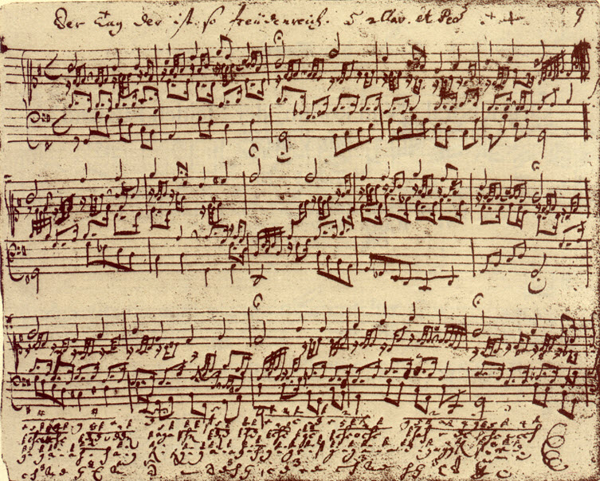
The Physics of Music
An introduction to the course

Slide 2
What does Physics have to do with Music?
1. Physics is a search for understanding of the natural world – it provides a Quantitative theory for sound and the nature of what we call musical sound.

Slide 3
2. Method of Experimental Enquiry
For example: By experimenting with different kinds of strings you might better understand what affects the damping time, “warmth” of tone, and durability.
Different scenarios and explanations can be tested via experiment.

Slide 4
3. Source of ideas on how to vary the way we make/record music.
Yucatan Brown Jay, copyright Daniel J. Mennill 1999
Notes:
BrownJayAscal.mp3

Slide 5
4. Hobby for physicists, musicians, craftsmen, engineers, psychologists and biologists
Darker is higher volume
Pitch
Time
Montezuma Oropendola
Bird songs and spectra thanks to: Daniel J. Mennill 1999
Notes:
MontezumaOropendola_song.mp3

Slide 6
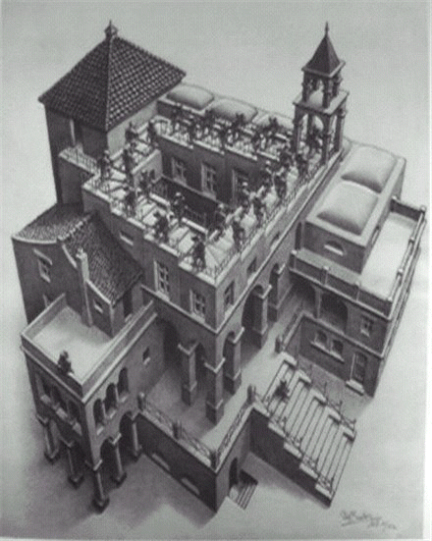
5. Physics of Perception: how does the ear and brain work?
Physics and Music together encompass a wide range of intertwined scientific disciplines and methods of enquiry
Notes:
ascend_scale.mp3

Slide 7
6. A way to find beauty in physics and math
If physics can explain something musical then physics is beautiful.
Pythagoras showed that musical intervals were related to rational numbers (like 2/3)
If a physical model resembles an acoustic system it’s more beautiful and therefore better. (Kepler)
A way to explain physics. A way to catch people’s interest. (Era of classical and modern physics). Deep connections between ideas of quantum mechanics and harmonic analysis.
from F Gafurio Theorica Musice 1492] [rep. Wittkower 1949.]

Slide 8
Musical analogies in early astronomy and mathematics
"The chief aim of all investigations of the external world should be to discover the rational order and harmony which has been imposed on it by God and which He revealed to us in the language of mathematics." Johannes Kepler (1571-1630) from Astronomis Nova de Motibus

Slide 9
Kepler and the Music of the Spheres
In his book “Harmonies of the World”
“The heavenly motions are nothing but a continuous song for several voices, to be perceived by the intellect not by the ear; a music which through discordant tension through syncopations and cadenzas as it were progresses toward certain pre-designed six voiced cadences and thereby sets landmarks in the immeasurable flow of time.”

Slide 10
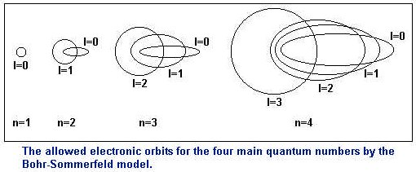
The Birth of Quantum Mechanics
“Would Kepler, the mystic who, like Pythagoras and Plato, tried to find and to enjoy the harmonics of the Cosmos, would he have been surprised the atomic physics had rediscovered the very same harmonies in the building stones of matter and this in even purer form? For the integral numbers in the original quantum theory display a greater harmonic consonance than even the star in the Pythagorean music of the spheres” --- Arnold Sommerfeld (1930)

Slide 11
The Birth of Quantum Mechanics
Shroedinger equation is based on the wave equation.
This combined with boundary conditions yields various modes of oscillation that depend on integers --- just like harmonics of a string
A resulting beautiful model for the quantization of the energy levels of the hydrogen atom
A nice analogy to Pythagorean approach --- the beauty of nature reflected or matched by simple integral/mathematical models

Slide 13
Musical analogies in modern physics
1996, Astrophysical Journal, 471, 30, Hu, Wayne, & White, Martin, Acoustic Signatures in the Cosmic Microwave Background
“We study the uniqueness and robustness of acoustic signatures in the cosmic microwave background by allowing for the possibility that they are generated by some as yet unknown source of gravitational perturbations. The acoustic pattern of peak locations and relative heights predicted by the standard inflationary cold dark matter model is essentially unique and its confirmation would have deep implications for the causal structure of the early universe.”
August 2005 issue, Scientific American
“Is the Universe Out of Tune? Like the discord of key instruments in a skillful orchestra quietly playing the wrong piece, mysterious discrepancies have arisen between theory and observations of the "music" of the cosmic microwave background. Either the measurements are wrong or the universe is stranger than we thought.” By Glenn D. Starkman and Dominik J. Schwarz
Power spectrum of spatial temperature fluctuations of the cosmic microwave background (from Physics Today)

Slide 14
Approach for this class
Exploration and search for understanding of natural world – the world of music
Exploration of physical concepts and explanations via experimentation
Demonstration and experimentation for fun
Develop skills we need to do interesting experiments and to understand acoustic systems
Understanding of musical instruments, how music is played and how we perceive it.
Instruments represent centuries of experimentation and design - can we understand some of the compromises involved in their design? We will be building instruments in the lab.

Slide 15
Focus
Enquiry and Lab based.
Follow our interests and our hunches. What topics would most likely lead to new undiscovered results or original creations?
Tackle math/physics/engineering/computer skills sufficiently to allow us to investigate questions related to our interests.

Slide 16
Syllabus
Harmonics and harmonic analysis
Spectra of musical sounds/ timbre
Resonances in a column of air
Modes of oscillating membranes
Sound waves, how they propagate, damp, reflect
Scales, Tuning, history of scales, Atonal and Microtonal music
Acoustics of wind instruments
Acoustics of stringed instruments
Acoustics of percussion instruments
Loudness, physical measurement and units
Room/concert hall acoustics
Perception of sound – the ear and brain
Perception of pitch and loudness
Perception of music

