Slide 1
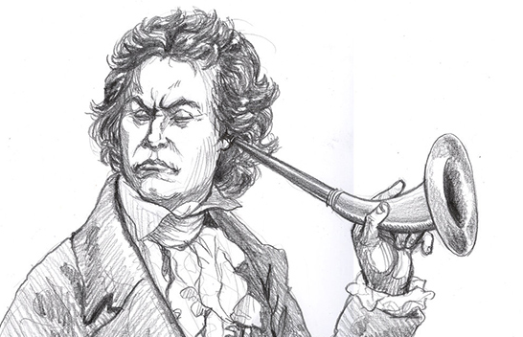
Sound Energy and the Perception of Loudness
Acknowledgments to Dr. Alice Quillen – University of Rochester
Notes:
experiments:
mix at different volumes--- BAD idea.
Standing waves in a room. Drive a low frequency and walk around. compute wavelength.
dB meter in room and inverse square law
in and out of phase with aluminum pipe, mic and hammer --- can also show Doppler shift!
balloon pop and microphone
how to measure power using Adobe Audition.
Daredevil DVD clip
Blindfold and paper
Two speakers both connected to sine wave generator with microphone on at 120Hz show in and out of phase!

Slide 2
Physical units
For a sound wave
The amplitude of the pressure variation in air is related to the energy carried by the wave (unit = Joule = J)
The power in the wave is the rate at which energy is carried by the wave (unit = Watt = W)
Intensity is Power/Area = W/m²

Slide 3
Mathematical Detour – The Logarithm
Our ear operates over an enormous energy range
Logarithms are a mathematical way to compress a huge range of numbers into a much smaller range
Our ears (and eyes) exhibit a logarithmic response to stimuli
Some practice ….

Slide 4
Decibel scale
A sound that is ten times more powerful is 10 decibels higher.
What do we mean by ten times more powerful?
.
Decibel is abbreviated dB
Amplitude in pressure would be related to the square root of the power.

Slide 5
dB scale is logarithmic
SIL = Sound intensity level in dB
I = sound intensity, I₀ = sound intensity threshold for most humans
$SIL=10log10(\frac{I}{Io}$)
Logarithmic scale like astronomical magnitudes or the earthquake Richter scale
A sound that is 10⁷ times more powerful than the threshold of hearing has what db level?

Slide 6
dB is a relative scale
Answer: 10 log₁₀(10⁷) = 70dB
Since the dB scale is defined with respect to the threshold of hearing, it is easier to use it as a relative scale, rather than an absolute scale.
You can describe one sound as x dB above another sound and you will know how much more powerful it is.
P₁/P₂ = 10^{x/10}

Slide 7
Over what range of sound power are our ears sensitive to? In other words: how much more powerful are deafening sounds than barely audible sounds?

Slide 8
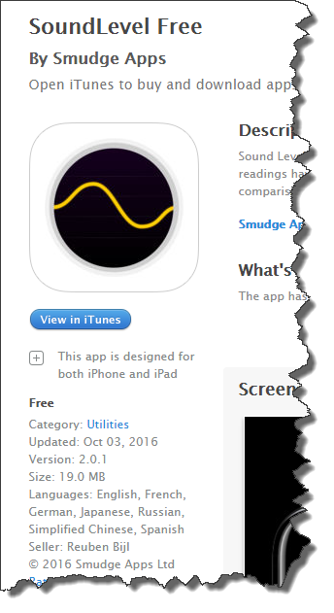
Some useful Apps for Measuring SILs…

Slide 9
Combining sound levels
Supposing you have two speakers and each produces a noise of level 70dB at your location.
What would the combined sound level be?

Slide 10
Points along one curve are all the same perceived loudness

Slide 11
Loud music need less bass. The mix you need depends on the db level. If you change the volume you need to change the mix.

Slide 12
Fletcher-Munson diagram

Slide 13
Phons
The 10 phon curve is that which passes through 10db at 1000Hz.
The 30 phon curve is that which passes through 30db at 1000Hz.
Phons are the perceived loudness level equivalent to that at 1000Hz

Slide 14
How is the Fletcher-Munson diagram measured?
It is a “perceived loudness” diagram?
So how would you carry out an experiment to measure this?
Done with sine waves.
Psychoacoustic experiments:
Matching the volume of one sound to that of another with a fixed frequency and volume (reference sound)
Rating sounds on a numerical scale (magnitude estimation

Slide 15
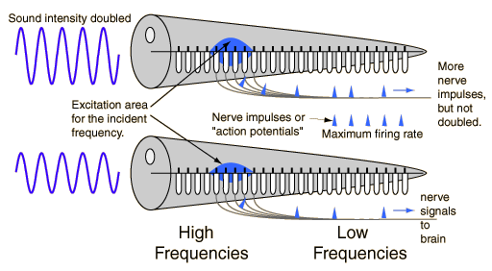
Models of Loudness
Loudness is somehow related to total neural activity ---
Loudness is related to a summation of neural activity across different frequency channels

Slide 16
Perceived loudness scale-Sones
A sound that we say is twice as loud is not twice as powerful.
Rule of thumb: twice as loud (perceived) is equivalent to 10 times in power or 10 dB

Slide 17
Violin sections in orchestra
How many violins are needed to make a sound that is “twice as loud” as a single violin?
10 in power or 10dB
If all playing in phase
or about 3 violins.
But that is not likely so may need about 10 violins
Many violins are needed to balance sound and a few don’t make much of a difference!

Slide 18
Dynamic range
Threshold of pain is about 140 dB above the threshold of hearing.
A difference of 10¹⁴ in power.
How is this large range achieved?

Slide 19
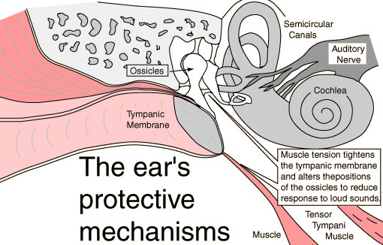
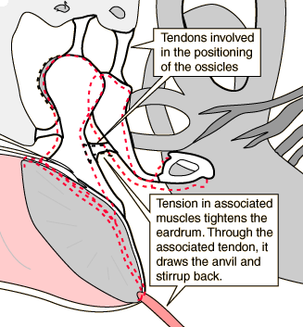
Loud!
In response to loud sounds, the tensor tympani muscle tightens the eardrum and through the tendon between the hammer and anvil and shifts the stirrup backward from the oval window of the inner ear. This shifting of the ossicles reduces the transmitted force to the inner ear, protecting it. However, it is a relatively slow action and cannot protect the ear from sudden loud sounds like a gunshot. The process is less effective in older ears. http://hyperphysics.phy-astr.gsu.edu

Slide 20
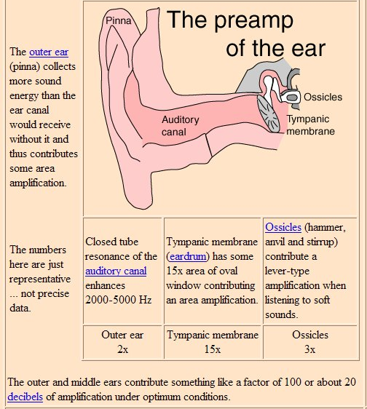
Outer and middle ear contribute to the sensitivity and dynamic range of the ear.

Slide 21
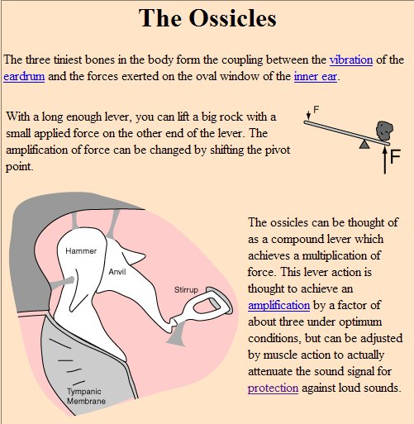
A small motion on the eardrum causes a larger motion on the oval window connecting to the inner ear.

Slide 22
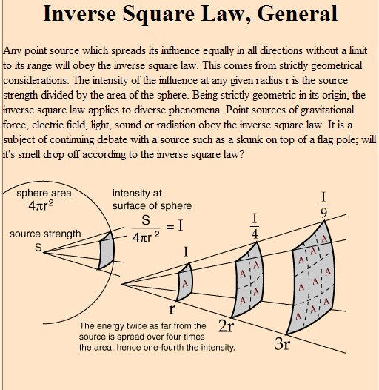
Sound in space
Power goes as
distance⁻²
How would you expect the dB level to depend on distance?

Slide 23
Inverse square law in dB
Notes:
Answer is 20

Slide 24
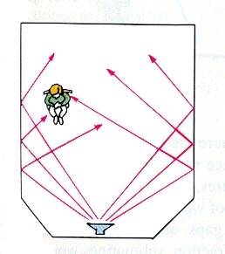
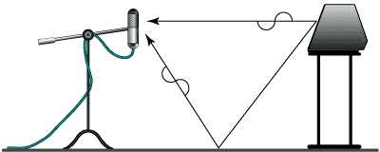
Is the inverse square law relevant for room acoustics?
Figure from JBL Sound System Design Reference Manual
Notes:
demo with dB meter and sound no inverse square
show daredevil scenes starting at 9:10 and 51:00

Slide 25
What is relevant to room acoustics?
Locations and angles of reflections
Timing of reflections
Quality of reflections:
as a function of frequency
what amount absorbed
Number of reflections
Modes in the room that are amplified

Slide 26
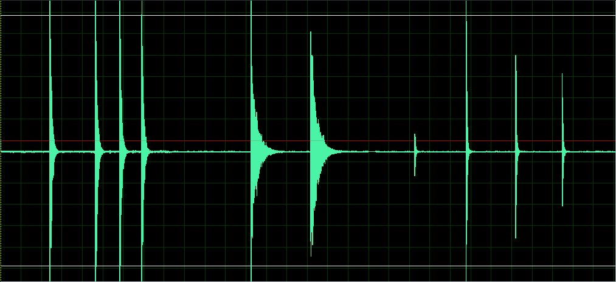
3 rooms
time →
Notes:
Demo, balloon popping!
reverb.mp3

Slide 27
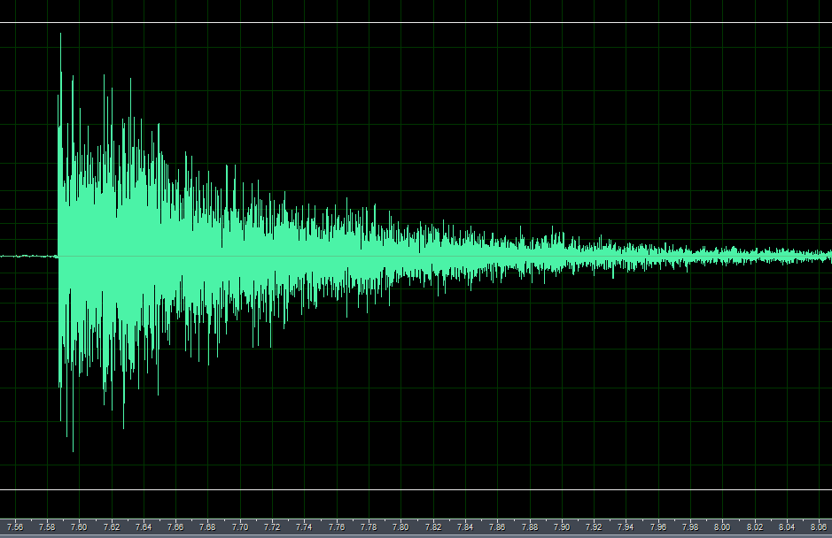
looking closer
direct sound
A pattern of echoes that
slowly dies away

Slide 28
Timing of echos
Speed of sound is 340m/s.
1/340 ~ 0.003 ~ 3ms
3 milliseconds per meter.
Echo across a room of 10m is 30ms.
Decay rates related to the travel time across a room.

Slide 29
Effect of Echoes
ASAdemo 35 Speech in 3 rooms and played backwards so echoes are more clearly heard
Echo suppression
Notes:
ASAdemo35.mp3

Slide 30
How do we describe a decay?
A timescale.
How about a halftime? Like a half life?
After t _{1/2} the sound is ½ the power
We could use a function to describe the power
We can write this P(t) = P₀2^{-t/t_1/2}
Or we could use
P(t) = P₀ exp(-t/t_{decay}) exponential drop
Or we could use something like this
P(t) = P₀10^{-t/td}.
Actually if you adjust td or t_{decay} these three expressions can be the same function.

Slide 31
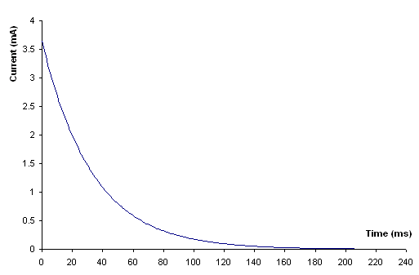
An exponential decay
becomes a line on a log plot→
drops to half
P
drops to half again
log P
drops to half again
time
time
The height decreases very quickly at first, and then decreases more slowly.
A curve with this exact shape is called an exponential curve. So, since the current is decreasing (or decaying) along a curve of this shape, we call this exponential decay.

Slide 32
Measuring a half life
Suppose we measure power in dB. How many dB change corresponds to twice the power?
10log₁₀2 ~ 3.0dB
Measure the time it takes to drop in power by 3dB and that corresponds to the t_{1/2}.

Slide 33
Room acoustics
It is now recognized that the most important property of a room is its reverberation time.
This is the timescale setting the decay time, or the half time of acoustic power in the room
Surfaces absorb sound so the echoes get weaker and weaker.
The reverberation time depends on the size of the room and the way the surfaces absorb sound.
Larger rooms have longer reverberation times.
More absorptive rooms have shorter reverberation times.

Slide 34
Reverberation time
The reverberation time, RT₆₀, is the time to drop 60 dB below the original level of the sound.
The reverberation time can be measured using a sharp loud impulsive sound such as a gunshot, balloon popping or a clap.
Why use 60dB to measure the reverberation time? the loudest crescendo for most orchestral music is about 100 dB and a typical room background level for a good music-making area is about 40 dB.
60dB corresponds to a change in power of a million!
It is in practice hard to measure sound volume over this range. However you can estimate the timescale to drop by 20 dB and multiply by ......?

Slide 35
What is a good reverberation time for a room?
If you are using the room for lectures (speech) then a long reverberation time makes it difficult for the audience to understand words.
However long reverberation times are desirable for example in churches for organ music.
Rooms that are good for both speech and music typically have reverberation times between 1.5 and 2 seconds.
If the direct sound is week compared to the echo, then speech sounds garbled.

Slide 36
Estimating the reverberation time
Sabine’s formula
V/S_{e} in m, RT₆₀ in seconds
V/S_{e} in feet, RT₆₀ in seconds
V is the volume of the room and S_{e} the effective area
People or seats also can be given effective areas.

Slide 37
Sabine’s formula
A decay timescale proportional to a Volume/Area is a length
Time between reflections depends on length
Decay time depends on length
Bigger rooms have longer decay times

Slide 38
Sabine’s formula
If each more energy is absorbed each reflection then the decay timescale is shorter
Higher absorption on walls means shorter decay timescale

Slide 39
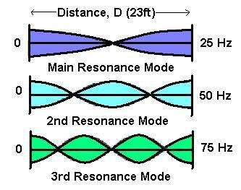
Standing waves in a Room
x,y,z wave-numbers
loud in corners
problem at low frequencies/large wavelengths
corner foams to damp low frequencies
Notes:
what are the resonances for B+L407? See if you can find out?

Slide 40
Just Noticeable Differences
JND in Sound Intensity
A useful general reference is that the just noticeable difference in sound intensity for the human ear is about 1 decibel.
JND = 1 decibel
In fact, the use of the factor of 10 in the definition of the decibel is to create a unit which is about the least detectable change in sound intensity.

Slide 41
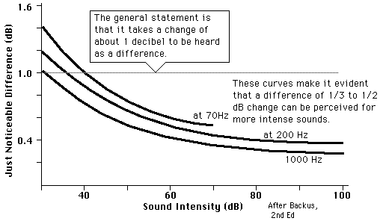
JND as a function of loudness
There are some variations. The JND is about 1 dB for soft sounds around 30-40 dB at low and midrange frequencies. It may drop to 1/3 to 1/2 a decibel for loud sounds.

Slide 42
Acoustic Gain and Feedback
Gain: increase in dB at the position of the listener. What is the maximum gain without feedback?
Figure from JBL Sound System Design Reference Manual

Slide 43
Acoustic Gain and Feedback
Can turn up the speaker until the signal at the microphone from the speaker is as loud as the voice
Figure from JBL Sound System Design Reference Manual

Slide 44
Acoustic Gain and Feedback
Difference in dB for direct voice between speaker and mic locations
20 log₁₀ 4 = 12.0 dB
Here 4/1 is ratio of distance between speaker and mic and mic and person.
You can amplify the voice by up to x4 the amplitude (with no feedback safety margin).
Listener has
20 log₁₀ 7 = 16.9 dB for direct voice
20 log₁₀ 6 = 15.6 dB for speaker
Volume 12.0-15.6=-3.6 speaker
Volume -16.9 dB direct
Difference is 16.9-3.6=13.3 dB.
Maximum gain is 13.3 dB.
Figure from JBL Sound System Design Reference Manual

Slide 45
Acoustic Gain and Feedback
Max gain
D_{sl}
D_{ms}
D_{vm}
D_{ml}

Slide 46
Critical Band
Two sounds of equal loudness (alone) but close together in pitch sounds only slightly louder than one of them alone.
They are in the same critical band competing for the same nerve endings on the basilar membrane of the inner ear.
According to the place theory of pitch perception, sounds of a given frequency will excite the nerve cells of the organ of Corti only at a specific place. The available receptors show saturation effects which lead to the general rule of thumb for loudness by limiting the increase in neural response.

Slide 47
Outside the critical band
If the two sounds are widely separated in pitch, the perceived loudness of the combined tones will be considerably greater because they do not overlap on the basilar membrane and compete for the same hair cells.

Slide 48
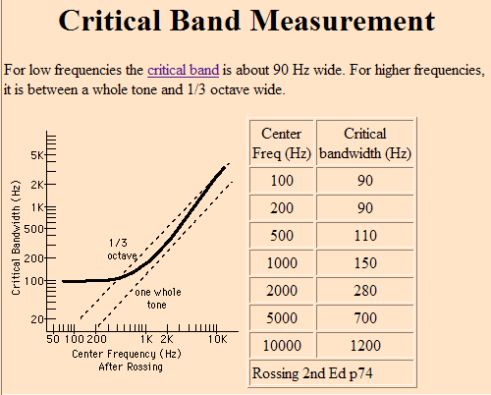
Critical Band continued

Slide 49
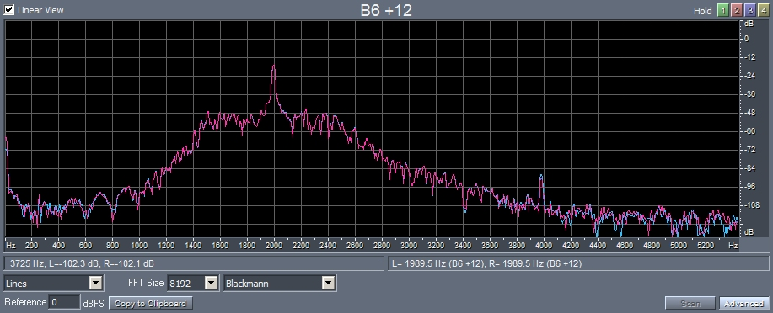
Critical Bands by Masking
ASAdemo2 Tone in presence of broad band noise
The critical band width at 2000Hz is about 280Hz so you can hear more steps when the noise bandwidth is reduced below this width.
Notes:
ASAdemo2

Slide 50
Critical Bands by Loudness comparison
A noise band of 1000Hz center frequency.
The total power is kept constant but the width of the band increased.
When the band is wider than the critical band the noise sounds louder.
ASA demo 3
Notes:
Asademo3

Slide 51
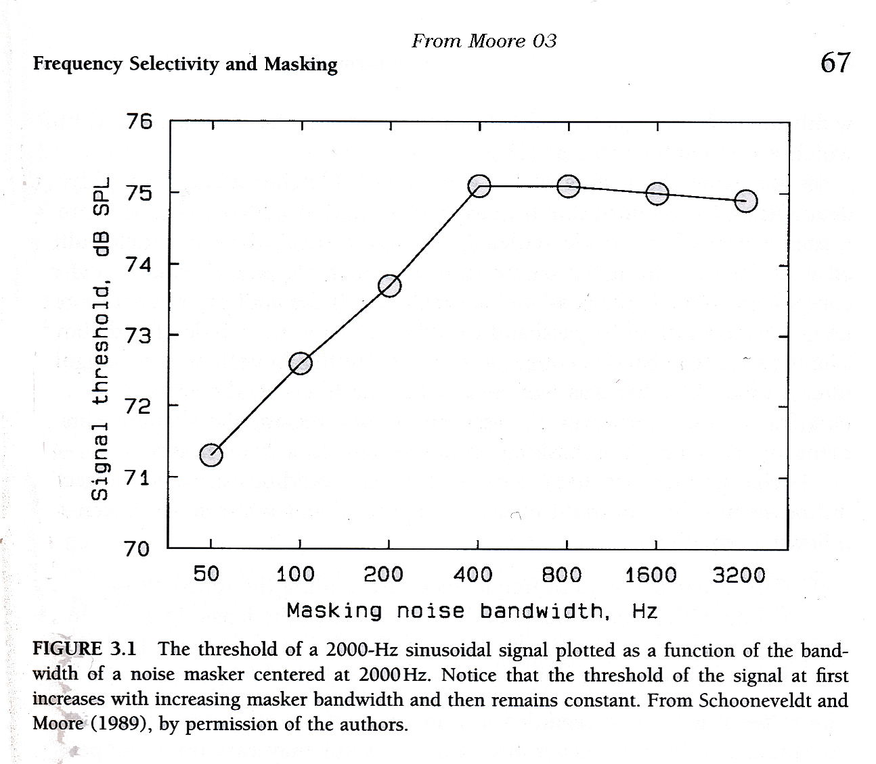
A sine (signal) in the presence of noise that has a band width (in frequency) centered around the signal.
critical band
Past a particular frequency width the masking doesn’t increase.
The wider the noise bandwidth the more the signal (sine wave) is masked.
critical band

Slide 52
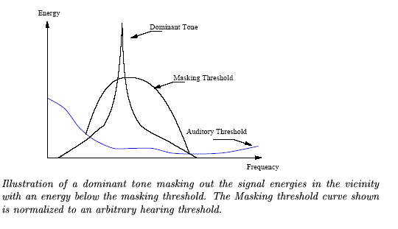
Masking
If a dominant tone is present then noise can be added at frequencies next to it and this noise will not be heard. Less precision is required to store nearby frequencies.
13dB
critical band

Slide 53
13 dB miracle
If the signal is 13 dB louder than the noise then the noise can’t be heard (within a band).
Each sub-band is quantized differently depending upon the masking threshold estimated in that band

Slide 54
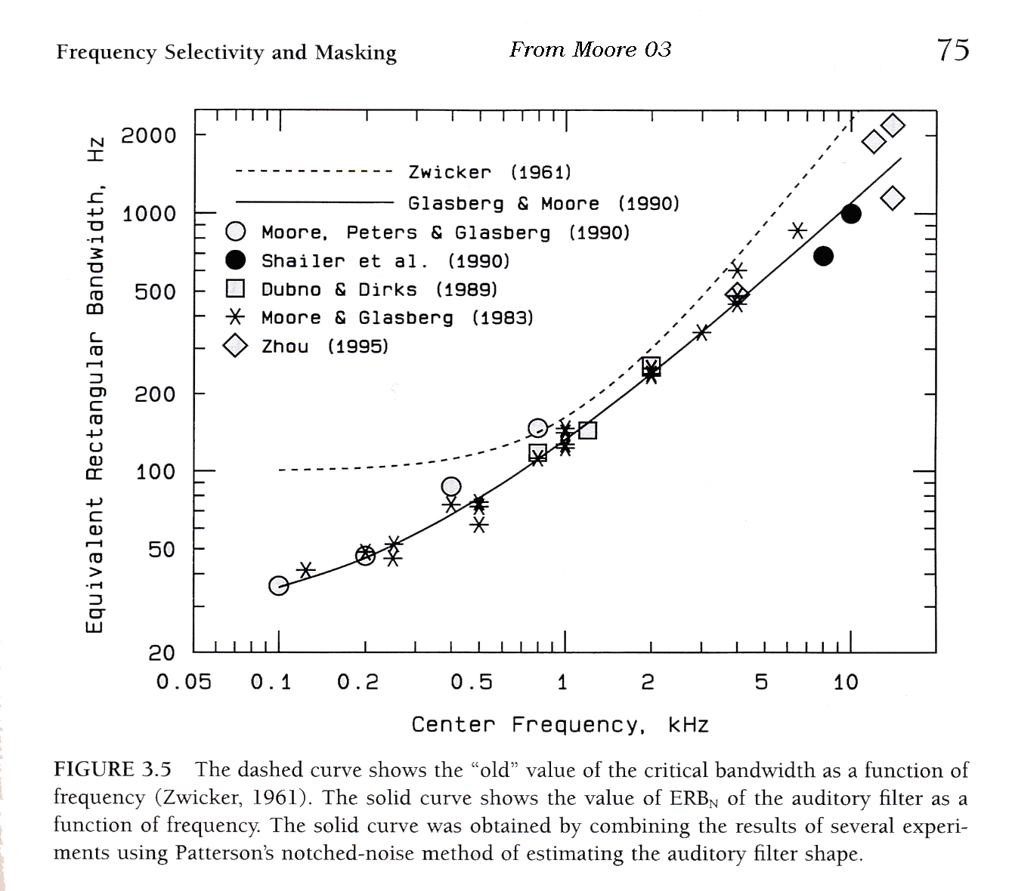
Critical band width as a function of frequency
Size of critical band is typically one tenth of the frequency

Slide 55
Critical band concept
Only a narrow band of frequencies surrounding the tone – those within the critical band contribute to masking of the tone
When the noise just masks the tone, the power of the tone divided by the power of the noise inside the band is a constant.

Slide 56
The nature of the auditory filter
The auditory filter is not necessarily square – actually it is more like a triangle shape
Critical band width is sometimes referred to as ERB (equivalent rectangular bandwidth)
Shape difficult to measure in psychoacoustic experiments because of side band listening affects -some innovative experiments (notched filtered noise + signal) designed to measure the actual shape of the filter).

Slide 57
Physiological reasons for the masking
Basal membrane? The critical bandwidths at different frequencies correspond to fixed distances along the basal membrane.
However the masking could be a result of feedback in the neuron firing instead. Negative reinforcement or suppression of signals. Or swamping of signals.

Slide 58
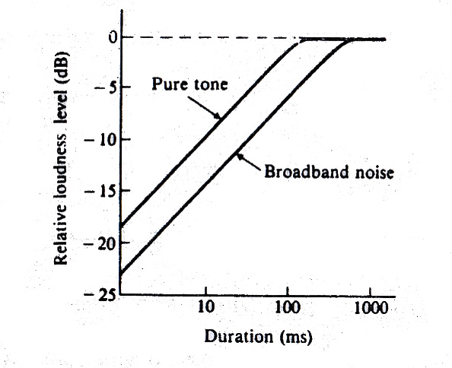
Temporal integration
ASA demo8
Bursts are perceived to be louder if they are longer –up to a particular threshold time
Notes:
Asademo8

Slide 59
Temporal effects - non-simultaneous masking
The peak ratio of the masker is important -- that means its variations in volume as a function of time compared to its rms value. Short loud peaks don’t necessarily contribute to the masking as much as a continuous noise.
Both forward and backward masking - masking can occur if a loud masker is played just after the signal!
Masking decays to 0 after 100-200ms

Slide 60
Physiological explanations for temporal masking
Basal membrane is ringing preventing detection in that region for a particular time
Neurons take a while to recover - neural fatigue

Slide 61
Outside the critical band
If the two sounds are widely separated in pitch, the perceived loudness of the combined tones will be considerably greater because they do not overlap on the basilar membrane and compete for the same hair cells.

Slide 62
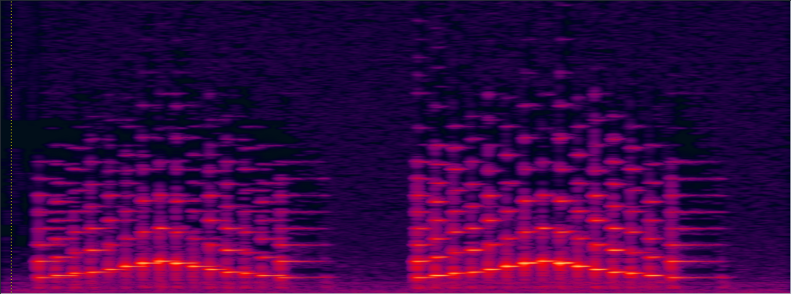
Pushing MP3 to its limits
-uncompressed
-over compressed mp3
Above compressing to 60kbps
Using home.c4.scale.AIFF show mp3 options DEMO with Audition to experiment
Notes:
home.c4.scale.mp3
home.c4.scale.A.mp3

Slide 63
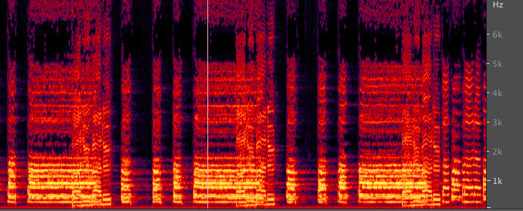
mp3 compressions
.wav 11.9MBytes
192 Kbps (44100Hz) 414KBytes
56 Kbps(44100Hz) 246KBytes
32 Kbps(22050Hz) 143KBytes
8Kbps(8000Hz) 45KBytes
bps=bits per second
Notes:
cosmic_clip.mp3
cosmic_clip_1.mp3
cosmic_clip_3.mp3
cosmic_clip_2.mp3

Slide 64
Recommended Reading
Moore Chap 4 on the Perception of Loudness
Berg and Stork Chap 6 pages 144-156 on the dB scale and on the Human Auditory System or Hall chapters 5+6
On Room acoustics: Berg and Stork Chap 8 or Hall Chap 15.

