Slide 1
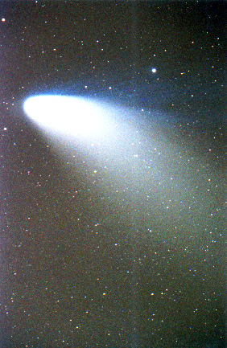
I am like a slip of comet, Scarce worth discovery, in some corner seen Bridging the slender difference of two stars, Come out of space, or suddenly engender'd By heady elements, for no man knows; But when she sights the sun she grows and sizes And spins her skirts out, while her central star Shakes its cocooning mists; and so she comes To fields of light; millions of travelling rays Pierce her; she hangs upon the flame-cased sun, And sucks the light as full as Gideons's fleece: But then her tether calls her; she falls off, And as she dwindles shreds her smock of gold Between the sistering planets, till she comes To single Saturn, last and solitary; And then she goes out into the cavernous dark. So I go out: my little sweet is done: I have drawn heat from this contagious sun: To not ungentle death now forth I run.
Gerard Manley Hopkins

