Slide 1
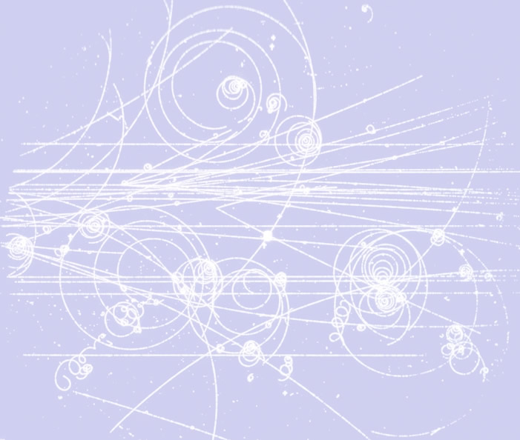
Impulse, Momentum and Collisions

Slide 2
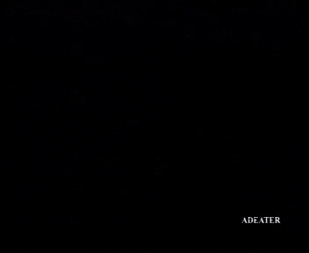
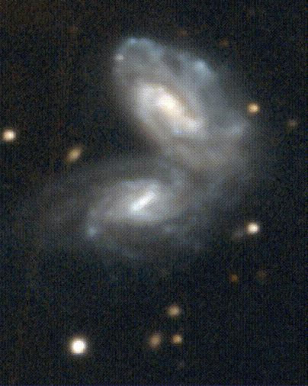
Interactions and Impulse – a quick reminder of things you already know
From
  an expertly placed shot in a soccer match
  to the violent tug-of-war between galaxies
it all boils down to interactions and impulse

Slide 3
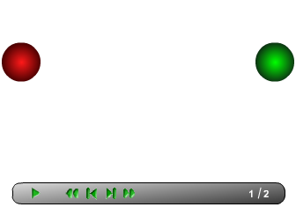
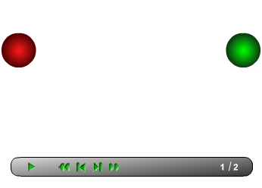
Collisions
What happens when two bodies collide?
The two bodies exert equal and opposite forces on each other and for equal amounts of time. They exert equal and opposite impulses.

Slide 4

Impulse
Impulse is the simple combination for Force and Time. We can express this as
A simpler way to understand this is to recognize that impulse appears as the area under a Force-Time graph.
go to the MAP pages on Impulse and Collisions

Slide 5
Conservation of Momentum and Impulse
It is easy to see how the idea of “equal and opposite impulses” (just and extension of Newton’s Third Law) leads naturally to the idea of momentum and the Law of Conservation of Momentum.
go to the MAP pages on Collisions and Conservation of Momentum

Slide 6
Two Key Conservation Laws…
To understand a collision we need to consider both CoM and CoE
Question: How could you express CoM and CoE graphically? How would a “CoM” graph differ from a “CoE” graph?
Go to MAP tutorial on 1D-collisions

Slide 7
Coefficient of Restitution
Introduced into physics by Christian Huyghens
Arises naturally from CoM and CoE

Slide 8
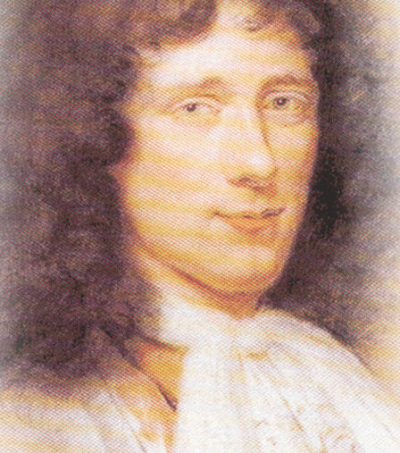
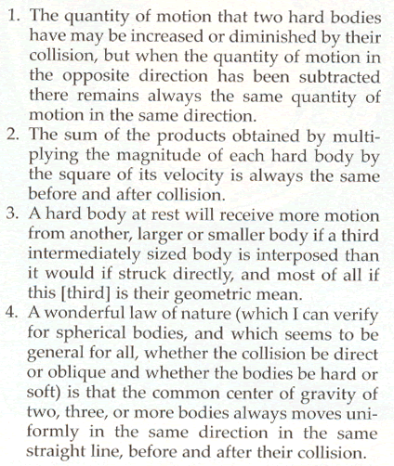
Christian Huygens
(1629-1695)

Slide 9
Sample…
A 3kg mass moving at +2 m/s collides with a stationary mass of 5 kg. The collision is not perfectly elastic (e = 0.8). Determine:
  Final velocity of each mass
  Kinetic energy of each mass after the collision as well a K_{cm}.
  Fraction of K lost in the collision. Where did this energy go?

Slide 10
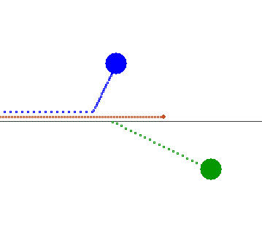
Collisions in 2 and 3 D…
Nothing new! Just repeat previous steps in each dimension
Show that the collisions produced by the applet collide2D produce correct results

