Slide 1
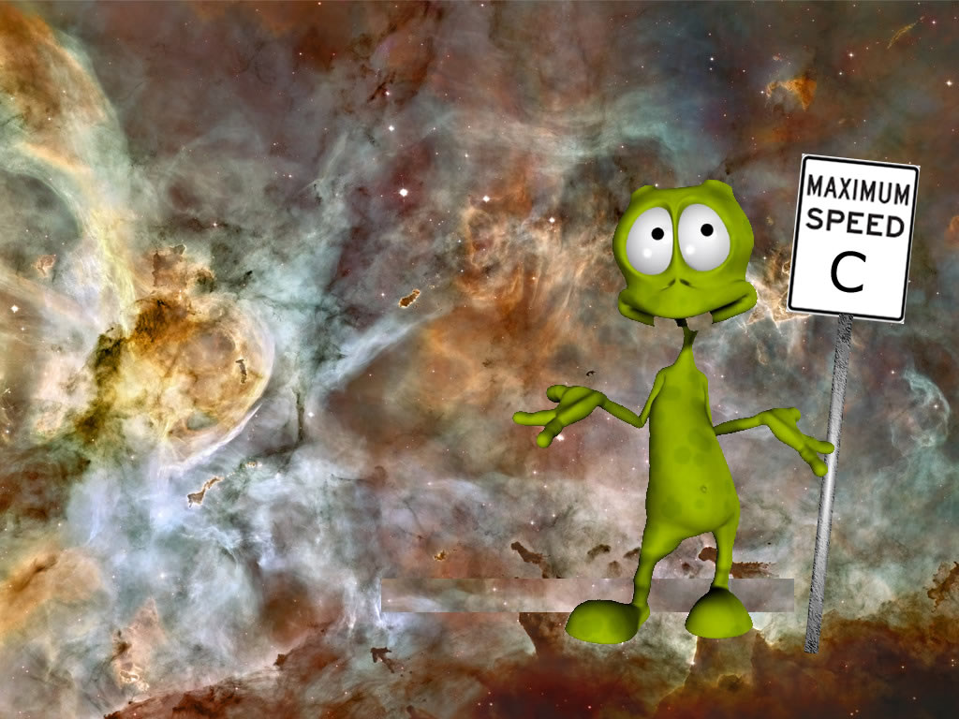
The Cosmic Speed Limit

Slide 2
Why “C” is the universal speed limit…
Causality demands it!
Look at “gamma”
The velocity addition formula

Slide 3
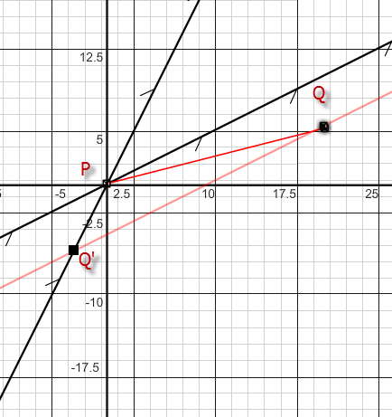
Looking at Causality…
Event P is the test firing of an experimental laser canon. Event Q is the destruction of a Klingon supply ship. Could event P have caused event Q?
Cosmic Rule: temporal order must be preserved!

Slide 4
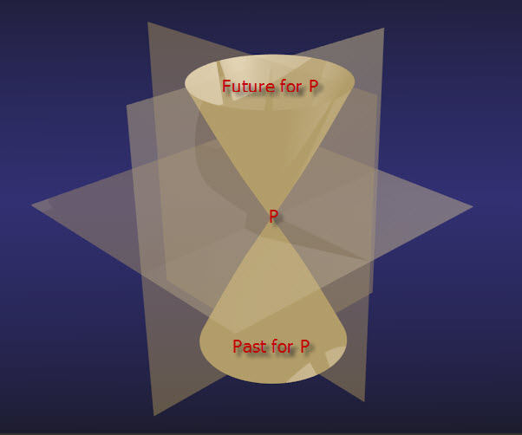
Classifying Spacetime Intervals

Slide 5
Velocity Addition Formulae
Use the Lorentz transformations to show that

