Slide 1
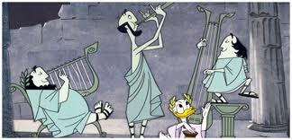
Musical Scales
Special thanks to Alice Quillen
Notes:
donald_duck_pyth_clip.mp3
play in quicktime or in VLC

Slide 2
Diatonic scale
Major scale
W | W | H | W | W | W | H

Slide 3
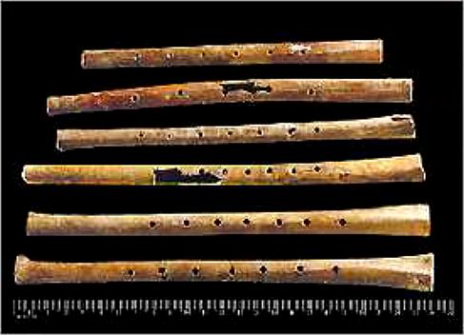
How universal is this scale?
9,000 Year Old Chinese Flutes JUZHONG ZHANG et al. Nature 1999
Excavations at the nearly Neolithic site of Jiahu in Henan Province China have found the earliest completely playable tightly dated multinote musical instruments
One of these flutes can be played: check the file K-9KChineseFlutes.ram

Slide 4
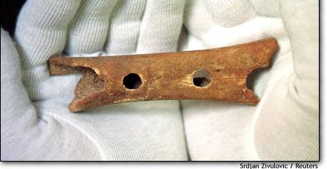
Neanderthal flute
This bear bone flute, found in Slovenia in 1995, is believed to be about 50,000 years old.
Differing hole spacing suggest a scale with whole and half note spacings

Slide 5
Overtones of the string

Slide 6
Diatonic scale
Fifth
Notes that are octaves apart are considered the same note. x2 in frequency
An octave+ 1fifth is the 3rd harmonic of a string, made by plucking at (1/3) of the string
If f is the frequency of the fundamental then the third harmonic is 3f
Major scale
W | W | H | W | W | W | H
Drop this down an octave (divide by 2) and we find that a fifth should have a frequency of 3/2f

Slide 7
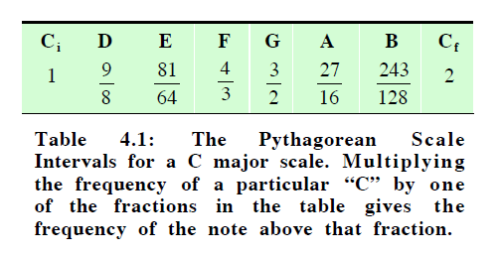
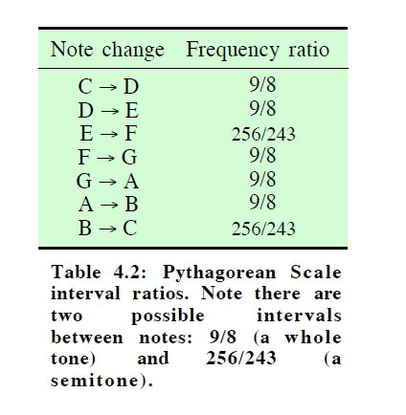
The Pythagorean Scale

Slide 8
Pythagorus and the circle of fifths
Image from Berg + Stork
Every time you go up a fifth you multiply by 3/2. Every time you go down an octave you divide by 2.

Slide 9
Pythagorean scale (continued)
third
fourth
The major third is up a fifth 4 times and down an octave twice
The fourth is up an octave and down a fifth

Slide 10
Pythagorean scale (continued)
minor third
sixth
The sixth is up a fifth 3 times and down an octave once
The minor third is down a fifth three times and up and octave twice.

Slide 11
Pythagorean scale (continued)
1 |  |  |  |  |  |  | 2
third
fourth
fifth
sixth
octave
frequency
The musical scale related to pure fractions! Mathematical beauty is found in music.

Slide 12
The circle doesn’t exactly close
What happens if you go up by a fifth 12 times? The circle of fifths leads us to expect that we will get back to the same note.
(3/2)¹²=129.746337890625
An octave is 2 times the base frequency
7 octaves above is 2⁷ times the base frequency.
2⁷=128.0000
However 2⁷≠ (3/2)¹²

Slide 13
Getting all the notes
One fifth has to be bad. The Wolf fifth.
So the subdominant chords can be played the bad fifth is placed between C# and A

Slide 14
Circle of fifths
Guides harmonic structure and key signatures for baroque, romantic and much folk music.
Keeping chords in tune in one key is sufficient for much of baroque and folk music.

Slide 15
Equivalency over the octave
We associate notes an octave apart as the same note
It is difficult to determine the octave of a note. Some people sing an octave off by mistake.
Other animals (birds) will not recognize songs played in a different octave

Slide 16
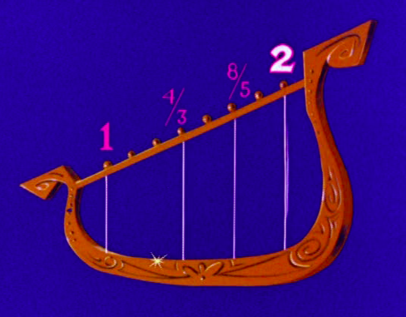
third of longest string
fifth of long
string
2 x 2/3
2 x 4/5
Pythagorean third:
In frequency 3⁴/2⁶
In length
2x 2⁶ /3⁴
plucked is a major chord

Slide 17
Perfect fifths and thirds
What’s so perfect about the perfect fifth?
We started with a harmonic 3f and then took it down an octave to 3f/2 Frequency ratio 1:3/2
Is the Pythagorean third perfect?
Fifth harmonic 5f is 2octaves +a major third
Take this down two octaves and we find a major third should be 5f/4 = 1.25f.
Frequency ratio 1:5/4
However the Pythagorean major third is 1:(3⁴/2⁶)=1.2656

Slide 18
What do they sound like?
Perfect fifth with frequency ratio 1:3/2
Wolf fifth
(between C# and A ) 1:218/311=1.4798
Perfect third
1:5/4
Pythagorean third 1:34/26=1.2656
I used the generate tones function in the old Audition
Sequence:
Sum of 2 sines perfect, interval followed by Pythagorean interval
Then sum of 2 sets of 5 harmonics, perfect interval followed by Pythagorean interval
Notes:
fiths.mp3
thirds.mp3

Slide 19
What do the waveforms look like?
One of these is a perfect third, the other is the Pythagorean third. Which one is which?

Slide 20
Perfect intervals and periodic waveforms
A sum of perfect harmonics adds to a periodic wave --- for sum of frequencies that are integer ratios - Fourier series
However 5/4 (prefect major third) is not an integer times 1 --- so why does the sum of two frequencies in the ratio 1:5/4 produce a periodic waveform?

Slide 21
Major and minor chords
Perfect major third and fifth
Frequency ratios 1:5/4:3/2
For the triad
Minor chord: set the major third.
Divide the G frequency by 5/4 so that the G and E give a perfect third.
3/2*4/5=6/5
Frequency ratios 1:6/5:3/2 for the triad
Major Minor
Minor third
Major third
Notes:
majorchord.mp3
minorchord.mp3

Slide 22
Triads
Major triad with perfect major third and fifth 1:5/4:3/2 The minor third in the triad has ratio 3/2 divided by 5/4 = 6/5 and so is perfect or true.
However other thirds and fifths in the scale will not be true.

Slide 23
Just temperament
More than one tuning system which use as many perfect ratios as possible for one diatonic scale.
Image From Berg and Stork

Slide 24
The Just Scale
Two different whole tones
T1 = 9/8 = 1.125
T2 = 10/9 = 1.111
One semitone
S = 16/15 = 1.067

Slide 25
Listening example (from Butler)
An ascending major scale beginning on C4, equal temperament followed by the chord progression I-IV-V7 in Cmajor and in F# major.
The same scale but with Pythagorean tuning, followed by the same chord progression
The same scale and chords, quarter comma meantone temperament (errors distributed in a few tones)
Just intonation
Notes:
ButlerTrack3.12.mp3 extracted from CD Track3

Slide 26
Meantone temperament
In general, a meantone is constructed the same way as Pythagorean tuning, as a chain of perfect fifths, but in a meantone, each fifth is narrowed in order to make the other intervals like the major third closer to their ideal or perfect just ratios.
Quarter-comma meantone is the most well known type of meantone temperament, and the term meantone temperament is often used to refer to it specifically.
Uses exact 5:4s for major thirds, but flattens each of the fifths by a quarter of a syntonic comma where a syntonic comma is equal to the frequency ratio 81:80, or around 21.51 cents.

Slide 27
Just intonation
Desirable if only a few instruments are playing
You want that ringing baroque quality
You are only going to play in one or two keys.

Slide 28
Equal temperament
Desirable properties of this scale:
Sounds okay for all triads for all keys.
Allows instruments in different keys to play together more easily
Give up perfect fifths and thirds for a scale that is good for any key
Makes rapid key changes possible. Led to the development of a different type of music.

Slide 29
12 tones
To make a tempered scale we need to fit 12 notes within an octave -- between f and 2f
How can we do this?
Linearly f(1+n/12)? where n are integers
C | C# | D | D# | E | F | F# | G | G# | A | A# | B | C
1 | 13/12 | 7/6 | 5/4 | 4/3 | 17/12 | 3/2 | 19/12 | 5/3 | 7/4 | 11/6 | 23/12 | 2
Problems with this: 1) it sounds bad, 2) Makes no sense in the next octave where interval would have to be 2f/12

Slide 30
Equal Temperament
How else can we make 12 even divisions between 1 and 2?
2) With multiplicative factors: A^{n} where A is a factor and n are integers → Even in log space
A⁰=1.0 and we want A¹²=2.0.
Solve this (take the 12th root of both sides of the equation). We find A = 2^{1/12}=1.05946
C | C# | D | D# | E | F | F# | G | G# | A | A# | B | C
1 | 1.059 | 1.1225 | 1.1893 | 1.2601 | 1.3351 | 1.4145 | 1.4987 | 1.5978 | 1.6823 | 1.7824 | 1.8885 | 2
Not too far from a perfect third
Pretty close to a perfect fifth
Nearly a perfect fourth

Slide 31
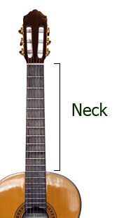
Equally spaced by multiplicative factors
The closer to the bridge the closer the frets
How big is 2^{1/12}?
Notes:
answer 1.06

Slide 32
Listening examples, log and linear spacings
ASADemo18
8 note diatonic scale
13 note chromatic scale
Notes:
ASADemo18a.mp3
ASADemo18b.mp3

Slide 33
Tempered scale octaves

Slide 34
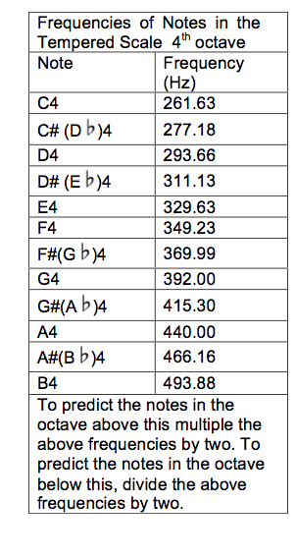
Frequencies
Tempered scale
C4=middle C on the piano
A4 = concert A

Slide 35
Cents
The cents scale
Cents=1200 log₂(f/f₁)
If f/f₁ = 2, then
The octave = 1200 cents
The interval between two scale notes that are a half step apart is 100 cents
Notes:
if not covered previously

Slide 36
Turning notes and cents into frequencies
What is the frequency of C#4 +25cents
C#4 is 277.18Hz
2^{25/1200}=1.0145453
277.18 x 2^{25/1200} = 281.21 Hz
What if I want C#4 -25 cents?

Slide 37
Equal temperament
Intervals are NOT exact integer ratios.
What does it mean to add two sine waves that are not integer multiples of each other?
------ What difference is there in the waveform?

Slide 38
Attempts at new scales Harry Partch’s tuning
American composer Harry Partch (1901-1974) based all of his mature musical compositions on a musical scale tuned in just intonation and based on the 11-limit tonality diamond, played on instruments he designed and built himself to be played in that tuning. The number of notes varied for a time from about 29 to 55, until he finally settled on a scale of 43 tones to the octave (his identity interval, which Partch always referred to by its frequency ratio 2/1).
Partch's tuning is often called "extended just intonation", because traditional just intonation used ratios with only the prime-factors 2, 3, and 5, whereas Partch added 7 and 11 to these.
As described by Joe Monzo

Slide 39
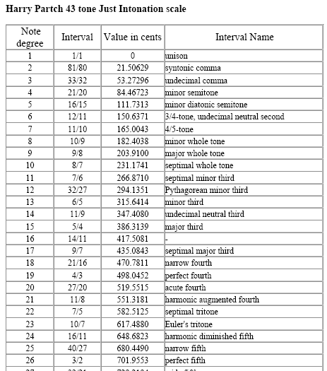
from http://www.microtonal-synthesis.com

Slide 40
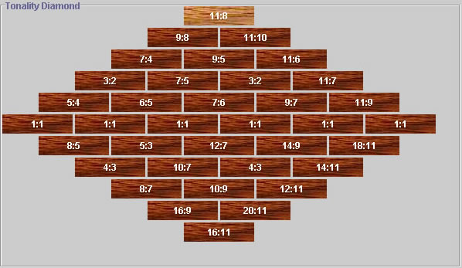
Partch’s tonality diamond
Check out a version on this web site that lets you listen to the notes http://prodgers13.home.comcast.net/Sub_Pages/DiamondMarimba.html

Slide 41
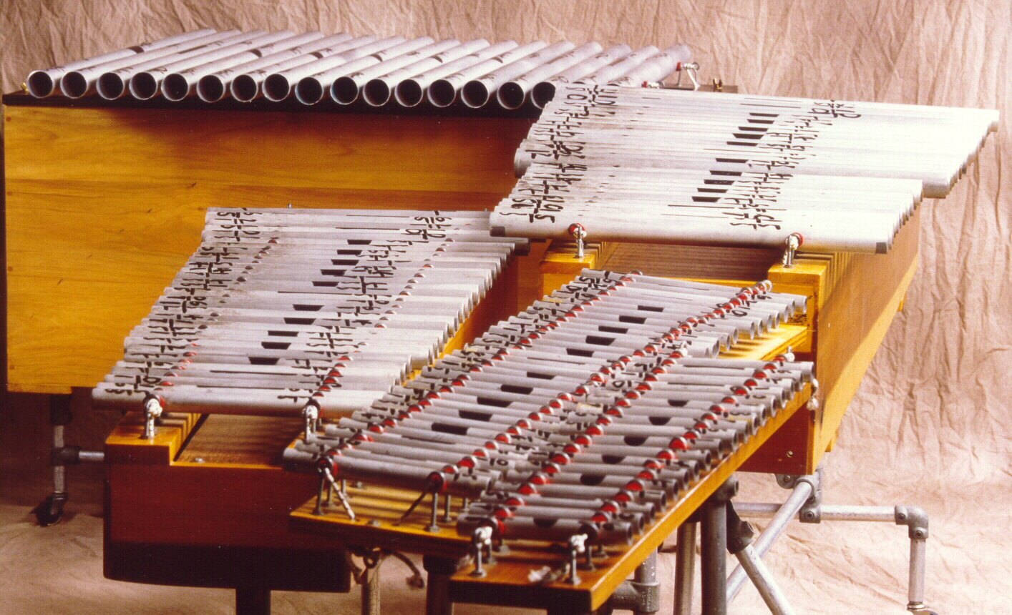
Partch’s and Partch-era compositions
Two Studies on Ancient Greek Scales
`Columbus’ by Dean Drummond
For flute (Stefi Starrin)+zoomoozophone (Dean Drummond, Dominic Donato, James Pugliese) -- percussion instrument with 31 tones
From the CD Microtonal Works by Partch, Cage, LaBarbara, Drummond
Notes:
TwoStudiesonAncientGreekScales_Partch.mp3
Columbus_DeanDrummond.mp3

Slide 42
Microtonal music
This is a piece for flute, clarinet, finger piano, guitar, and percussion. It's based on the 10:11:12:13:14:16:18:20 septany.
By Prent Rodgers -for the downridders
Notes:
prentrodgers+forthedownriders.mp3

Slide 43
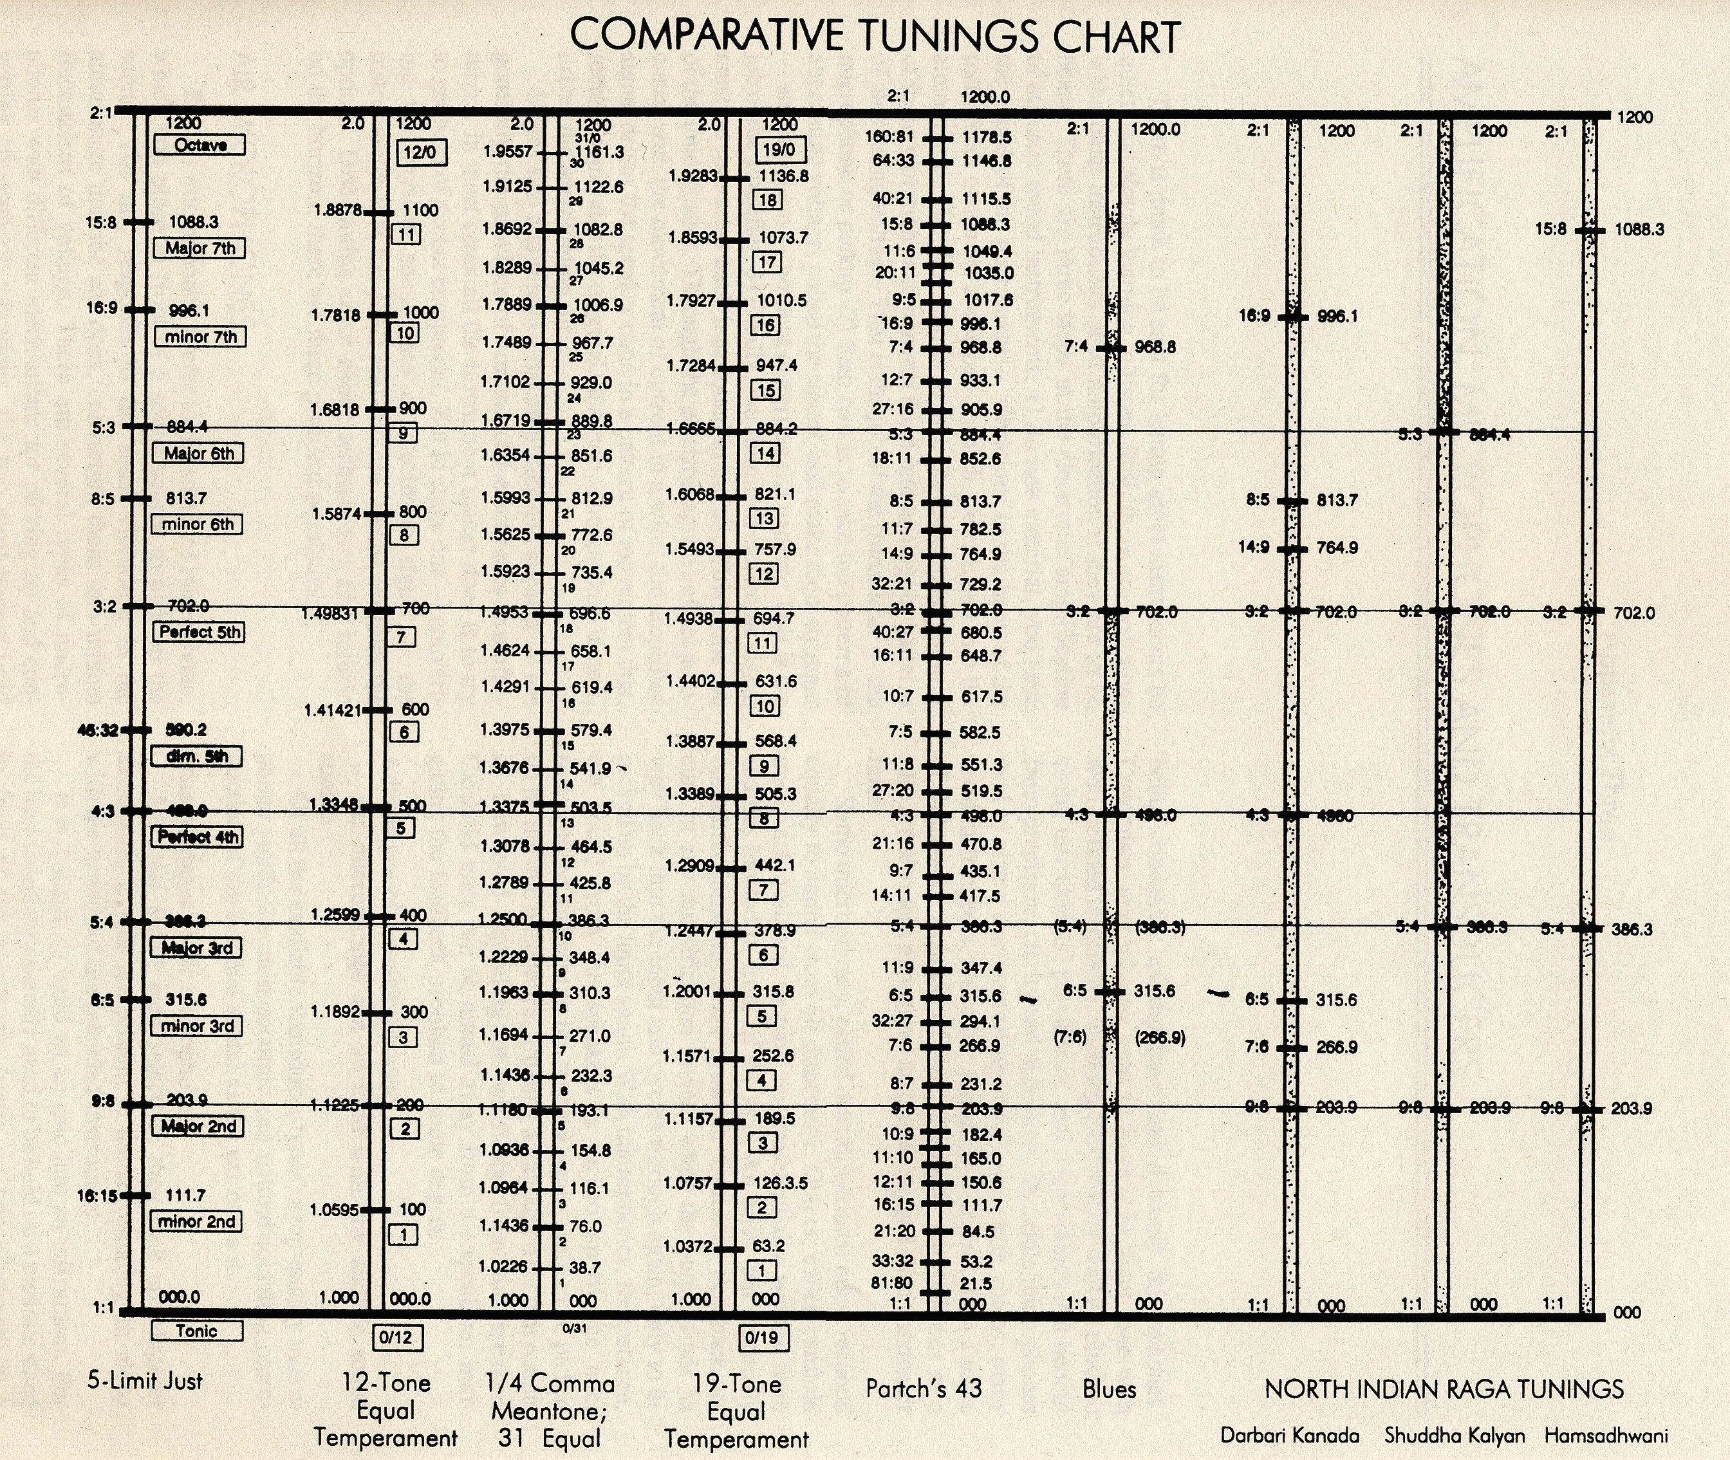
From Hopkin

Slide 44
19 tone tempered scale
“What happens when you play simultaneously in different tunings? Each note in this 19-tet melody is ``harmonized" by a note from 12-tet, resulting in some unusual nonharmonic sound textures. The distinction between ``timbre" and ``harmony" becomes confused, although the piece is by no means confusing.”
Incidence Coincidence by William A. Sethares
Played with an astral guitar built with 19 tones in each octave.
Sympathetic metaphor
Notes:
Incidence_Coincidence.mp3
Sympathetic metaphor.mp3

Slide 45
Adaptive tunings
As each new note sounds, its pitch (and that of all currently sounding notes) is adjusted microtonally (based on its spectrum) to maximize consonance. The adaptation causes interesting glides and microtonal pitch adjustments in a perceptually sensible fashion.
Three Ears by William A. Sethares
Notes:
Three_Ears.mp3

Slide 46
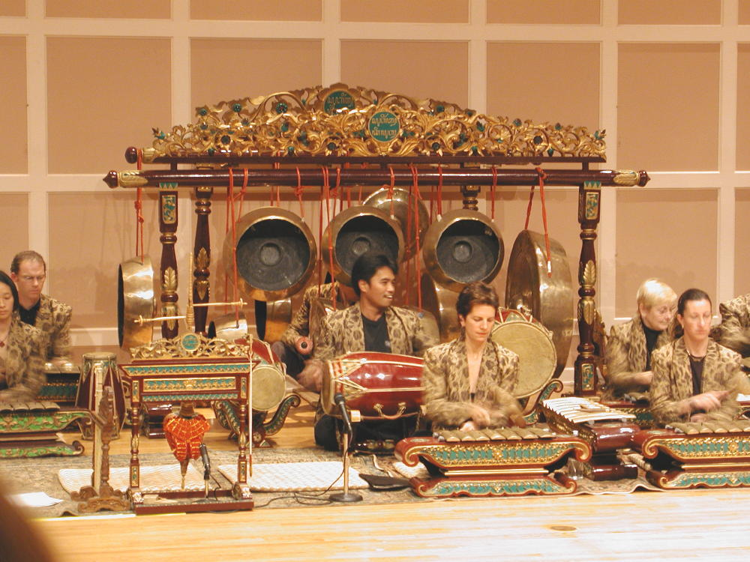
Gamelan tones
Cook demo 68 (From the book edited by Perry Cook)
Gamelon music example
Sample tune in Bali tuning
probe tone
Repeat of tune
another probe tone
Notes are out of tune compared to the tempered scale
Notes:
I would like to add music here Ab, D Eb, Ab, A Bb A Ab G ....
cookdemo68.mp3

Slide 47
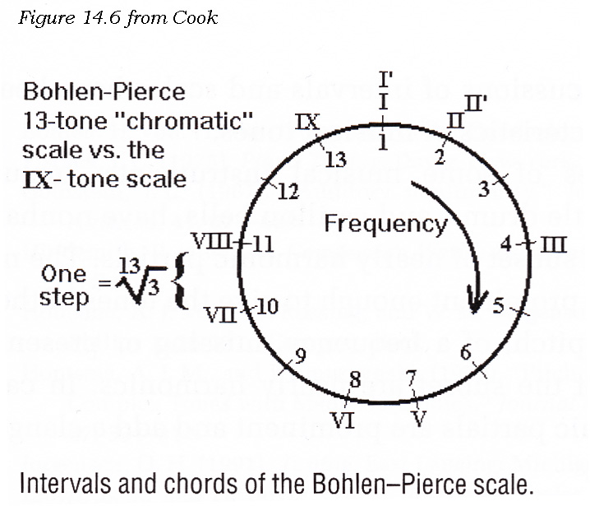
Pierce Scale
The Bohlen-Pierce scale repeats every tritave (1:3; 1: octave+5th) rather than every octave.
The tetrad 3:5:7:9 is fundamental to the scale.
13 chromatic tones separated by a factor
9 main scale notes from the 13
Cook demo 62
Notes:
Cookdemo62.mp3

Slide 48
Ragas
Based on the Raga guide (edited by Joep Bor)
7 basic tones or scale degrees are used in classic Indian music
Sa Re Ga Ma Oa Dha and Ni.
Twelve semitones are available. However typically only 7 are in the scale at a time. The first and fifth scale degree cannot be altered. However the other 5 can be adjusted. Lowered by a semi-tone (komal) Re Ga Dha Ni
Like flats
Raised by a semi-tone only Ma – tivra Like a sharp

Slide 49
Indian music and pitch
While Indian musicians have a great sense of accuracy in pitch, however there is no fixed or absolute pitch for notes.
Large microtonal variations... and these are carefully played by the musician.
What is a raga?
Associated with a particular theme scale and tune. Tonal framework for composition.
Ragas from CDs with the Raga Guide “A survey of 74 Hindustani Ragas”

Slide 50
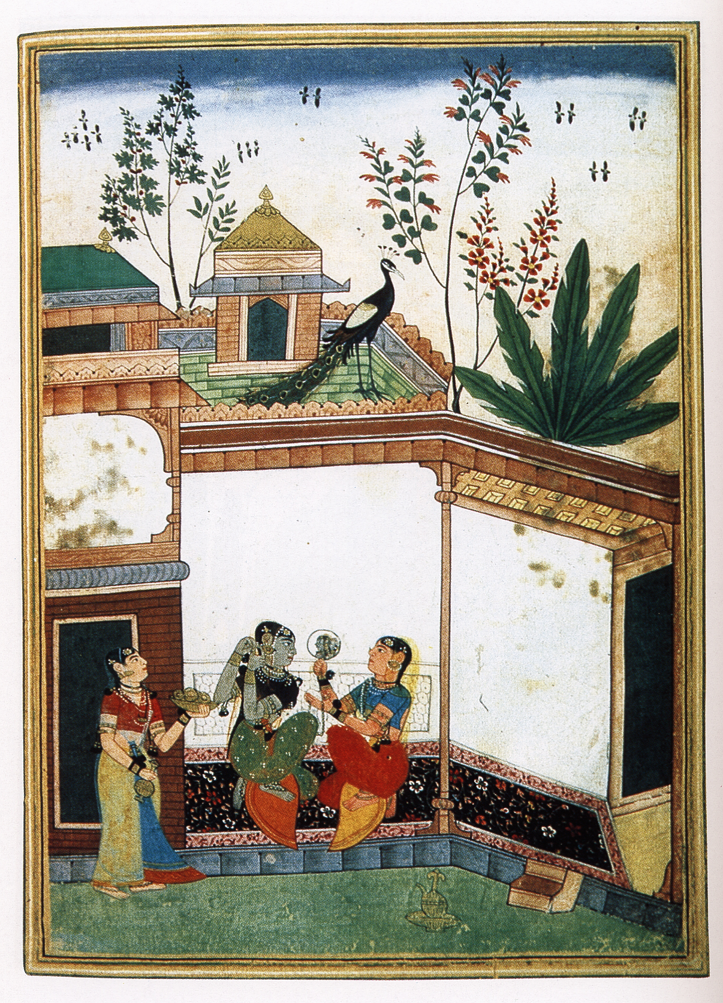
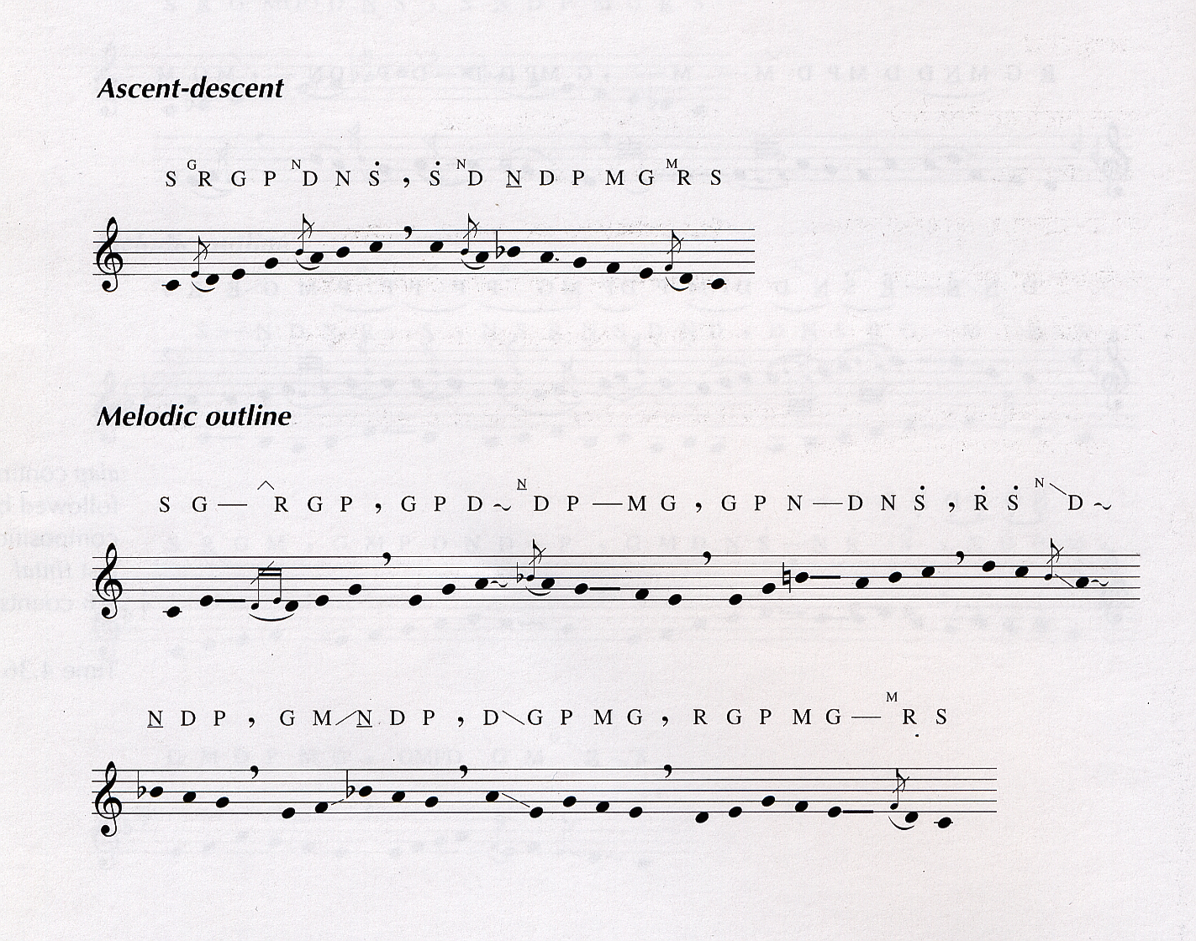
Alhaiya bilaval time: late morning –major scale
performed by Shruti Sadolikar-Katkar
Notes:
alhaiya_bilayal.mp3

Slide 51
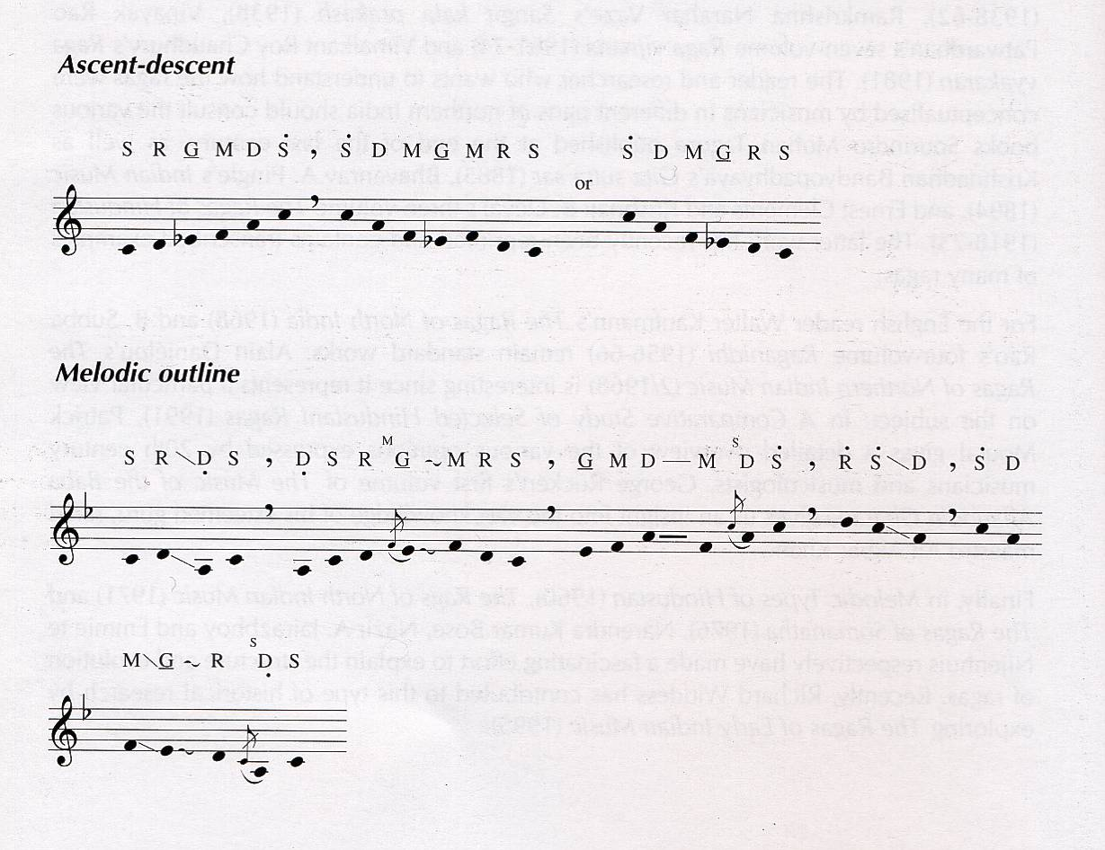
Abhogi - Early night
performance by Hariprasad Chaurasia
Notes:
abhogi.mp3

Slide 52
Recommended Reading
Berg and Stork Chap 9
Hopkin Chap 3 and appendix 2
Loy, Chapter 3

