Slide 1
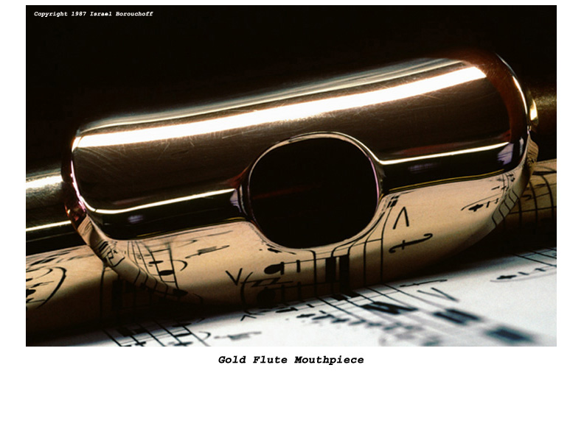
The Physics of Wind Instruments
Special thanks to Alice Quillen
Notes:
All flutes, piccolo, whirly pipe, sax, reeds, organ pipes, ocarina, harmonica, honk and quack pack
tuner, mic
solo music?

Slide 2
Normal modes of a column
No pressure variation,
large motions
No motions,
large pressure variations

Slide 3
Is the flute -an open column -a closed column or -one end open and other end closed?
How can we find out?
Notes:
Lower an octave or not when end is blocked
blow the harmonics

Slide 4
Experiments on the open pipe
Blocking the end
Half blocking the end
How are high notes made easier to play?
Harmonics of Flute
Frequency f is speed of sound c divided by wavelength λ
Fingering and pitch change. Effectively shortening the pipe.
Comparing the flute and the recorder lengths

Slide 5
Oscillating Air Stream

Slide 6
Pitch
What changes the pitch?
-Speed?
-Distance from mouth to edge?
-Covering of hole?

Slide 7
Blowing
Breathy sound:
How do you get rid of it?
High notes vs low notes:
What does the flutist do to change octave?
(whirly tube?)
Vibrato:
How does it change the sound?
(dynamics, timbre, pitch)
How does the flutist do it?
Notes:
whirly tube
overblow the flute and the recorders

Slide 8
Thumb hole
Favors the higher overtones allowing the flutist to play an octave higher without over-blowing. However the thumb hole is not in the correct place for every note in the octave. → fingering changes from octave to octave

Slide 9
Dynamics
As the vibration becomes larger, more harmonics appear. Loudness in most instruments is accompanied by a change in strength of overtones.
The flute does not have a big dynamic range. Why?
How do flutists compensate?

Slide 10
Perceptual fusion and voicing
Voices stand out if their overtones move together. If overtones don’t move in pitch then the sound does not sound like a voice. Tones with no variation in pitch sound dull.
Demo from Perry Cook’s book. A bell has many overtones. 3 groups of overtones are given different vibratos. As the vibrato grows three voices are heard separately.
Notes:
Cookdemo77.mp3

Slide 11
Adjusting pitch
The distance between the mouth and edge is fixed for a recorder. When you blow harder the note is sharper.
Flutists can compensate by turning the flute.
Some recorder players compensate with different fingerings for louder notes!
If you add vibrato exact pitch is less precise (add vibrato to allow louder notes to still be effectively in pitch)– vocalists do this too

Slide 12
Material of Flute
Does it matter? Wood vs metal. Silver vs. steel.
How about with recorders?
What part of the instrument mostly affects the tone?
Timbre, temperature and humidity.
Experiments with Heads
Record wooden flutes vs metal flutes

Slide 13
Wood vs metal flutes
wood flute – metal flute –

Slide 14
The modern flute (Boehm)
Larger holes and covering system
Key rings and coupling of keys
Cylindrical body and tapered head
How do these characteristics improve or change the sounds of the flute?
F# experiment, low high notes flute+recorder
Moving crown while playing low notes and then high notes
Notes:
One note open next to one closed upper + lower octaves
penny whistle vs recorder on octave changes

Slide 15
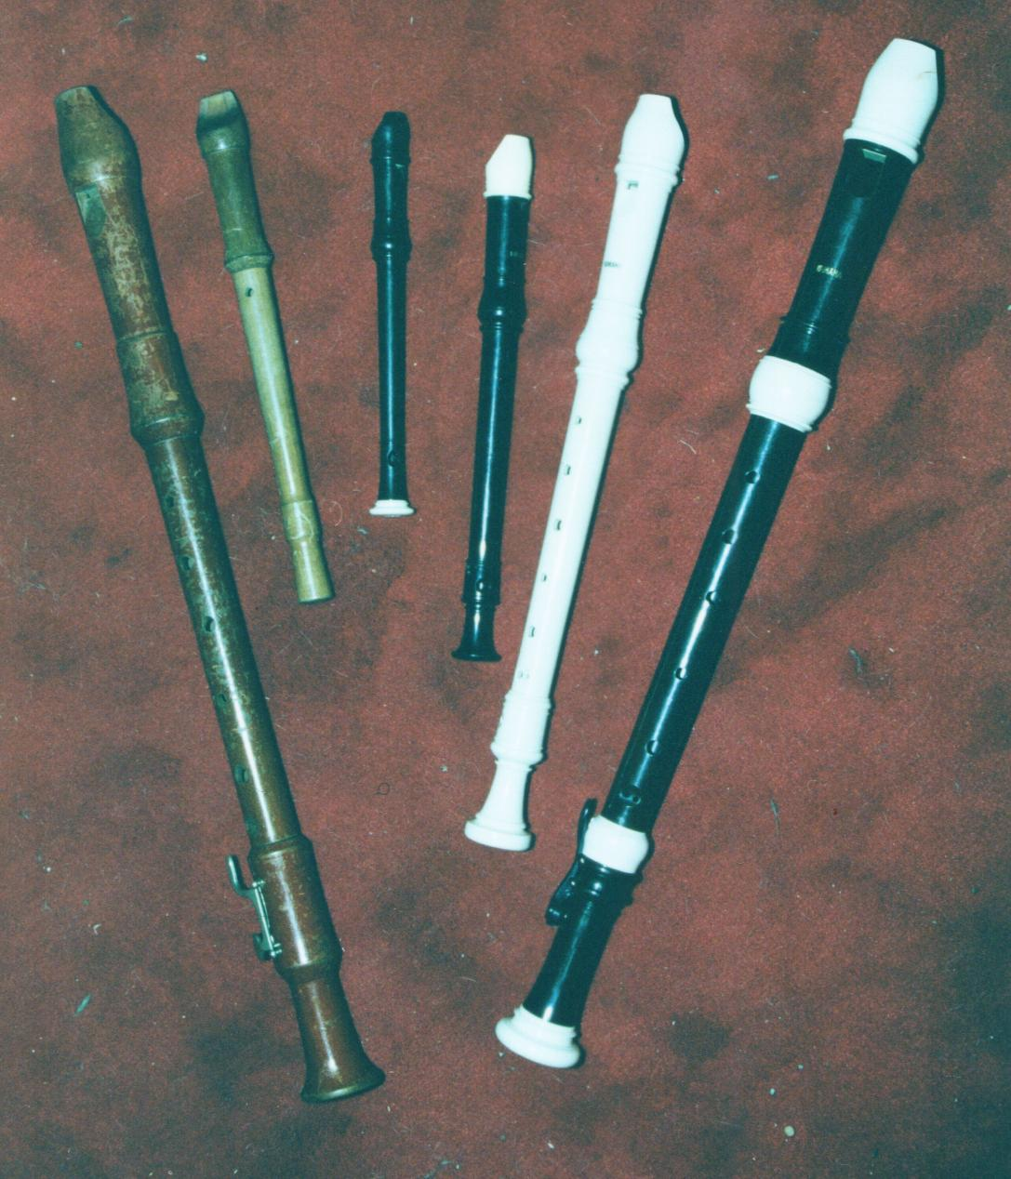
Recorders and tapered barrel
Taper improves higher octave tuning at the expense of some tonality and loudness
Experiment: octaves with penny whistles and recorder
Notes:
Recorder + penny whistle octave tests

Slide 16
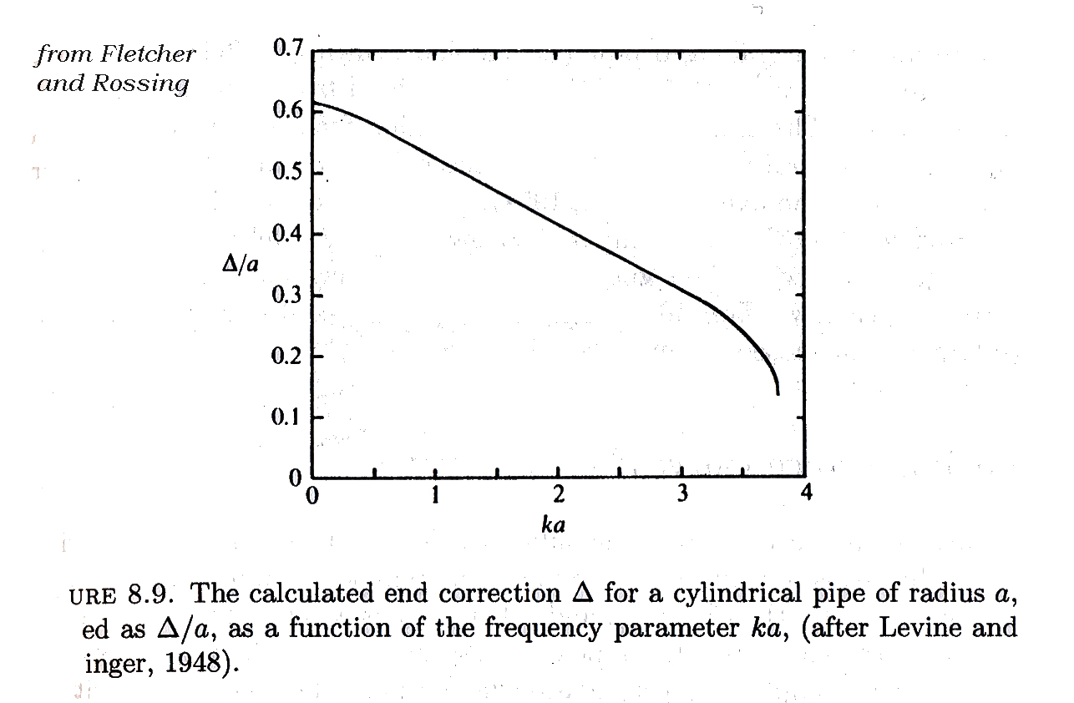
End correction
Effective length of pipe is L+Δ
Δ~0.61a where a is the diameter of the pipe
For a flanged pipe Δ~0.85a
As the end correction depends on wavelength, a flute is not in pitch across octaves. This leads to the design of tapered ends.

Slide 17
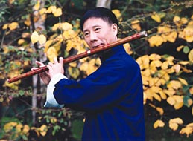
End correction
Width of the barrel does make a difference.
Experiment: diameter barrel
End of flute does change the pitch (see Chinese flute).
Placement of rice paper
near mouth so all notes
have extra vibration
Dizi

Slide 18
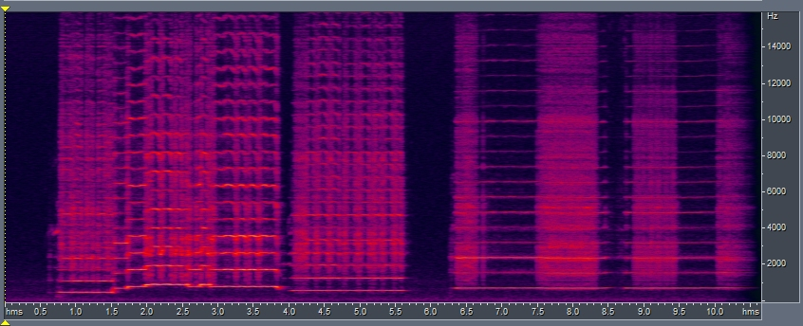
Chinese flute
Rice paper has its own vibrating frequencies and also adds noise

Slide 19
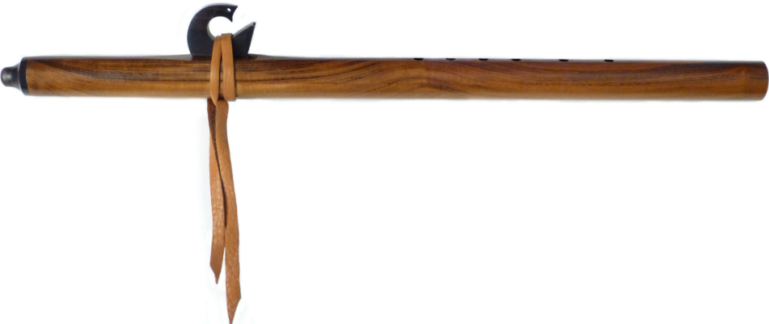
Native American-style Flute

Slide 20
Design of Mouthpiece
depth of mouthpiece determines pitch range for a single note

Slide 22
What sets diameter of bore?
Short fat bores are poorer in high overtones.
If the bore is too thin, the low overtones are difficult to excite (e.g. thin whirly tube).
This would suggest that one uses the same ratio of bore diameter to length for all instruments. However for low notes the sound is dull unless the high overtones are strong. In organs the lower pipes tend to be narrower. (2/3 diameter increase for a pipe twice as long).

Slide 23
Narrow vs Wide Flutes
Narrow flutes are better for high registers
Wider flutes louder and have richer timbre
e.g. Indian flutes vs penny whistle, piccolo, Japanese flute

Slide 24
Wide holes vs narrow holes
recorder vs bamboo flutes

Slide 25
Hole size and Flared ends
Louder sound if holes are larger
The sound that escapes through a hole depends on the wavelength. If the wavelength is much larger than the hole then not much sound radiates.
Low instruments tend to have bells at the end
Instruments with finger holes (meaning not brass) tend to lack bells.
Bells on instruments with holes (clarinets, oboes) tend to primarily affect notes played with nearly all holes closed.
Exceptions: bassoon (bass but no bell), sax (large holes and large bell), trumpet (has bell but is soprano)

Slide 26
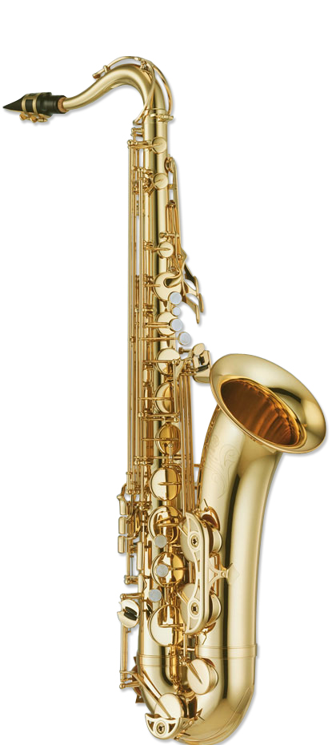
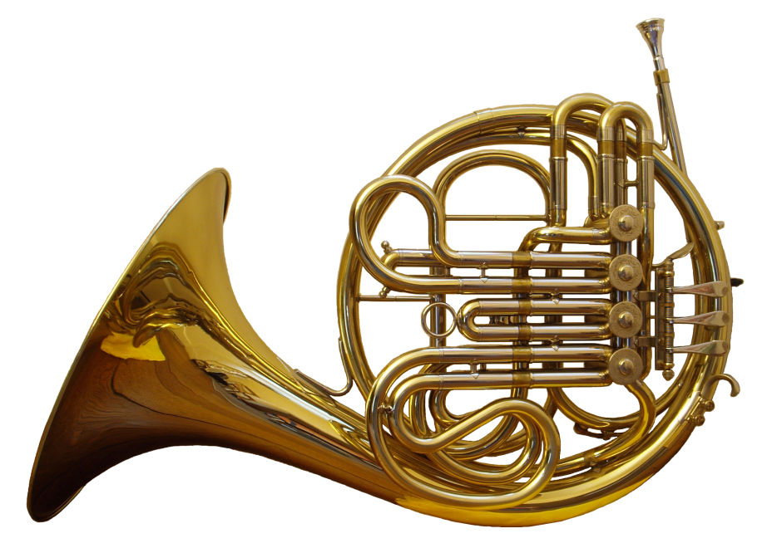

Slide 27
Flared ends and buildup of sound
The shape of the end sets boundary condition as a function of frequency.
If radiation is too efficient then sound won’t build up inside instrument. Trade off between build up and radiation.

Slide 28
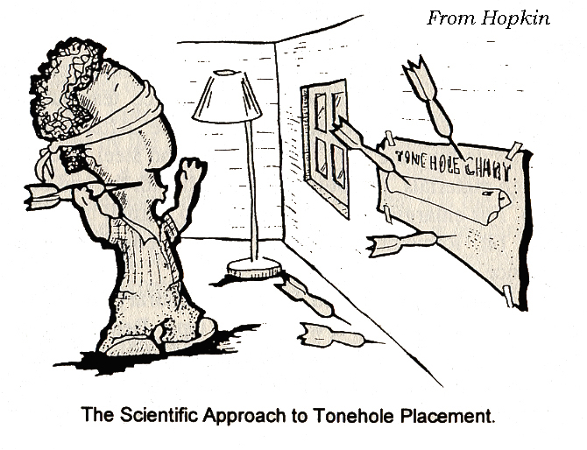
Calculating pitch
In practice it is difficult to calculate the pitches played by a flute as a function of positions and size of holes

Slide 29
Trends in pitch
To raise the pitch:
Larger holes
Decrease distance between holes and blow hole
Additional holes outside the last open hole
Decrease distance of cork from blow hole
Thicker barrel requires larger holes for same pitch
The smaller first open tone hole is, the more effect subsequent ones have in raising pitch
Subsequent holes have less effect on higher registers

Slide 30
Calculating effective lengths with corrections

Slide 31
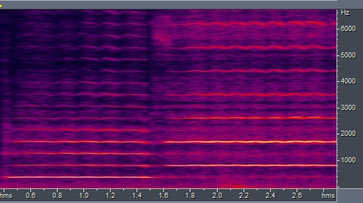
Octaves
Low octave overtones are present even in the higher note

Slide 32
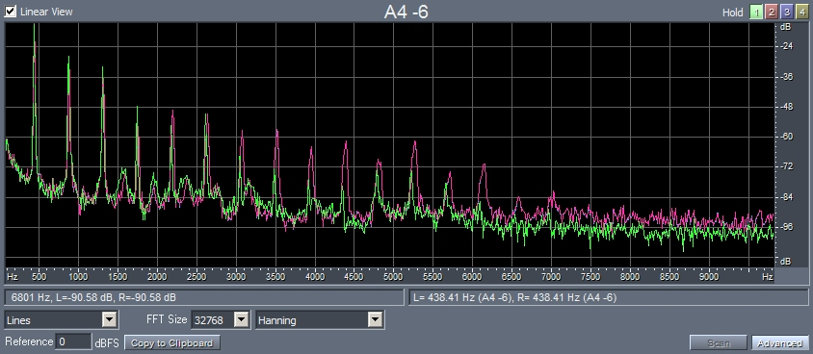
Differences between plastic and wood recorders

Slide 33
Wooden flutes
Differences:
Diameter
Holes, size, placement
Types of mouthpieces
Material/type of wood
Additional compromises
Requiring fingers to cover holes
No additional mouthpiece
Material
Restriction to one register

Slide 34
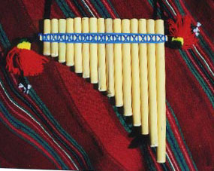
Pan Pipes
Solomon Islands – Pan pipes – from musical instruments of the world
Breathy sound
Closed end so an octave lower than a transverse flute

Slide 35
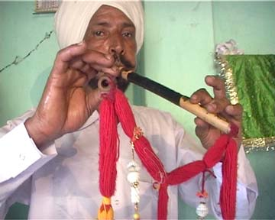
End blown flutes- Algoza (Rajasthan)
end blown, beveled end
one drone one melody flute
continuous blowing (circular breathing like the digeridu)

Slide 36
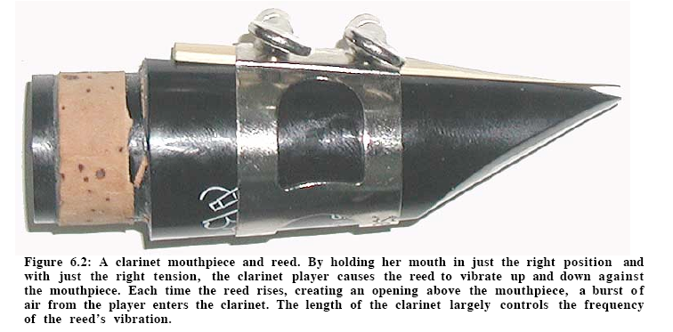
Reed Instruments
www.tufts.edu/as/wright_center/physics_2003_wkshp/book/

Slide 37
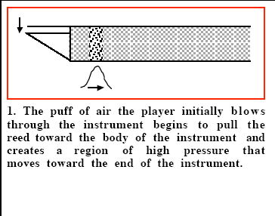
www.tufts.edu/as/wright_center/physics_2003_wkshp/book/

Slide 38
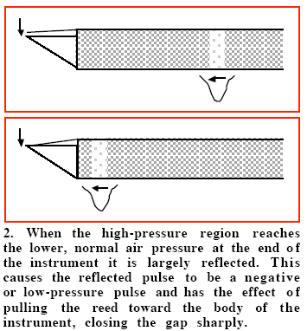

Slide 39
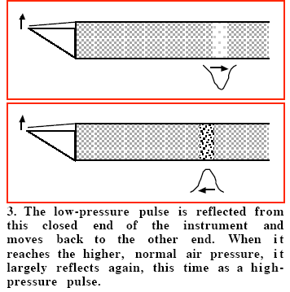

Slide 40
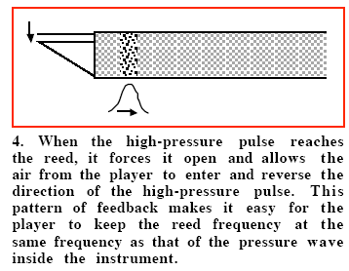

Slide 41
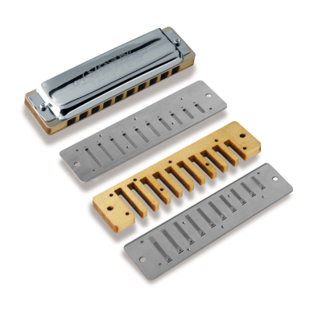
Harmonica
Length of reeds set pitch
Two sets of reeds, one for blow, other for draw

Slide 42
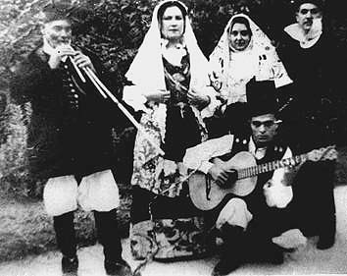
Sardinian triple clarinet -- Launeddas

Slide 43
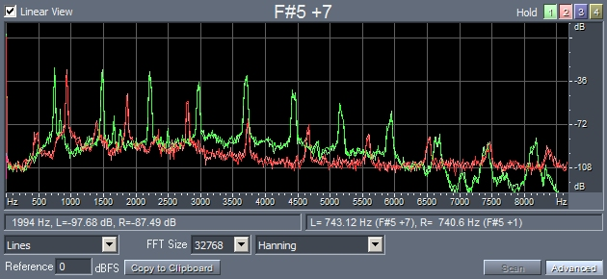
Spectrum of oboe vs flute
red is flute, green is oboe

Slide 44
Excitation for reed instruments
For excitation of tube of air
trap door analogy for clarinet reed
converting DC pressure into AC flow
image from http://www.phys.unsw.edu.au/jw/clarinetacoustics.html#reed

Slide 45
Timbre depends on how hard you blow
image from http://www.phys.unsw.edu.au/jw/clarinetacoustics.html#reed
Blow pressure affects the shape of the airflow curve and so the timbre. Blowing harder increases the strength of higher harmonics.

Slide 46
Excitation of digi

Slide 47
Other noises
sound recorded near mouth
sound recorded in room

Slide 48
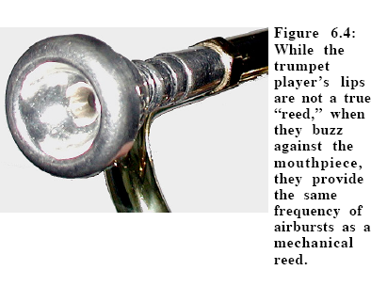
Note: the shape of the mouthpiece is important as it affects the high frequency response of the instrument!

Slide 49
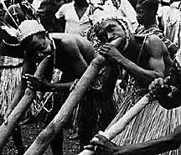
Wooden trumpets Central African Republic
Ongo ensemble of the Banda people consists of wooden and antelope horn trumpets

Slide 50
Closed/open pipe
Which instruments behave like closed ends?
Clarinet, oboe, brass, some pan pipes?
Which ones have open/open ends?
Organ, flute, recorders, organ pipes
We might expect odd integer overtones from the brass, however the bell at their end shifts the overtone spectra to nearly all integers

Slide 51
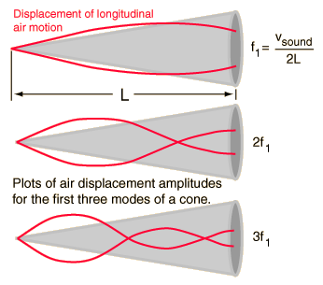
Wavelength shift due to conical bore
Easiest way to think of this is in terms of volume and air piling up at anti-nodes.
Mouthpiece cuts off the end of the cone but is an approximate match to volume of that cone.

Slide 52
Ocarinas
More like Helmholtz resonators.
Pitch is changed by adding holes

Slide 53
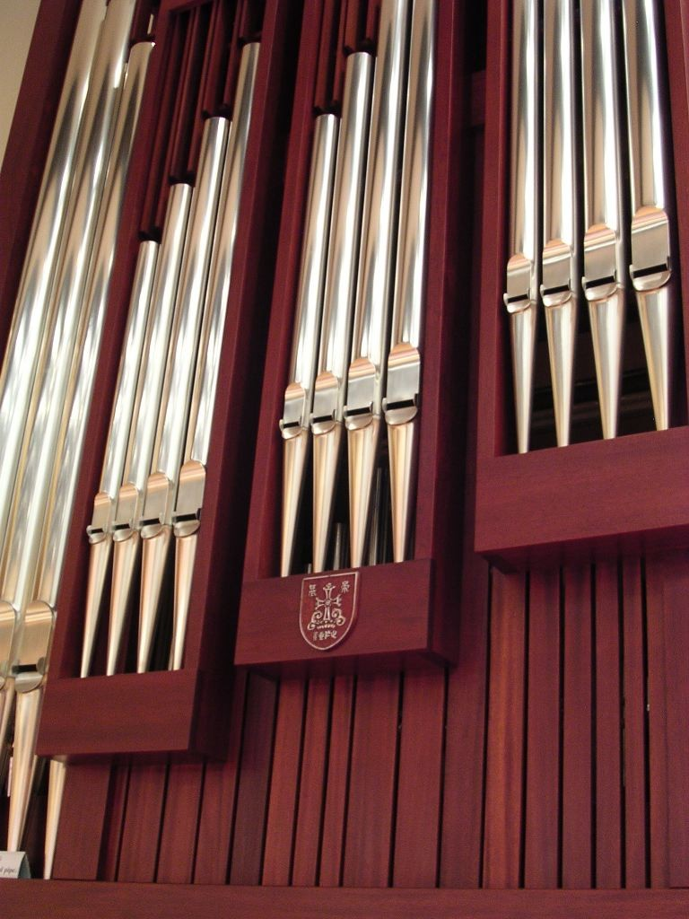
Organ pipes
Technological innovations led to improved air pumps in the late middle ages showcased in churches

Slide 54
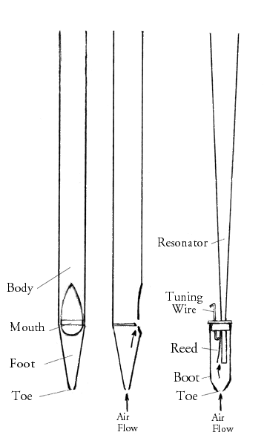
Types of organ pipes
open/closed flue type – acoustics similar to flute but airflow is very important
Reed type– tuned by adjusting length of reed – like the quack caller hunters use but with a more interesting resonator.

Slide 55
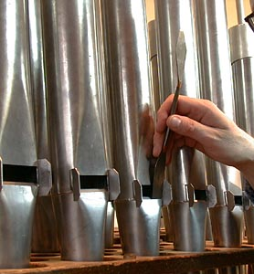
Voicing of Craighead-Saunders Organ Christ Church (Episcopal) Eastman Rochester Organ Initiative by Munetaka Yokata (2008)
Adjusting the depth and shape of the lip
The organ is a reproduction of a 1776 organ from Vilnius Lithuania
this image from Oberlin to illustrate voicing
Notes:
9 minute clip! organ2_clip in Winds

Slide 56
Organ Pipe Voicing Delay of fundamental harmonic
Notes:
organ2_voicing.mp3 in Winds

