Slide 1
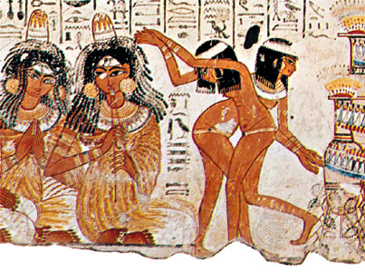
Resonances, Standing Waves and Normal modes of a column of air
Detail of a feast for Nebamun, fragment of a scene from the tomb-chapel of Nebamun. Thebes, Egypt, Late 18th dynasty, around 1350BC
Power point Alice Quillen
Notes:
Props: organ pipe, flute, whirly tube, didgeridoo, slinky, pan flute, ocarinas
Big tube, microphone, preamp, speaker and sine generator
Tape measure
Resonant excitation of tuning fork, string and tube with speaker (if not done in last lecture)
One sided Cable to illustrate open boundary condition
Slinky for showing longitudinal excitations
Heavy cable for showing a different boundary condition in a string
Doppler ball, whirly film cartridge with slot
wave generator on string + pole (or in previous lecture)
If extra time show spectral display with time of liquidnitrogen or the syrinx or the quark song!
(or previous lecture)

Slide 2
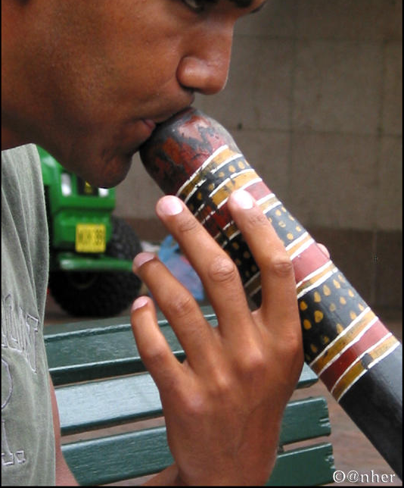
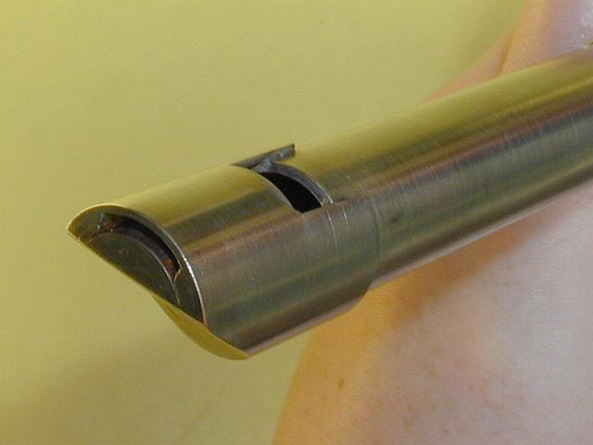
Wind Instruments
Tubes of air excited by blowing vibrations
organ pipes, flutes, whistles, recorders
brass family, reed instruments
didgeridu
ocarina
from DAVID O'BRIEN WHISTLES review by Jessie Driscoll
Notes:
demo flute, organ pipe, recorder
digi_kanghop.mp3

Slide 3
Pressure waves in air Longitudinal waves
Animation from Dan Russel
Notes:
Slinky demo

Slide 4
Standing waves or modes in a column of air
The motions shown are air velocity.
The shorter wavelength motions should be faster.
One of these is a pipe that is closed on one end and the other is open on both ends. Which one is which?

Slide 5
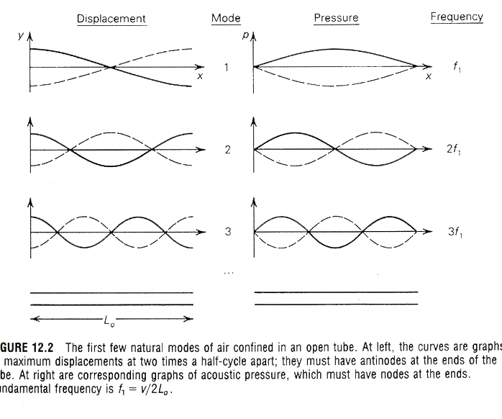
Open/open tube

Slide 6
Open/closed tube

Slide 7
Harmonics or overtones
Closed/open tube only has odd harmonics (e.g., clarinet) f, 3f, 5f, 7f
Open/open tube has all integer multiples f,2f,3f,4f,5f (e.g., organ pipe)
In this case the tubes are the same but the boundary conditions are different.
The boundary: A closed end allows large pressures but no motions. An open ends allows motions but no pressure changes.
Notes:
Demo the whirly tube
show harmonics AND show that notes are higher when smaller

Slide 8
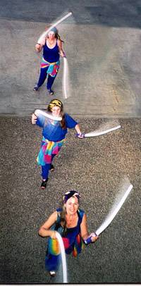
Music from overtones of pipes
Sarah Hopkins
Kindred Spirits
from Gravikords, Whirlies and Pyrophones
note Doppler shift!
Notes:
sarah_hopkins.mp3

Slide 9
A wave reflecting off of the boundary
At an open boundary: the air bounces moving in and out of the boundary.
When the air moves out the pressure in the middle is low and the air is sucked back in.
When the air moves in, the pressure is high in the middle and the air is pushed back out.
motions
Notes:
Demo boundary conditions with string and cable

Slide 10
Wave reflecting off of the closed boundary
At a closed boundary: the wave reflects if it has a high pressure at the wall. The air compresses at the wall and then bounces back.

Slide 11
Normal modes of a column open/closed
No pressure variation,
large motions
No motions,
large pressure variations

Slide 12
Which one has a lower fundamental tone? Open/open or open/closed?
Open/open open/closed
Notes:
closing end of flute!

Slide 13
Length, fundamental and harmonics
The open-closed pipe has a fundamental wavelength equal to four times its length and higher resonances at odd integer multiples of the fundamental frequency.
The open-open pipe has a fundamental wavelength equal to two times its length and higher resonances which occur at all integer multiples of the fundamental frequency.

Slide 14
Resonant excitation
Small pushes correctly timed will add up and excite large amplitude motion.
Small pushes incorrectly timed will tend to cancel out.

Slide 15
Resonant excitation of a column of air
How long does it take a disturbance to travel down the length of the tube and come back?
Correctly timed excitations allow the mode to grow. Otherwise they are cancelled out by each other.

Slide 16
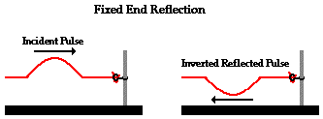
Boundaries
Open end
A travelling positive pressure pulse pushes the air out converting the pressure pulse into motion. The motion outwards excites a vacuum pulse inside moving the other way and flipping the sign of the pulse --- analogous to the fixed end of a string.
Closed end
At a closed boundary a high pressure pulse bounces against the boundary sending back a positive pressure pulse.
Analogous to the free end of a string.

Slide 17
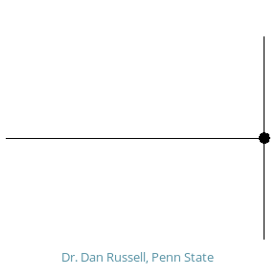
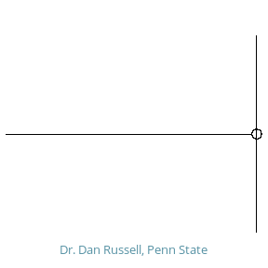
Waves reflecting off of boundaries
Animations courtesy of Dr. Dan Russell, Grad. Prog. Acoustics, Penn State
Notes:
russell_hards_wm.gif
russell_softs_wm.gif

Slide 18
Reflection at boundary
Sign of wave reflected depends on nature of boundary
Show on string, vs cable
If the sign is opposite or same then 2 reflections needed to get back to original
If sign is opposite on one side and same on other then 4 reflections needed

Slide 19
Open/Closed Open/Open
reeds
horns
digi
panflutes
flutes
organ pipes
recorders, whistles

Slide 20
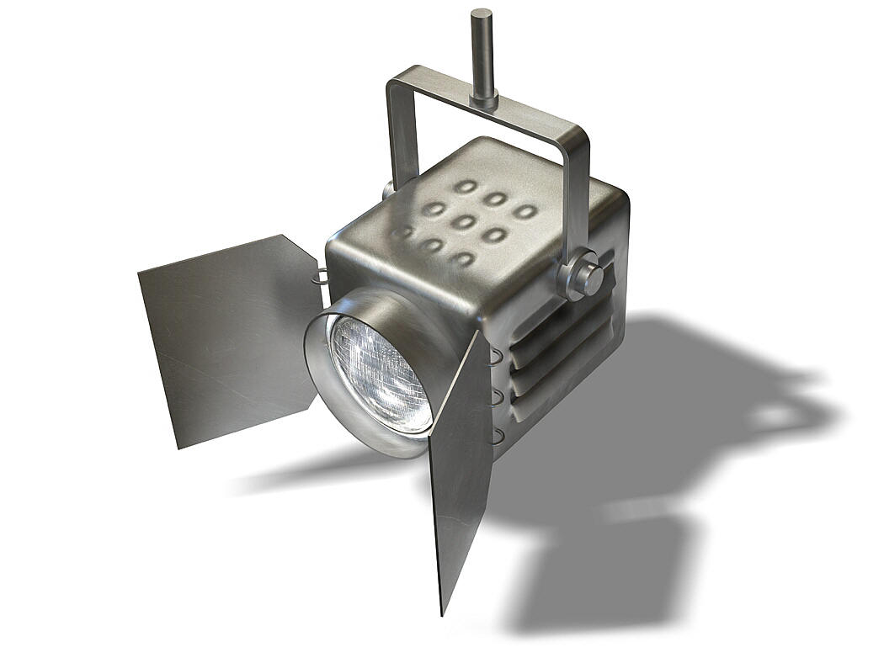
Excitation of digi
movie by me+Raz Rivlis
Notes:
digiclip.mov

Slide 21
Which modes will grow?
If I put random pressure fluctuations into the pipe, some will grow and others will not.
How do I describe the way the pipe reacts to an input sound?
Impedance is a way to measure this.
Relates input pressure to actual air velocity.
Is a function of frequency

Slide 22
Speed of sound and excitation of a mode in an open column of air
The speed of sound is 330 m/s
If the column is 1.7m long then it takes
If the column is excited at this frequency then a resonance is likely to be excited.
Notes:
Demo: on open pipe with microphone to show volume change
Find harmonics
Demo on closed pipe

Slide 23
Water trumpet analogy for a trumpet
From Benade

Slide 24
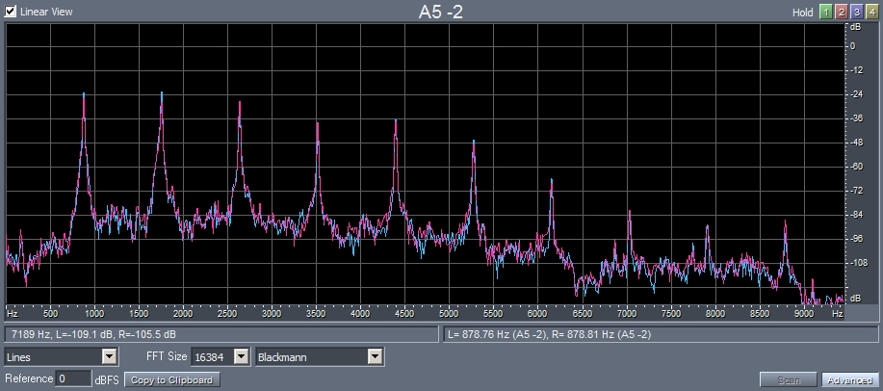
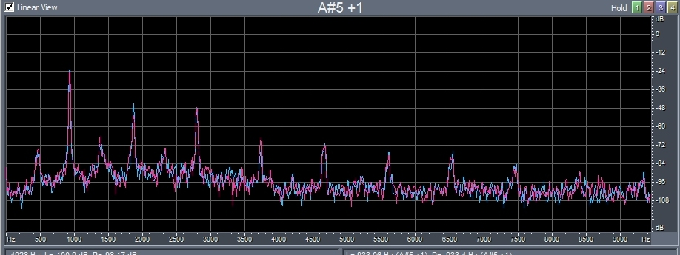
Timbre of Winds
clarinet
flute
Despite closed end clarinet has all integer harmonics
Flute has stronger lower harmonic compared to clarinet -- Flute also seems to have some intermediate frequencies from the lower octave.
Notes:
The fundamental for A5 should be around 920Hz. The low frequency in the flute suggests that the lower octave note is also excited.
Clips: Britten_Pan clip in Winds, Debussy_Syrinx_clip in Winds

Slide 25
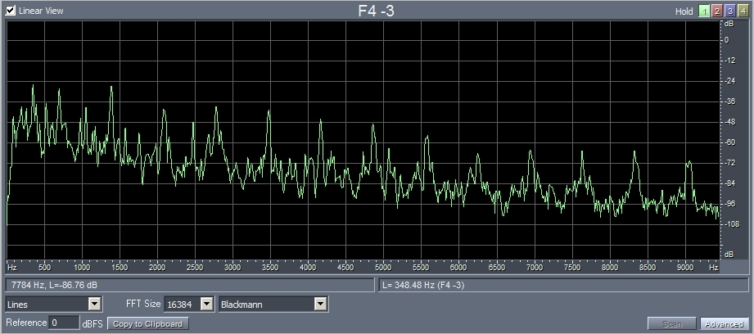
Clarinet and Brass
Clarinet
Horn
Horn has more broad band noise particularly at lower frequencies and at start of note. As was true for the flute there are tones in between but they are not the octave below.
Notes:
Clip: Blacher_divertimento_1 in Winds

Slide 26
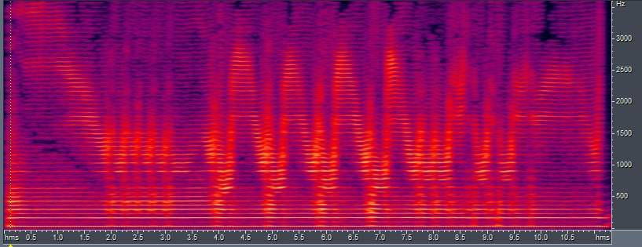
Digderidu
Notes:
clip: digi_kanghop.mp3

Slide 27
Ocarina
Pitch adjusted by number of open holes rather than position of hole – not a tube!
Almost pure tones
Notes:
ocarina.mp3

Slide 28
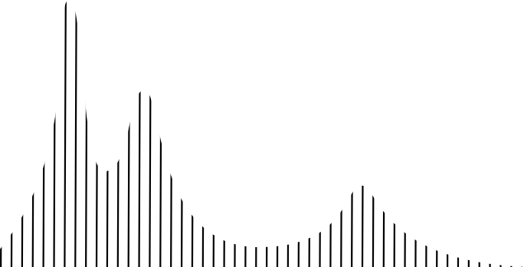
Whistle
vocal track is a squat deformable ~cylinder
frequency
Notes:
can I make a better demonstration of this!

Slide 29
Sliding whistle
When all the way in, no longer acts like a tube of air. Acts more like an ocarina. Lost of higher harmonics. Noted by many in the lab!
Even integer harmonics often weak because of inner closed end.

Slide 30
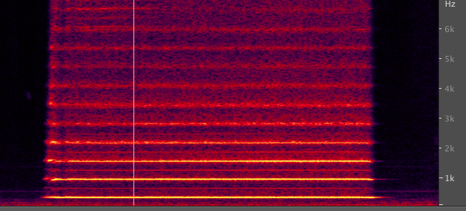
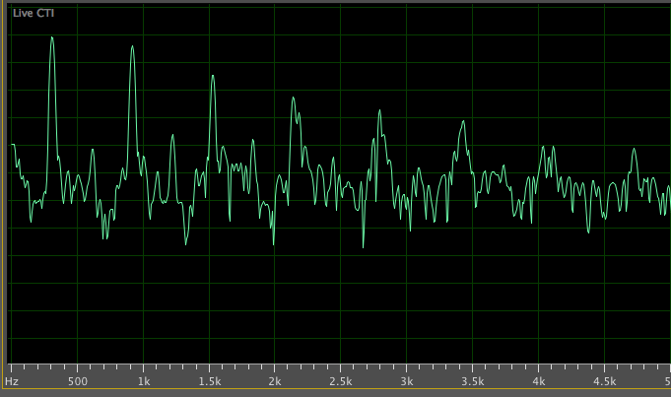
frequency →
Sliding whistle
time →
600Hz
weak even integer
harmonics
loudness
strong odd integer
harmonics
300Hz
900Hz
1500Hz
frequency →
Notes:
sliding_whistle_2notes.mp3

Slide 31
Inside the whistle

Slide 32
Spectrum and resonances
On the string, each overtone frequency corresponds to a mode of oscillation
In percussion instruments that is also often the case
With wind instruments, integer multiple overtones are often seen but these are not always resonances of the instrument

Slide 33
Terms introduced
Resonances
Resonant excitation
Pressure waves
Boundary conditions
Longitudinal waves
Open/open and open/closed tubes and modes of oscillation in them
Impedance
Notes:
Spectral display of quark song or liquid nitrogen?

Slide 34
Recommended reading
Chap 6 of Hopkin on Aerophones pages 73-75

