Slide 1
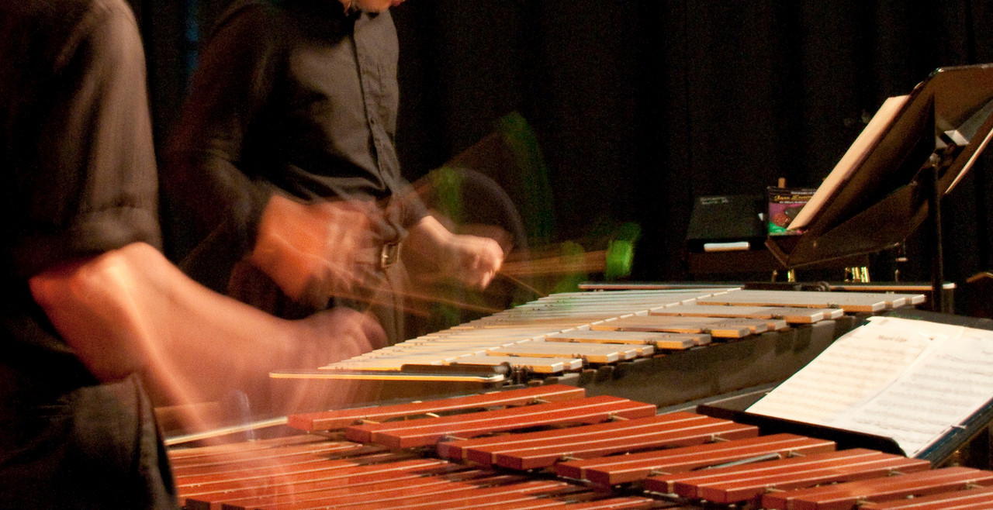
The Physics of Percussion
Special thanks to Dr. Alice Quillen
Notes:
Microphone for recording etc
drum, different strike, hold center, change angle w.r.t to viewer
wine glass with two pitches, change angle wrt to viewer
wine glass with distance
Chaladni plates, hoop
sliding track with springs to try to explain different modes
Steel rod - vibration and bending motions
sheet of metal and flapping that!
steel pipes and hammers
Long steel pipe (directional dependence)
Tuning fork on resonator
Tuning fork along (direction dependence)
Sample instruments to listen to: old class projects xylophones, drums
Different frame drums
Different wine glasses
Wine glass + water
Movies on this slide:
wine_glass.mov
russell_426-fundamental.gif

Slide 2
Percussion
Divided into
Membranophones: drums
and
Ideophones: chimes, xylophones, marimbas, jawharps, boos, tongue drums, bells, gongs
Could also be divided into those with pitch and those without

Slide 3
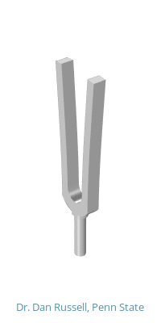
Modes of a tuning fork
Out of plane symmetric and anti symmetric
In plane symmetric bending “clang”
fundamental mode
In plane asymmetric bending
Animations courtesy of Dr. Dan Russell, Grad. Prog. Acoustics, Penn State
Notes:
russell_426-fundamental.gif
russell_385-inplanet.gif
russell_2171-inplanet-2.gif
russell_2484-Clang.gif
russell_457-Outplane.gif
russell_537-Quad.gif

Slide 4
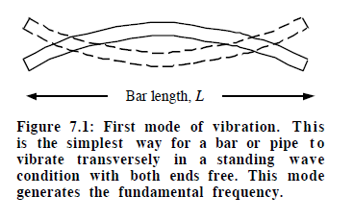
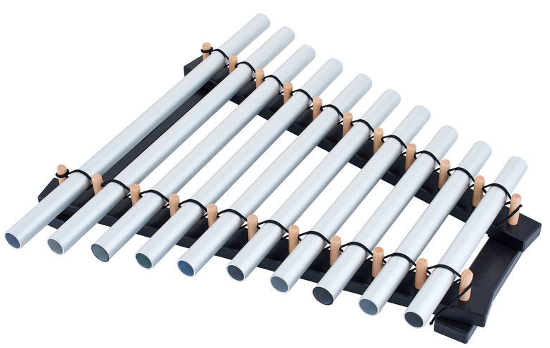
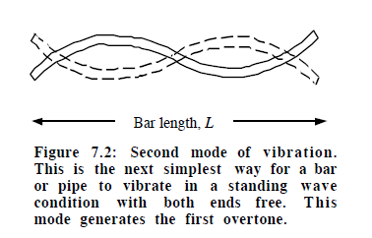
Ideophones
n | m
1 | 3.0112
2 | 5
3 | 7

Slide 5
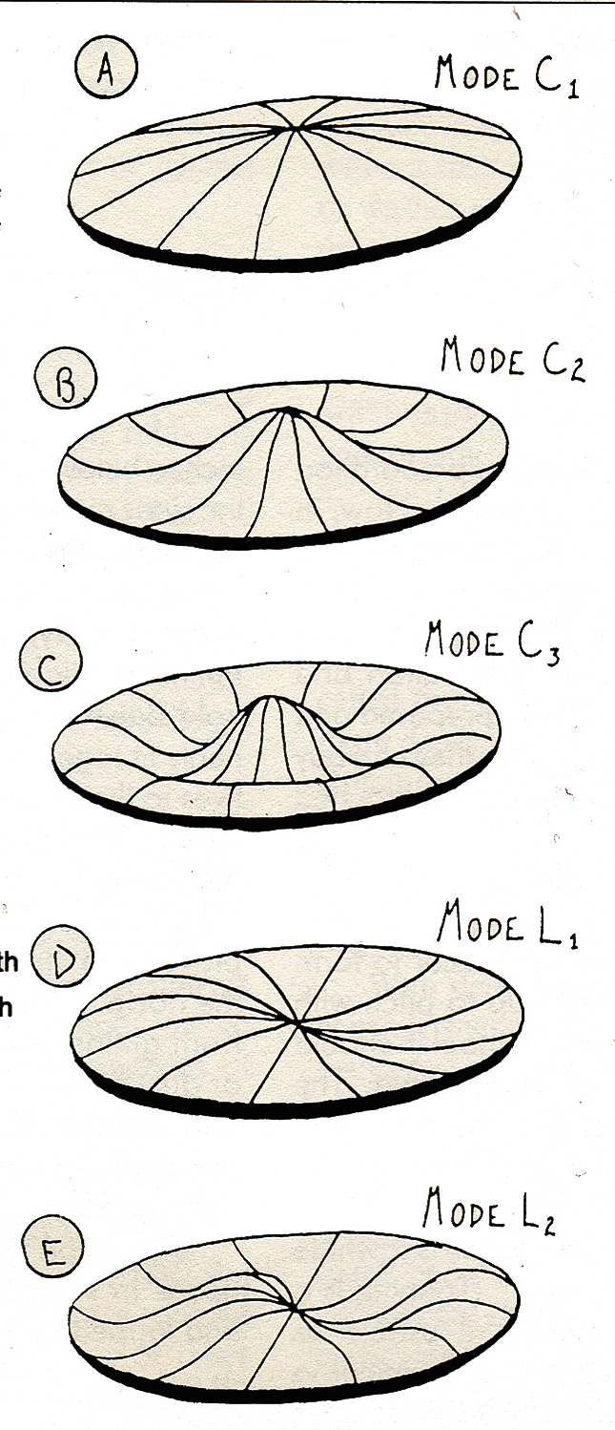
Circular Membranes modes of vibration
The first three modes C₁,C₂, C₃ are axisymmetric (circular rings).
The last 2 modes have azimuthal structure (bilateral) L₁, L₂
C vs L mode spectrum depends on where you hit the drum. You get higher frequency vibrations when you hit the edge of the drum
C₁ f₁
C₂ 2.3f₁ sharp major 9th
C₃ 3.6f₁ octave + minor 7th
L₁ 1.59f₁ minor 6th
L₂ 2.92 f₁ octave + 5th
Figure from Musical Instrument Design by Bart Hopkin

Slide 6
Resonances of the membrane
By changing the tension on the membrane you can change the pitch of the drum (experiment with flatdrum!)
By making the membrane heavier you should be able to lower the pitch

Slide 7
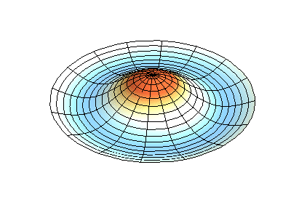
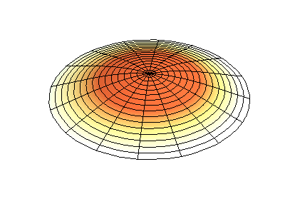
Nodal diameters and circles
(a,b)
a= The number of circular nodes (circles that don’t move)
b= number of diameters nodes (lines that don’t move)
C1: (0,1)
no diameter nodes
1 circular node, the outer edge
C2: (0,2)
two circular nodes
outer edge and at radius=0.43
Radiates sound very quickly
The only mode that is not on average zero
Animations courtesy of Dr. Dan Russell, Grad. Prog. Acoustics, Penn State
Notes:
russell_mode01.gif
russell_mode02.gif

Slide 8
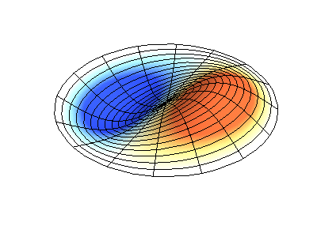
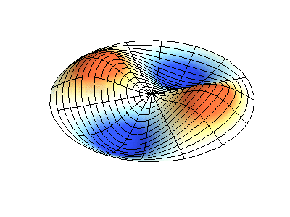
L modes
L1 (1,1)
one diameter node
one circular node, the edge
L2 (2,1)
two diameter nodes
perpendicular to each other
Animations courtesy of Dr. Dan Russell, Grad. Prog. Acoustics, Penn State
Notes:
russell_mode11.gif
russell_mode21.gif

Slide 9
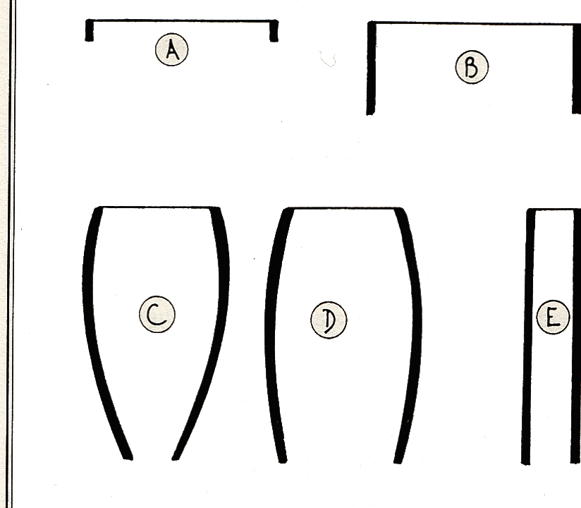
Resonances of the drum vs that of the body
A: frame drum
B: Tenor drum
C: Barrel drum with narrow opening
D: Barrel drum with large opening
E: tube drum
Figure from Musical Instrument Design by Bart Hopkin

Slide 10
Resonances of the drum vs that of the body
A: No added resonance -- out of phase waves from front and back cancel
C: Membrane and barrel could have different resonances- barrel usually has a deeper tone than the drum head – narrow resonance peak for barrel
D: Barrel might have a wider resonance peak
Figure from Musical Instrument Design by Bart Hopkin

Slide 11
Drum tuning
Adjusting the tension of the drum head changes the resonant frequencies of the drum head
It also changes the resonant frequencies within the drum chamber --- this is because the rigidity of the walls affects these resonances
Process of adjustment required to have the resonances of the membrane reinforce the resonances of the drum body --- leading to a fuller sound

Slide 12
Drum sound
Coupling of membrane motions to Helmholtz modes (air moving in and out)
If air and membrane move together, we expect a lower frequency combined mode, if they move in opposite directions we expect a higher frequency combined mode
Interference between sound launched from the front and sound driven from the back of the drum
back wave cancels out the front wave unless they are shifted in phase

Slide 13
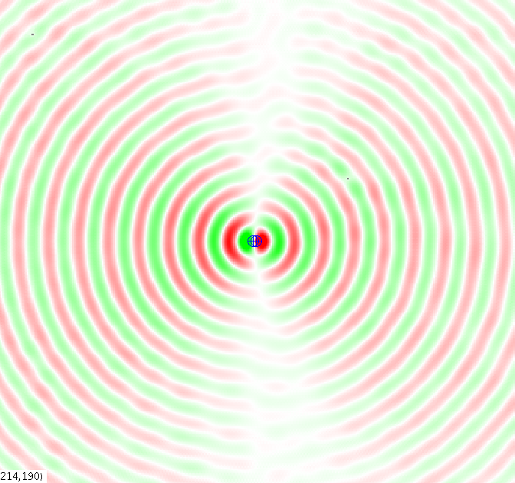
Two emitting sources that are closer than a wavelength
Using www.falstad.com/ripple/ (Paul Falstad’s applet)
dipole: two nearby sources
180º out of phase
monopole:
Two nearby sources, in phase
In the far field, the two sources cancel each other
1/r³ law
Far field radiation pattern is similar to a single source
1/r² law

Slide 14
Baffling
using Falstad’s applet and quicktime capture
Notes:
drum1.mov

Slide 15
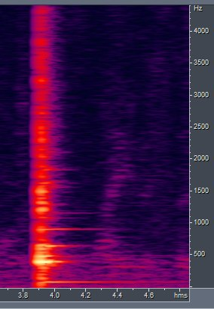
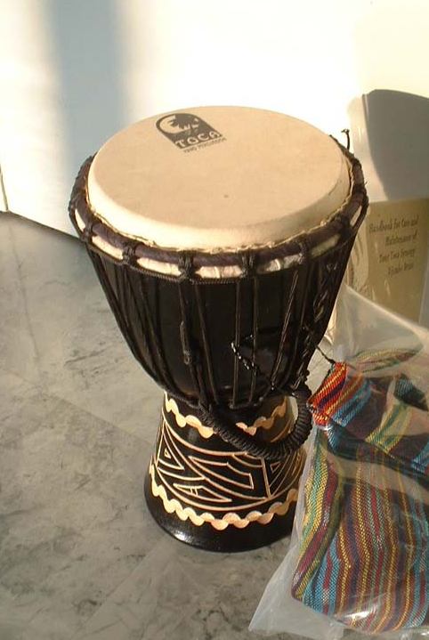
Spectrum of a drum
Toca drum
Notes:
tocadrum.mp3

Slide 16
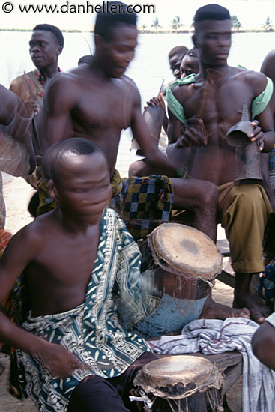
Drum ensemble from Benin
Sound box of wood with a laced skin membrane. The sound changes when stuck at different positions on the drum head.
Music taken from CD Musical instruments of the World 1990 CNRS
Notes:
drum_benin.mp3

Slide 17
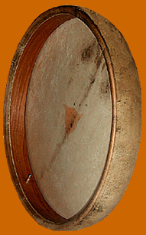
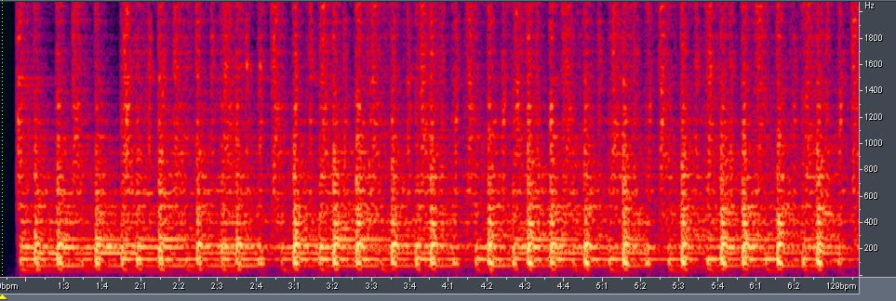
Frame Drum
Example from Rajasthan
One meter large, can be hit by more than one player
Notes:
framedrum.mp3

Slide 18
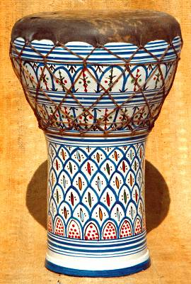
Goblet Drum - Darbuka
Egypt
Goblet with a glued membrane of lambskin
Tone quality is adjusted solely from changes of power and angle of attack
Notes:
darbuka.mp3

Slide 19
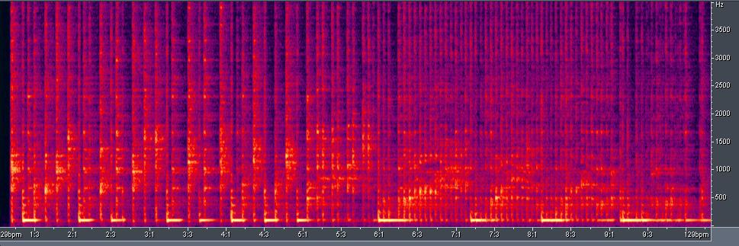
Spectrum of Darbuka
Notes:
darbuka.mp3

Slide 20
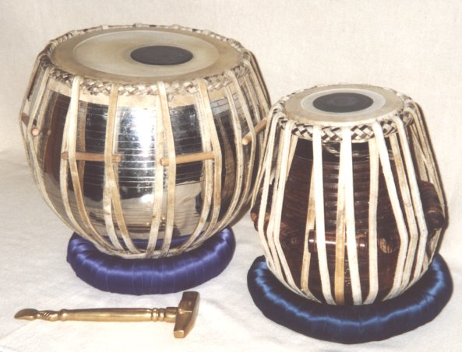
Tabla India
Note vocalization following
membrane thickness varies so sound is very sensitive to position hit
Notes:
tabla.mp3

Slide 21
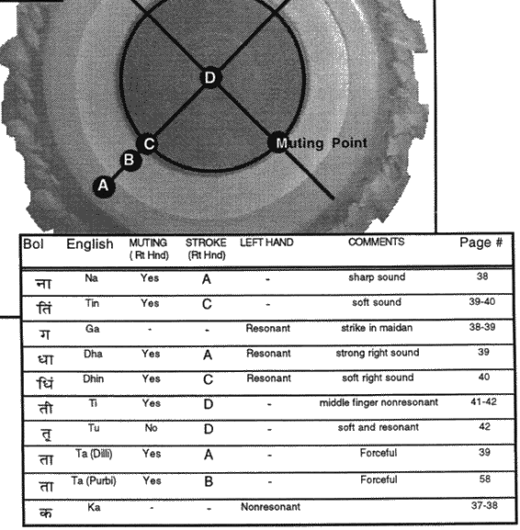
Tabla Talas
Image from http://www.chandrakantha.com/tablasite/quick.htm

Slide 22
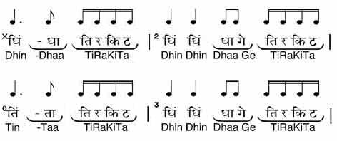
Science of Tabla
Jhumra
Image and clip from http://www.chandrakantha.com/tala_taal/jhoomra/jhumra.html
Necklace notation Figure From Rhythm and Transforms by W. Sethares
Notes:
jhumra.mp3

Slide 23
filmed in lab, plan is to make more movies
This one is hit in the center, 1200 fps but seems to primarily show a long lived fundamental mode
Notes:
drum_center.mov

Slide 24
hit offcenter
Notes:
drum_side.mov

Slide 25
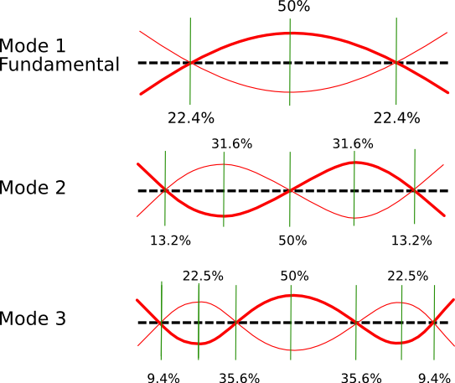
Steel pipe
Modes exited depend on where you hold it
Notes:
demo this with a large long plastic pole

Slide 26
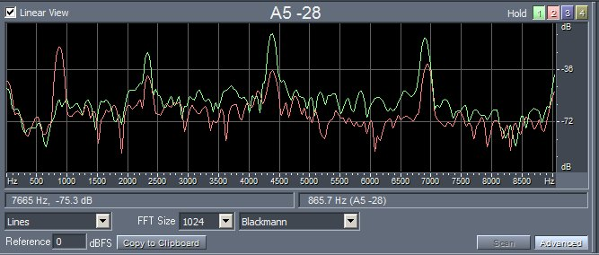
Steel pipe held at different locations
Note first overtone absent in green spectrum
Where did I hold the pipe for the green spectrum?
Notes:
steelpipe.mp3

Slide 27
Adjusting the pitch of one mode compared to another
symmetric mode
asymmetric mode
center higher mass but this mode frequency is unchanged
frequency of asymmetric mode is slower
movies made with paul falstad’s applet
Notes:
couple3a.mov couple3b.mov couple3c.mov couple3d.mov

Slide 28
Marimba tuning

Slide 29
Instruments made in this class 2005 and before
copper pipe xylophone
glass xylophone
solid aluminum chimes
Bobbi Stewart
Alex Frissel
Notes:
bobbistewartcopper.mp3
bobbistewartglass.mp3
alexfrissel_chimes.mp3

Slide 30
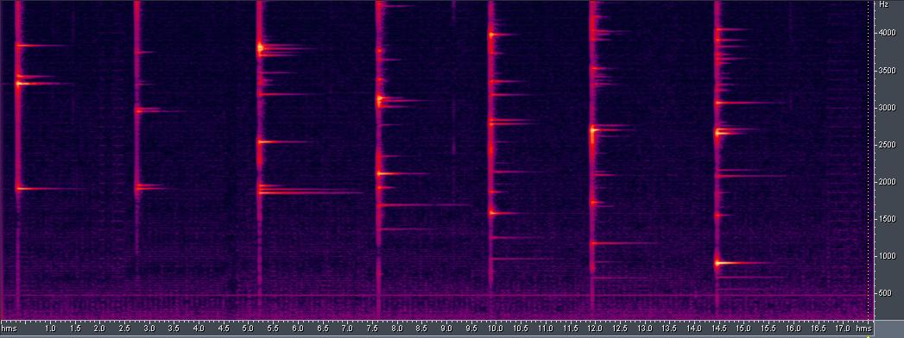
Copper pipe with slit cut to different lengths
Notes:
pipegong.mp3

Slide 31
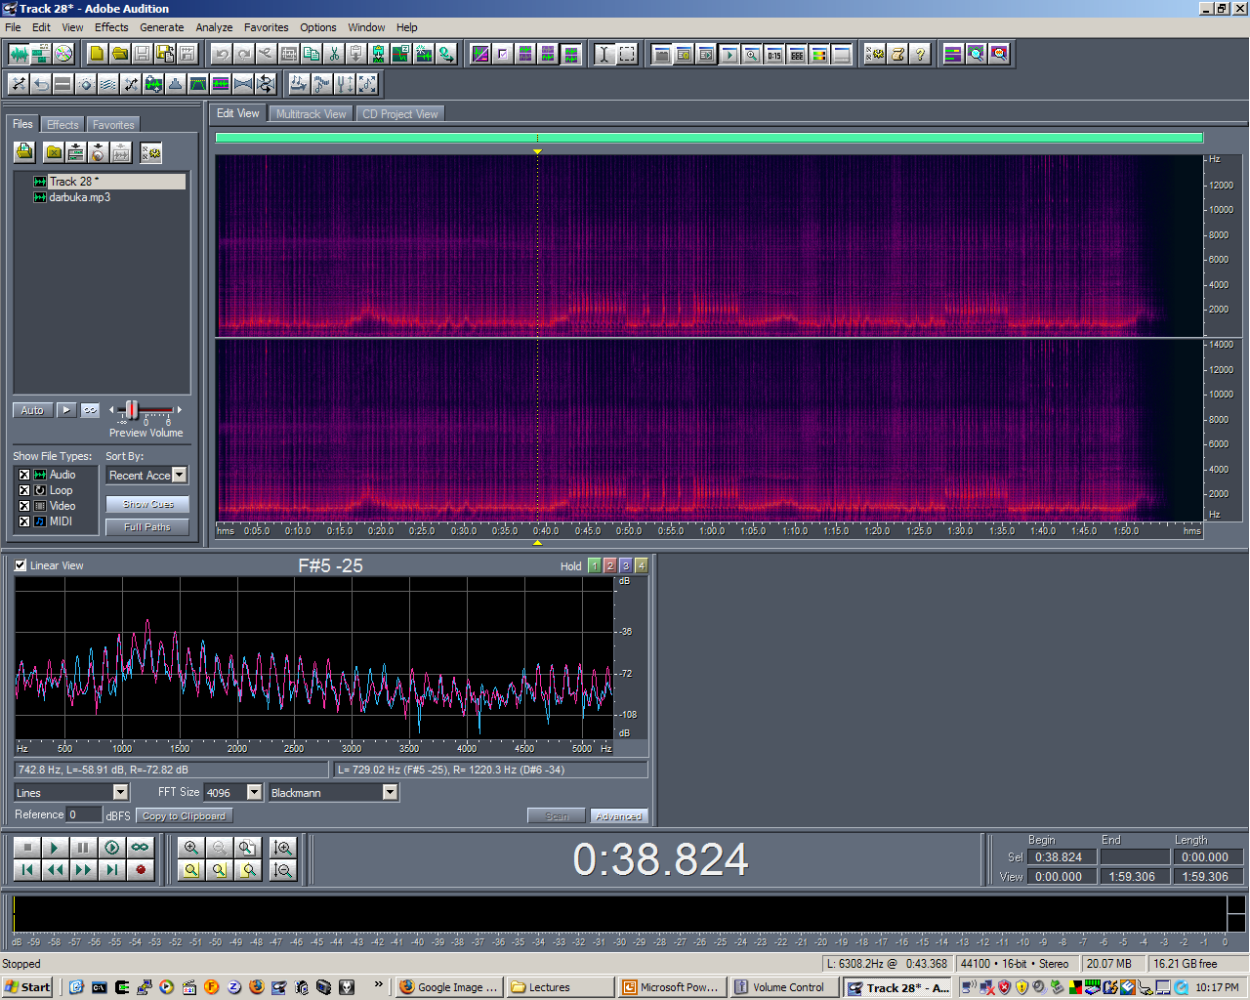
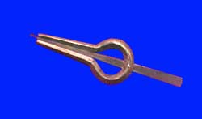
Jaw Harp (Rajasthan, moorchang)
Notes:
jewharp.mp3

Slide 32
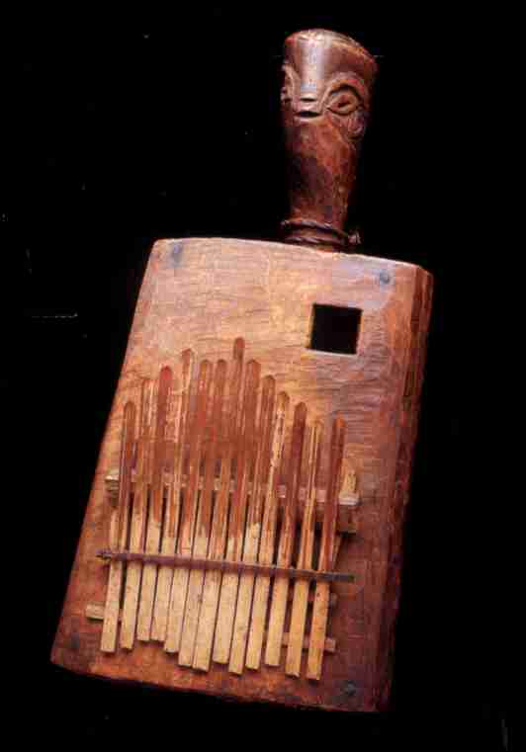
Lamellaphone –Sanza -west africa
Notes:
sanza.mp3

Slide 33
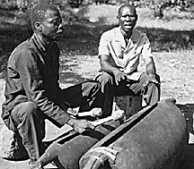
Slit Drum -central Africa
hollowed out wood with uneven thickness to the edges
Notes:
slitdrum.mp3

Slide 34
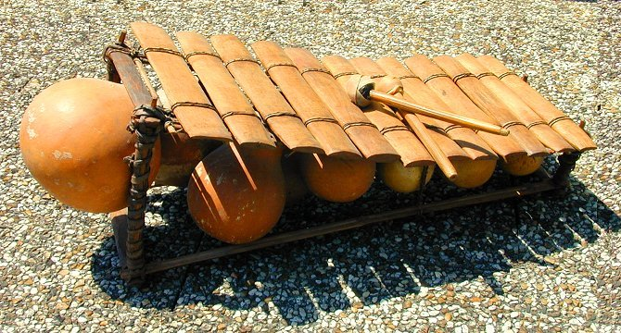
Guinea Bala Xylophone
hydrid percussion/wind or percussion/resonator
Notes:
balafon.mp3

Slide 35
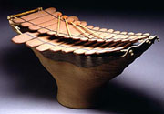
Clay percussion
Claycussion
Ward Hartenstein and the Eastman percussion ensemble
from Gravikords, Whirlies and Pyrophones
Notes:
claycussion.mp3

Slide 36
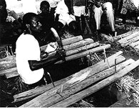
Double pit xylophone Benin doso
pit dug into the ground serves as a resonator
Notes:
doublepitzxylophone.mp3

Slide 37
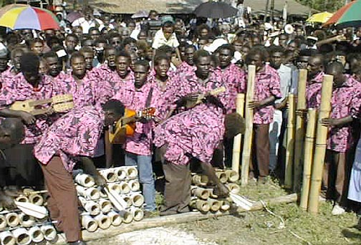
Stamping tubes-Solomon islands
Bamboo pipes striking a rock or the ground
The bamboo tube is held in one hand, the closed end at the bottom, and struck against the ground or a hard surface. The palm of the other hand partly opens or closes the open end, changing the timbre.
Image from http://www.folkenberg.net/Travel%20highlights/97%20SPD/97-2-Solomon_islands-2.htm
Notes:
stompingtubes.mp3

Slide 38
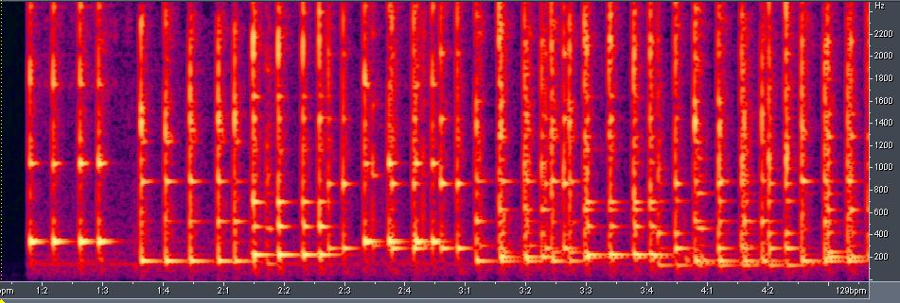
Stomping tube spectrogram flat + open/closed end pipe spectrum
Notes:
stompingtubes.mp3

Slide 39
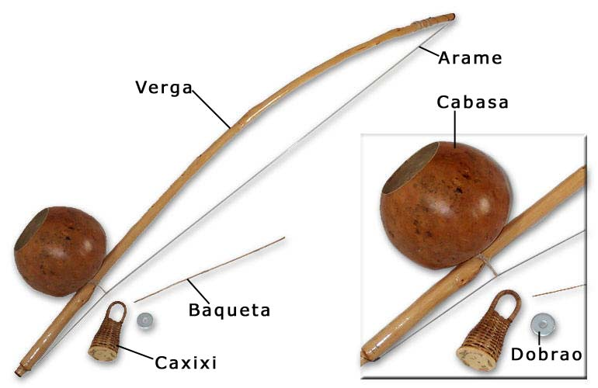
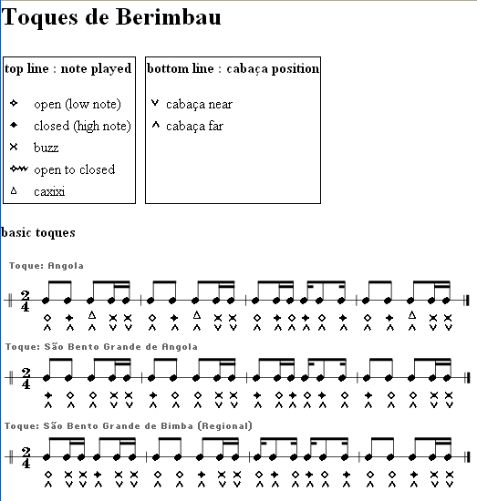
http://www.nccapoeira.com/music/toques.html
Notes:
Mestre\ Deputado\ -\ Sao\ Bento\ Grande.mp3

Slide 40
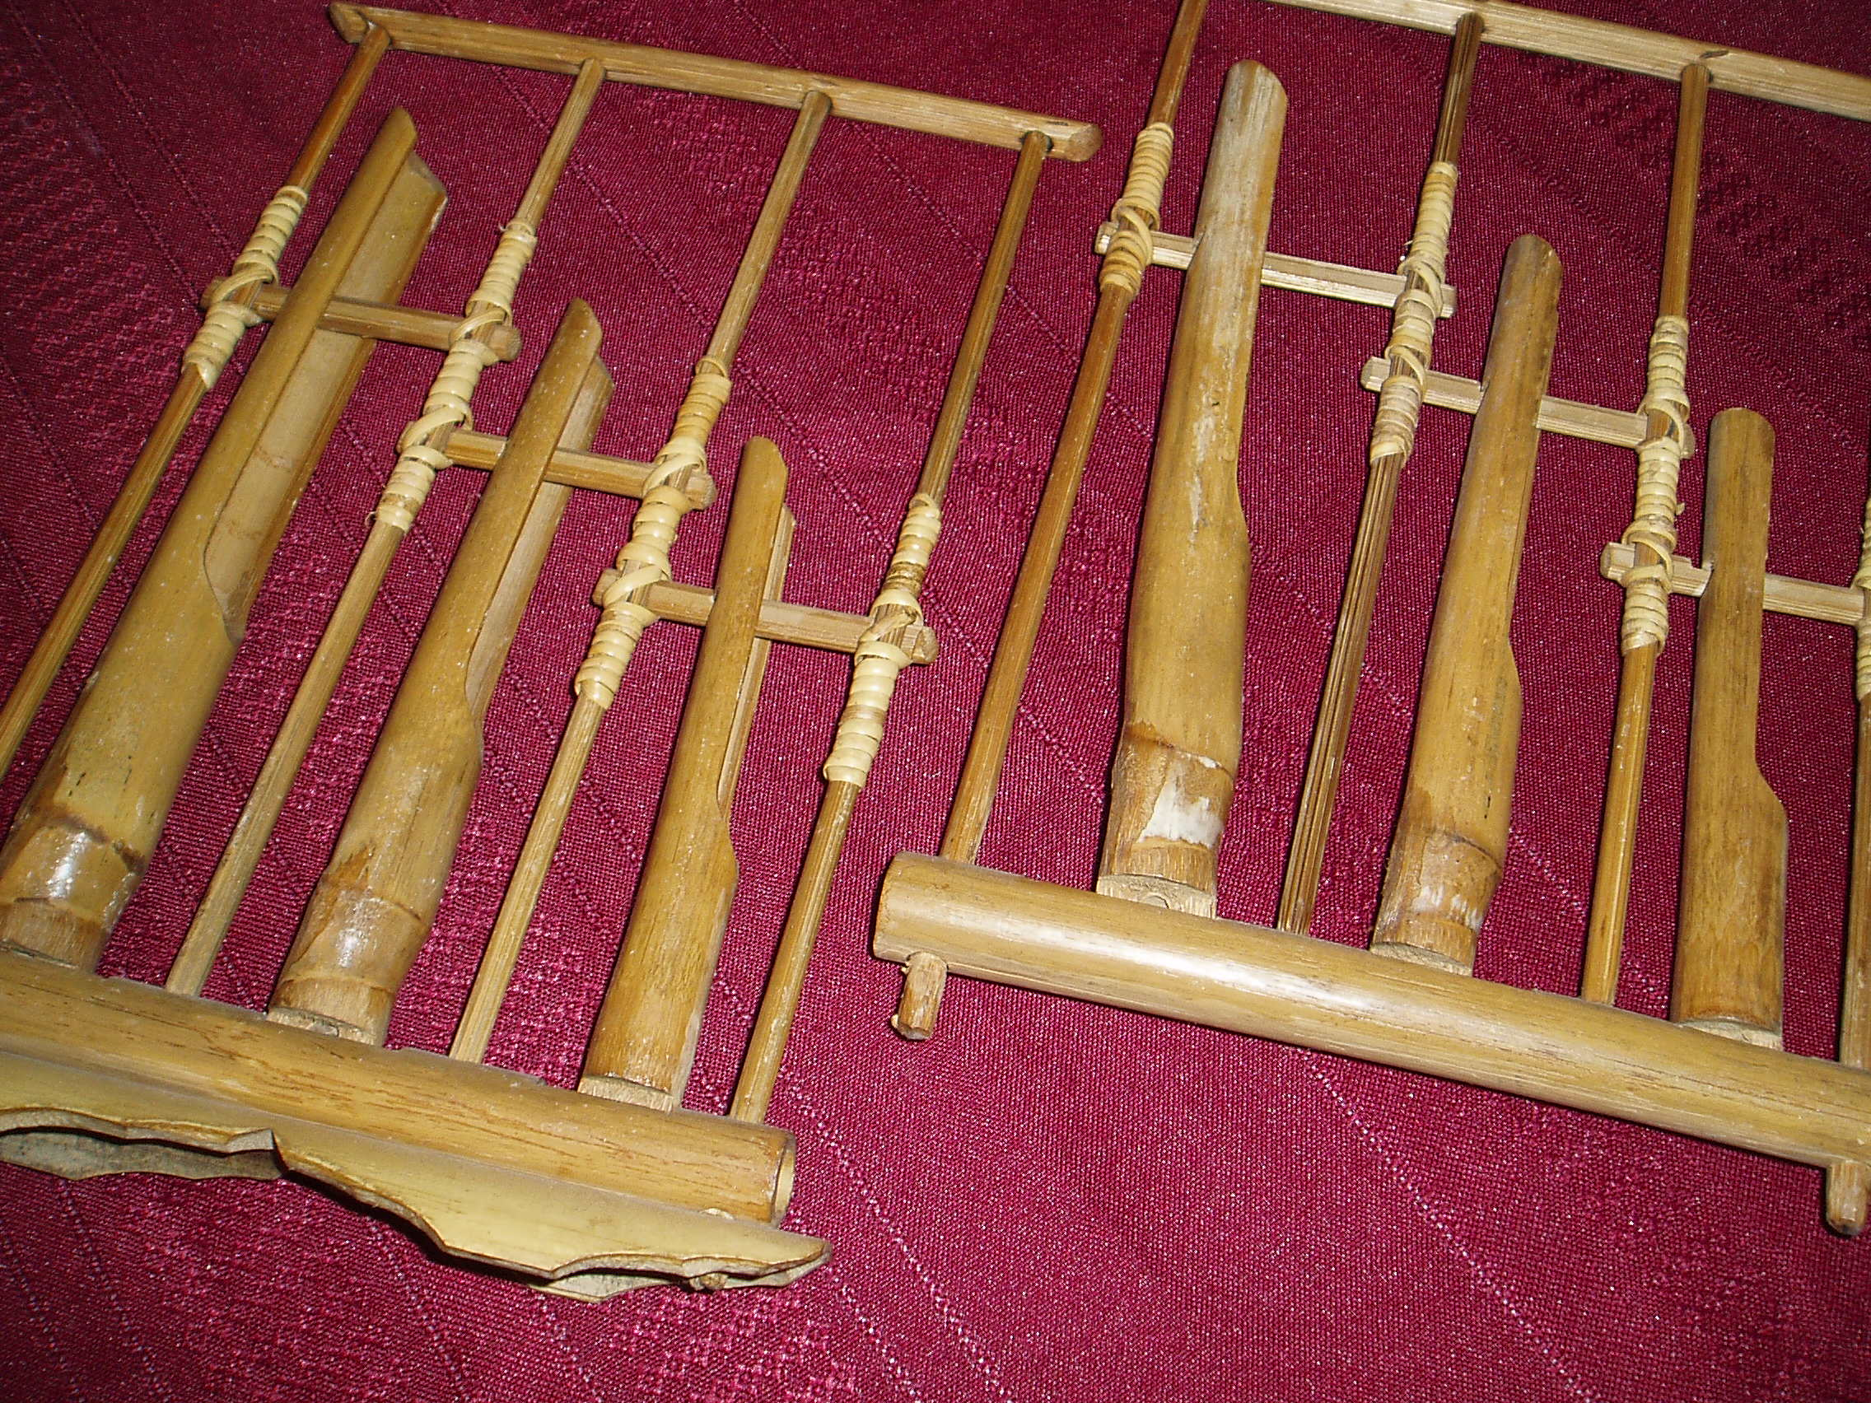
Angklung-sliding rattle Java
tongue vibration is tuned to be the same as the column of air below it
Notes:
anklung.mp3

Slide 41
Angklung spectrogram
Notes:
anklung.mp3

Slide 42
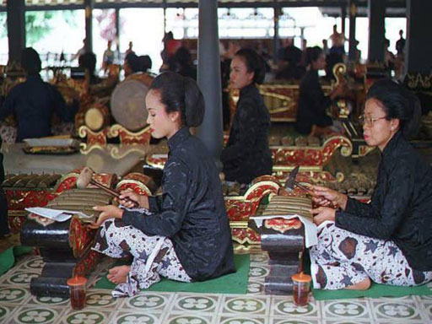
Gamelan – Bali – Metallophone Ensemble
Notes:
gamelan.mp3

Slide 43
Bell mode
lateral
quadrupolar
radiation field
Animation courtesy of Dr. Dan Russell,
Grad. Prog. Acoustics, Penn State
Movie by me
Notes:
russell_latquad.gif

Slide 44
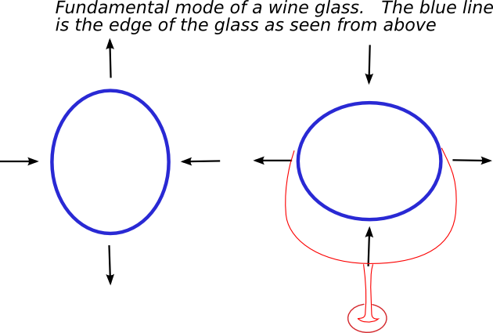
Fundamental mode of a wine glass

Slide 45
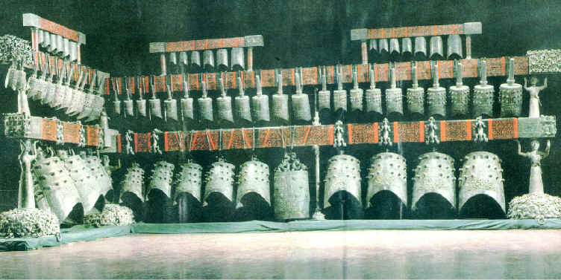
Archeology of Chinese Bells
An ensemble of 65 bells, with 130 discrete strike tones, was excavated in a fully preserved state 1978 in the Chinese province of Hubei from the tomb of the Marquis Yi of Zeng from 433 B.C. The ensemble's tuning system could now be investigated! http://web.telia.com/~u57011259/Zengbells.htm (Martin Braun)

Slide 46
“Two Tone” bells
Due to favorable conditions of tomb preparation, soil, and soon natural water filling, the bronze of the bells survived fully intact. The bells sound as they did 2,436 years ago.
The bells have an eye-shaped cross-section and vibrate in one of two modes, depending on where they are struck. A strike in the middle of the front makes frontside and backside vibrate as whole units and produces the lower tone sui. A strike between the middle of the front and a side edge makes frontside and backside vibrate as two units each and produces the higher tone gu. If struck correctly, both tones are fully independent, each with its own fundamental and harmonics.
Notes:
bell7.mp3

Slide 47
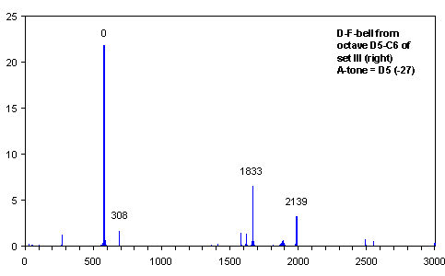
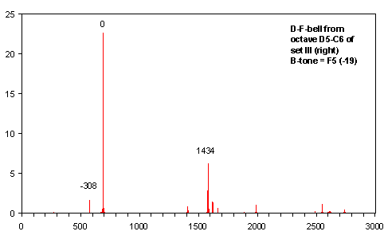
Two tones (continued)
The two tones a third apart, purposely

Slide 48
Evidence for tuning
Images from The Archeology of Music in Ancient China, Kutner, Fritz

Slide 49
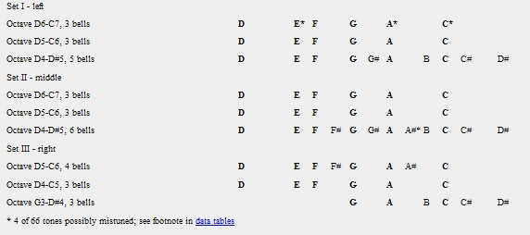
The scale
Scale D-E-F-G-A-C occurs eight times in melody bells

Slide 50
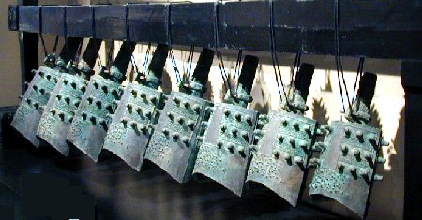
The bumps?
Western bells rarely have bumps --- Church bells have lasting rings.
Players of handbells damp the sound if they require a short note
Bumps do change the modes of oscillation as they give extra mass
They also help radiate sound and so damp the sound purposely
The bell can be louder?

Slide 51
Topics
Resonances/modes of a membrane
Modes of a vibrating pipe or bar
Modes of a resonating cavity coupled to a membrane
Membranophones/ideophones and lamellaphones
Suggested reading: Chapters 4,5,7 of Hopkins

