Slide 1
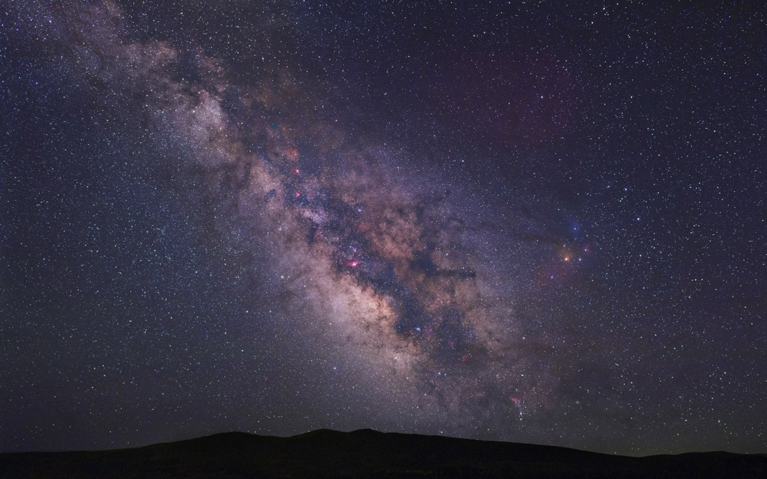
Music of the Spheres?

Slide 2
Some Physical Aspects of “Sound” and other Waves
Doppler Effect - how motion affects waves
Shock Waves – how moving “too fast” affects sound

Slide 3
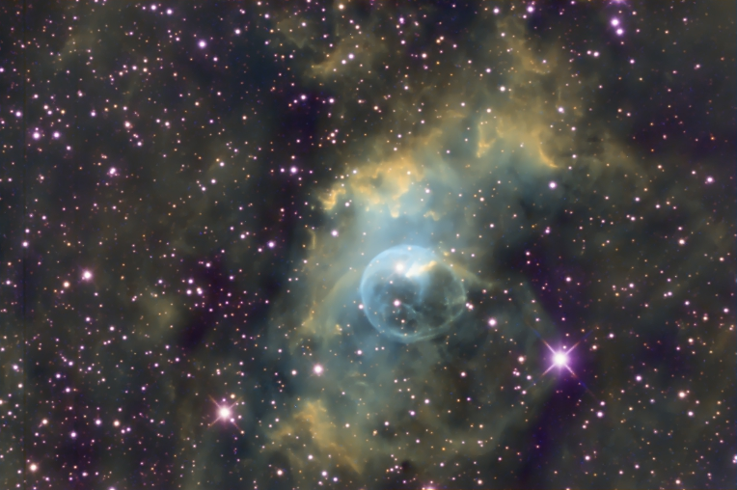
NGC 7635– narrow band image
TKUO#2 – September 2016

Slide 4
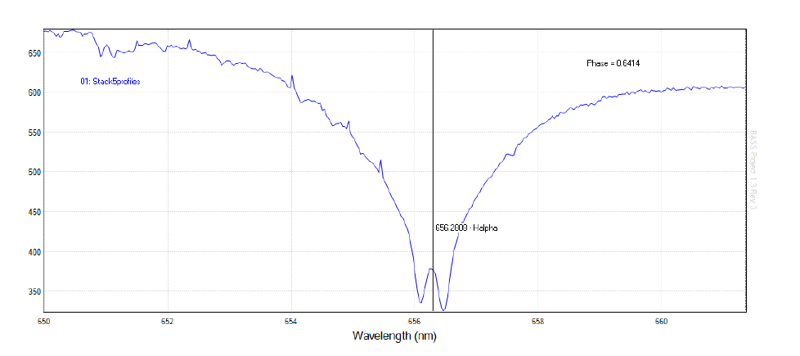
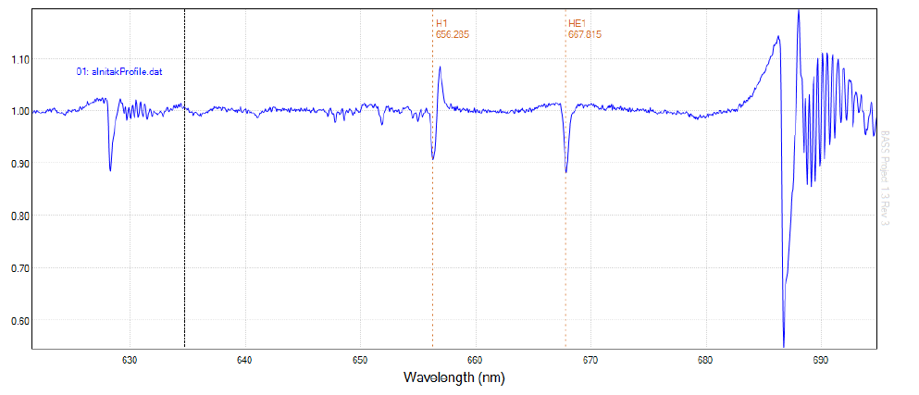
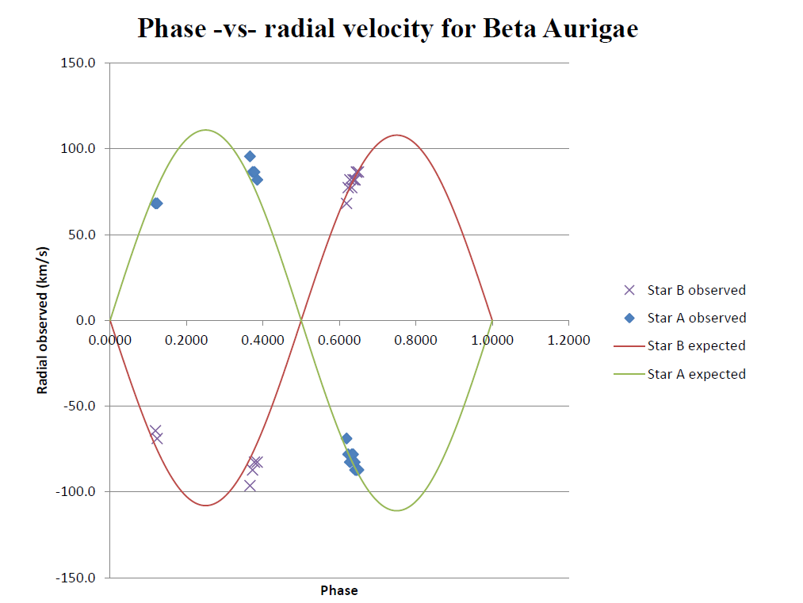
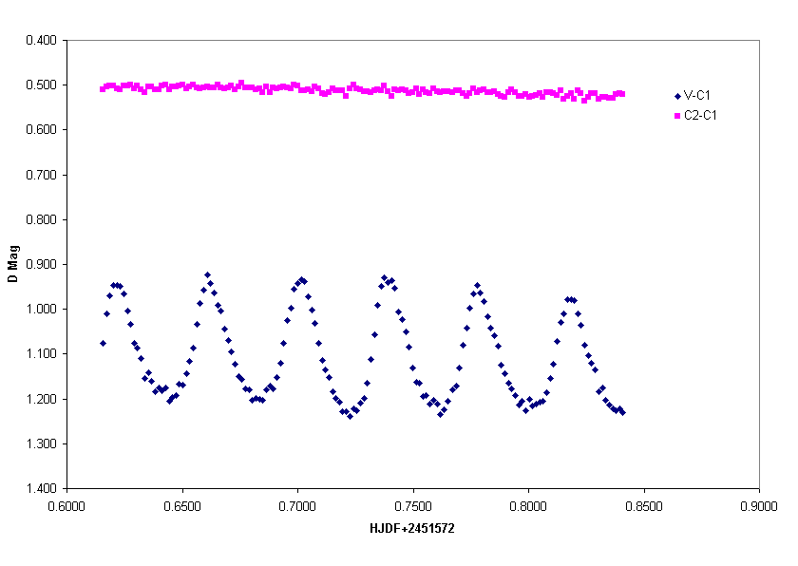
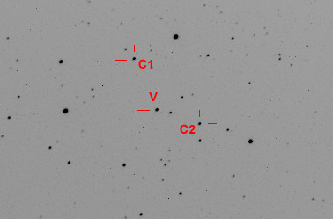

Slide 5
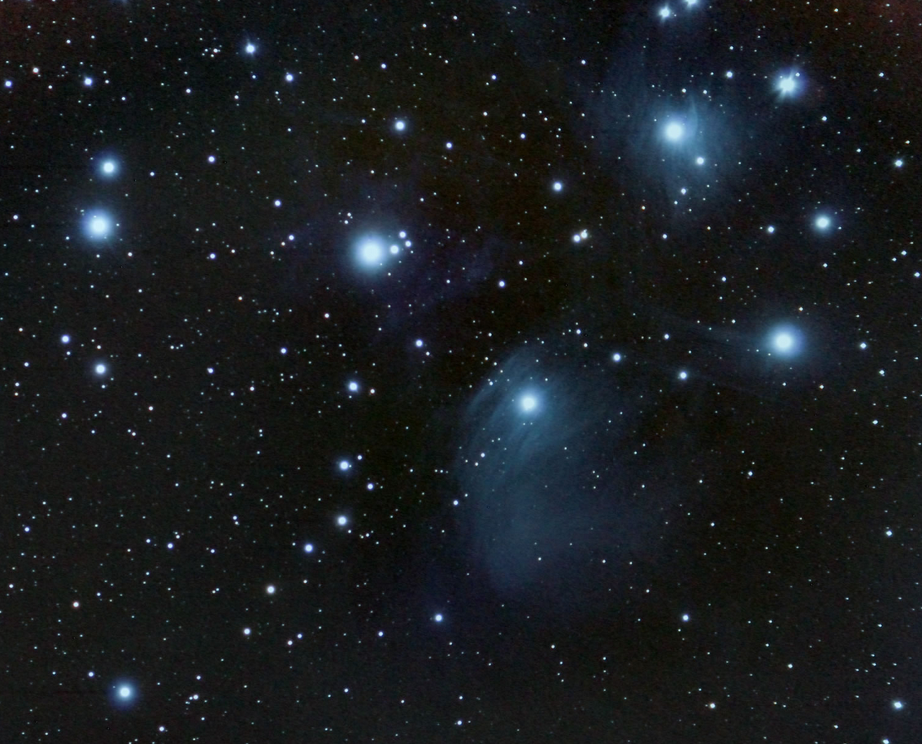
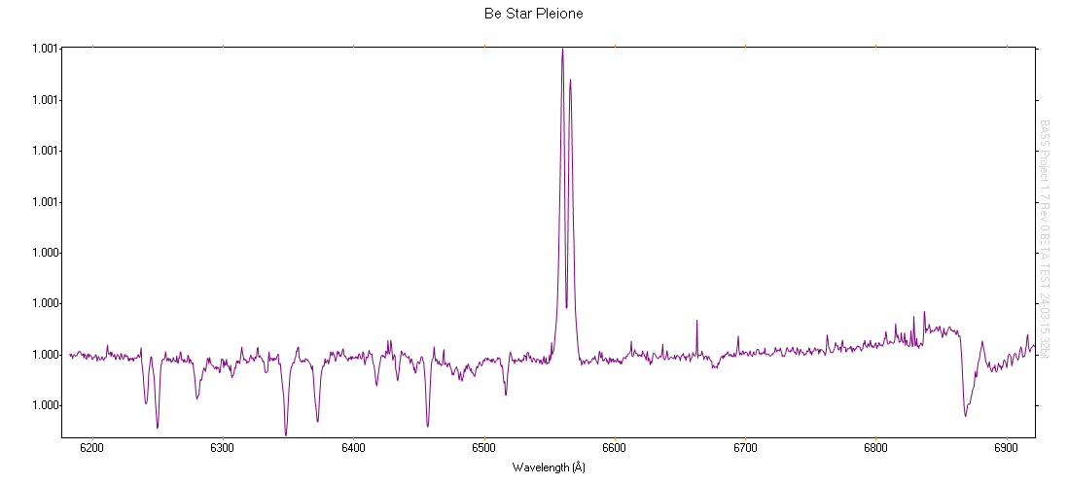
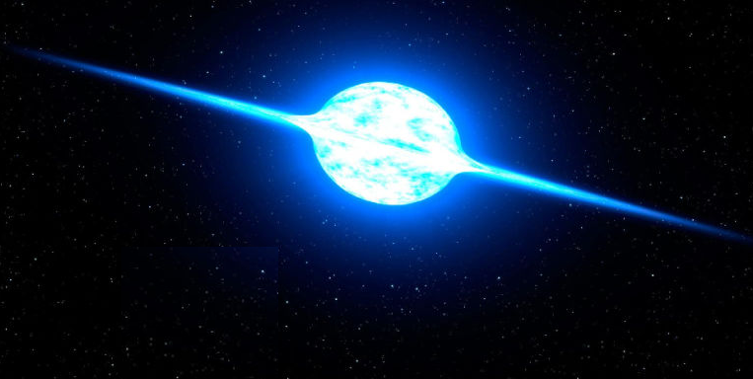
M45 – The Pleiades
TKUO #2 – October 16, 2015

Slide 6
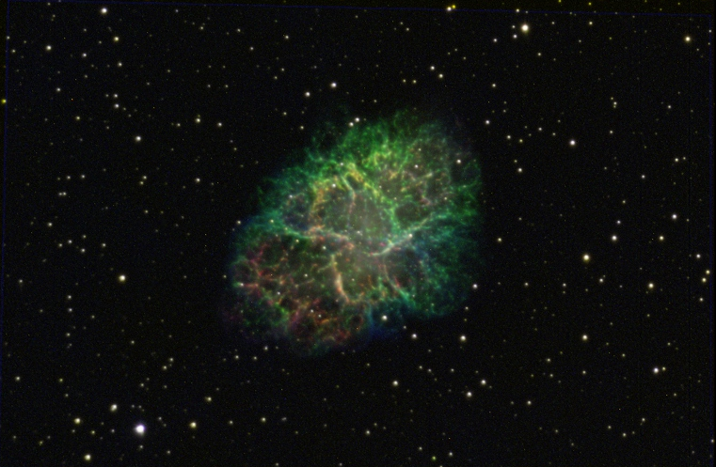
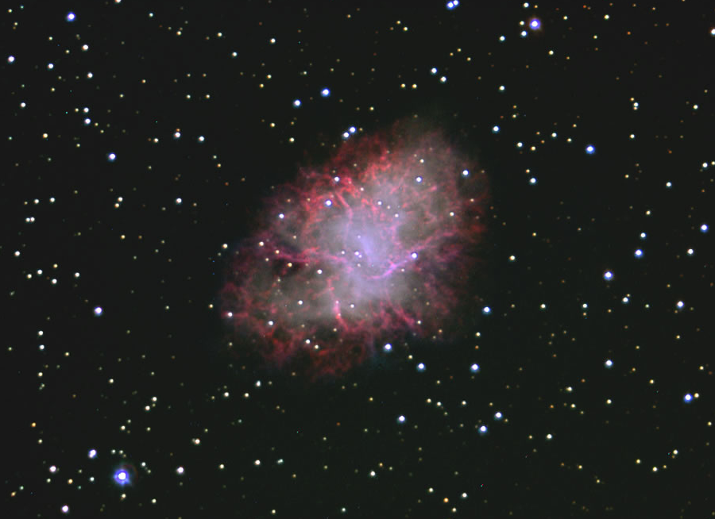
M1 – The Crab Nebula
TKUO #2 – January 2015

Slide 7
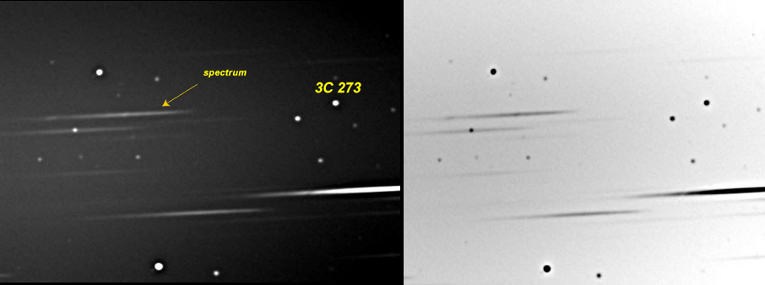
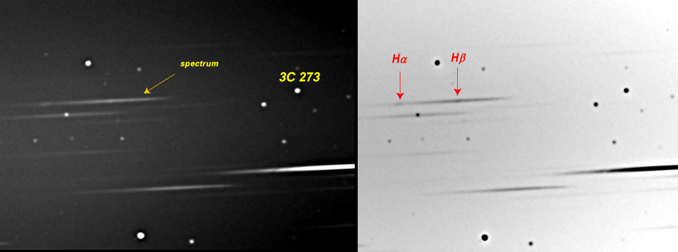
Quasar 3C 273
TKUO #1 April5, 2011

