Slide 1
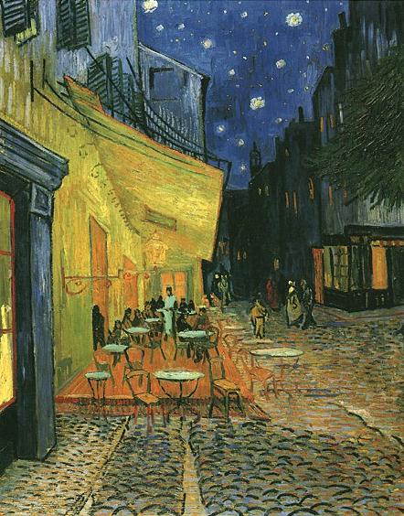
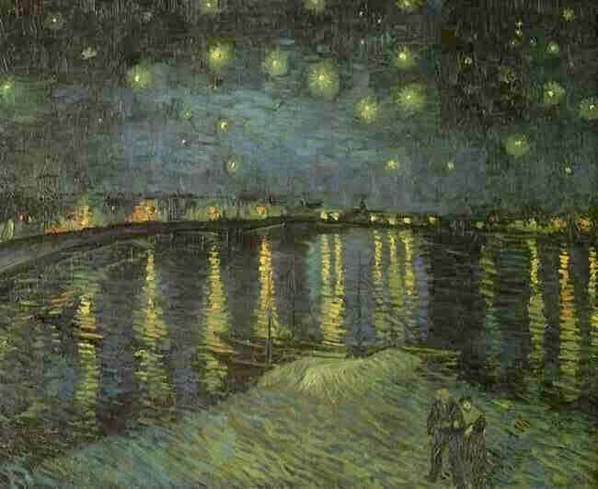
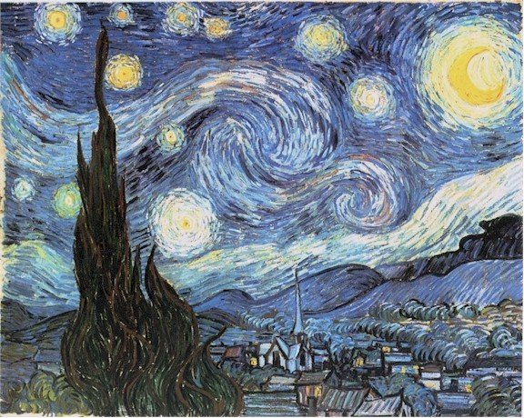
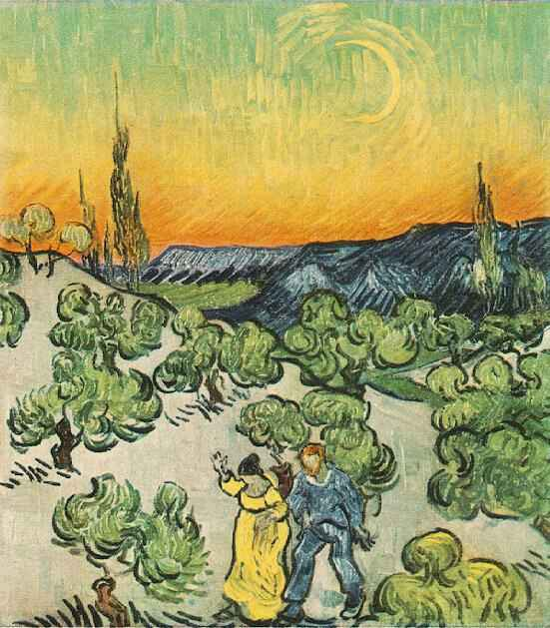
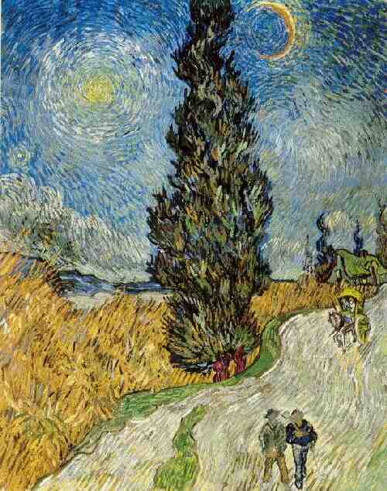
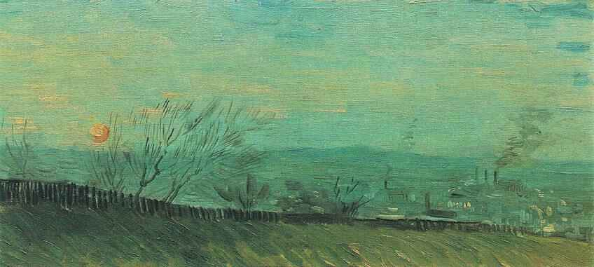
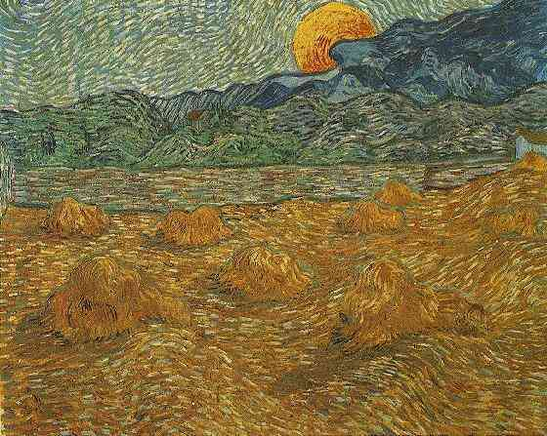
The Paintings of Vincent VanGogh

Slide 2
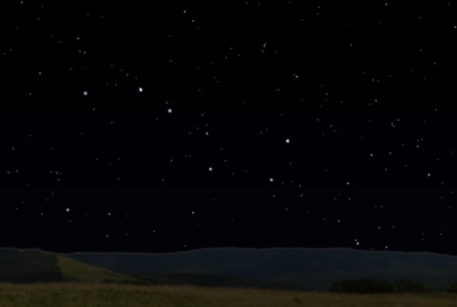
What the sky looked like on September 23, 1888 at 11:00 pm
Starry Night over the Rhone, Arles September 1888.

Slide 3
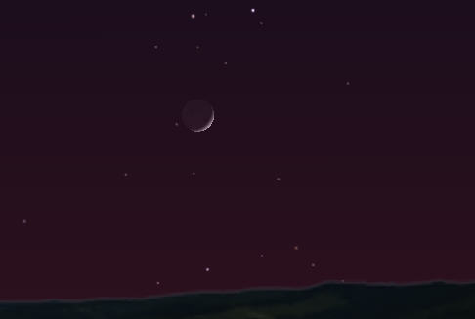
Landscape with Couple Walking and Crescent Moon, May 1890, St-Remy.
Just when did he paint Couple Walking? Compare the painting with the following computer re-constructions:
Phase looks better but now the problem is darkness. This is May 22, 9:09 pm - probably the time Van Gogh observed the moon. Gets worse if we go to later dates.
A thin crescent, 8:30 May 21, 1890. Roughly correct position, phase BUT - notice Venus. He would not have ignored this. Must have been painted later

Slide 4
Road with Cypress and Star. Saint-Rémy, 12-15 May, 1890. This is a real problem if you believe the dates and that Van Gogh "painted them as he saw them".

Slide 5
Two "controversial ideas":
the painting is based on observations not from May 12-15 but April 21, 1890
Van Gogh "flipped" the scene - perhaps for compositional reasons. Note that he appears to have painted both Venus and Mercury!

Slide 6
Here is some more evidence that I found on the net…
Here is a quote that I found in a letter that Van Gogh wrote to Albert Aurier (10 or 11 February 1890)
... next batch I send to my brother, in remembrance of your article. I am still working on it at the moment, as I want to put a small figure into it . The cypress is so characteristic of the Provence landscape. You will feel it, and say, “Even the colour black.” Until now
and to Gauguin, 17 June 1890:
I still have a cypress with a star from down there, a last attempt - a night sky with a moon without radiance, the slender crescent barely emerging from the opaque shadow cast by the earth - one star with an exaggerated brilliance, if you like, a soft brilliance of pink and green in the ultramarine sky, across which some clouds are hurrying. Below, a road bordered with tall yellow canes, behind these the blue Basses Alpes, an old inn with yellow lighted windows, and a very tall cypress, very straight, very sombre. Evening Landscape with Rising Moon, Saint-Rémy: early July,

Slide 7
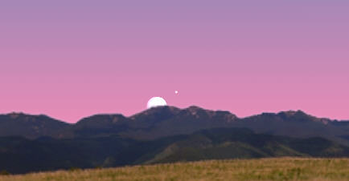
Evening Landscape with Rising Moon, Saint-Rémy: early July, 1889
This is a moonrise of an almost full moon on the evening of July 11, 1889. Note Jupiter above and right.

Slide 8
Starry Night, Saint-Rémy: June, 1889.
Sadly, not much can be done here - this was painted from memory while Van Gogh was in the asylum in St-Remy.

Slide 9
Factories Seen from a Hillside in Moonlight. Paris: first half, 1887
There is not really enough data here to apply an astronomical insight. If one could identify the buildings and location then moonrise could tell us the approximate date of the painting.

Slide 10
Cafe Terrace on the Place du Forum, Arles, at Night, . Arles: September, 1888.
This is one of his most famous night scenes but - unless I take a trip to Arles I can't really tell which way I'm looking. Hmmm

